Slide 1

65 Main Component
Peter H. Chen

Slide 2
65 Main Component
https://www.udemy.com/course/full-stack-development-web-app-mobile-app-back-end-api/learn/lecture/15139330#overview
Main Component
We generate three sub-components (movie-list, movie-details, and movie-form) for main component.

Slide 3
65.1 Sub-Component of Main

Slide 4
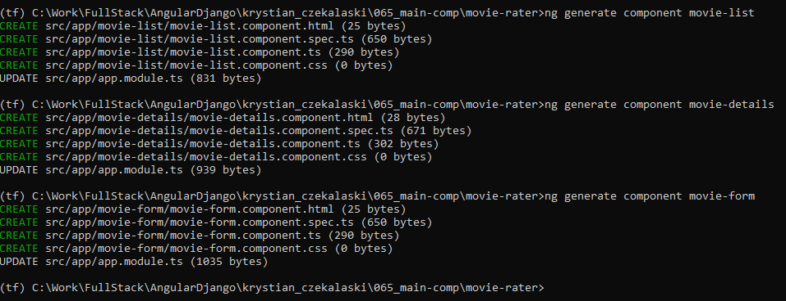
65.1 Sub-Component of Main
https://www.udemy.com/course/full-stack-development-web-app-mobile-app-back-end-api/learn/lecture/15139330#overview
Generate Sub-Components of Component Main
We generate two sub-components (movie-list and movie-details) for main component.
(tf) …\movie-rater> ng generate component movie-list
(tf) …\movie-rater> ng generate component movie-details
(tf) …\movie-rater> ng generate component movie-form

Slide 5
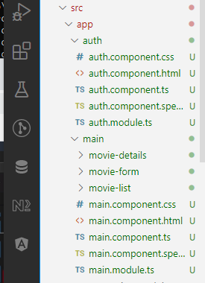
65 Main Component
https://www.udemy.com/course/full-stack-development-web-app-mobile-app-back-end-api/learn/lecture/15139330#overview
Generate Sub-Components of Component Main
We move the components movie-list, movie-details, movie-form under the component main folder

Slide 6
65.2 Sub-Component of Main

Slide 7
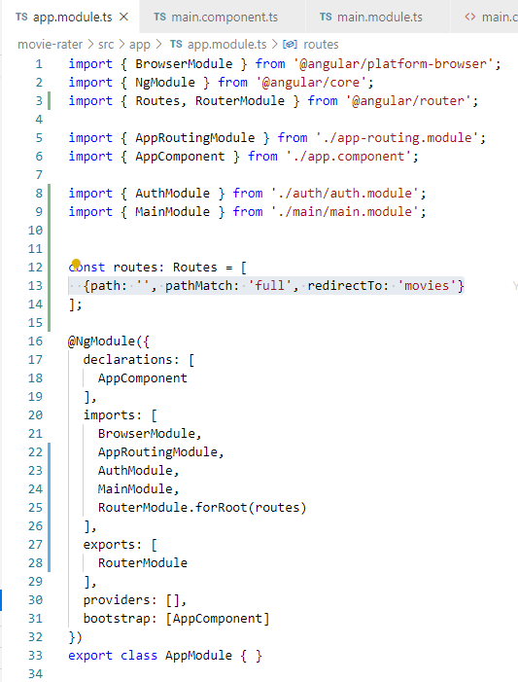
65.1 App Component
https://www.udemy.com/course/full-stack-development-web-app-mobile-app-back-end-api/learn/lecture/15139330#overview
App.moduels.ts
Remove movie-list and movie-details components from app.
Put movie-list and movie-details component into main component.

Slide 8
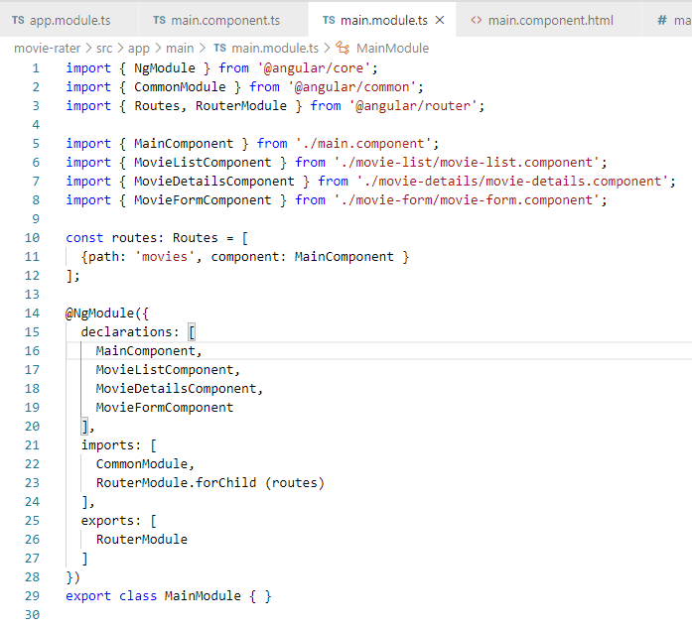
65.1 App Component
https://www.udemy.com/course/full-stack-development-web-app-mobile-app-back-end-api/learn/lecture/15139330#overview
main.moduels.ts
Remove movie-list and movie-details components from app.
Put movie-list and movie-details component into main component.

Slide 9
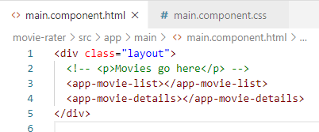
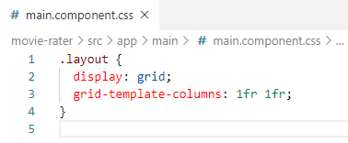
65.1 App Component
https://www.udemy.com/course/full-stack-development-web-app-mobile-app-back-end-api/learn/lecture/15139330#overview
main.moduels.html.
<app-movive-list>
<app-movie-details>

Slide 10
65.3 Verify

Slide 11
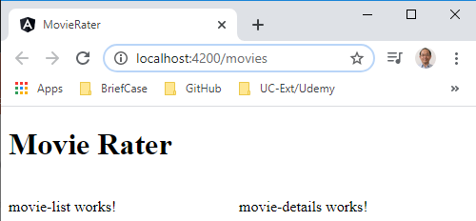
65.2 Verify
https://www.udemy.com/course/full-stack-development-web-app-mobile-app-back-end-api/learn/lecture/15139330#overview
Verify

Slide 12
End of Chapter

