Slide 1

46 Setup App
Peter H. Chen

Slide 2
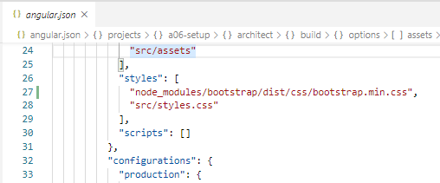
46 Setup App
https://www.udemy.com/course/the-complete-guide-to-angular-2/learn/lecture/9118764#overview
Setup App
> npm install bootstrap --save
The --save (or the shorthand -S) command installs package(s) gets added to the list of dependencies in your package.json file.
Similarly a dependency can also be removed by adding --save when running the npm uninstall command.
If we want to have better GUI look, we can use “npm install --save bootstrap”.
Then we need to include the CLI bundles all out script files and style files. We have to include bootstrap in angular.json.
The styles array includes global library and styles.css.

Slide 3
46.1 Code

Slide 4
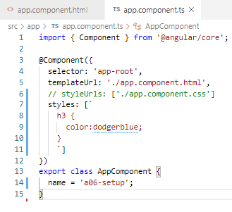
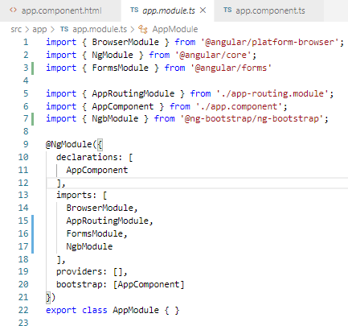
46.1 Code
https://www.udemy.com/course/the-complete-guide-to-angular-2/learn/lecture/9118764#overview
Code

Slide 5
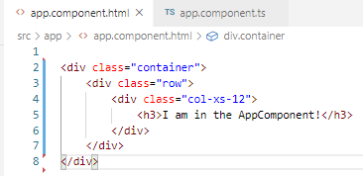
46.1 Code
https://www.udemy.com/course/the-complete-guide-to-angular-2/learn/lecture/9118764#overview
Code:
Bootstrap container with row and column.

Slide 6
46.2 Verify

Slide 7
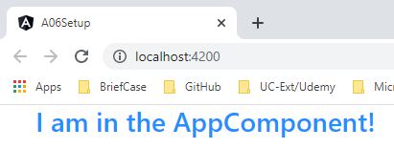
46.2 Verify
https://www.udemy.com/course/the-complete-guide-to-angular-2/learn/lecture/9118764#overview
Verify

Slide 8
End of Chapter

