Slide 1

47 Create Component
Peter H. Chen

Slide 2
47 Create Component
https://www.udemy.com/course/the-complete-guide-to-angular-2/learn/lecture/7233704#overview
Create Component
We have our project setup with bootstrap.
Now, we want to add the component for our layout.
Root
Header
Shopping List
Recipe Book
Shopping List
Recipe List
Shopping List Edit
Recipe Item
Ingredient
Recipe Detail
Recipe
Model
Component
Feature

Slide 3
47.1 Create Header Component

Slide 4
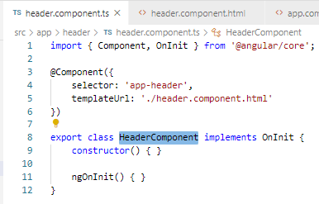

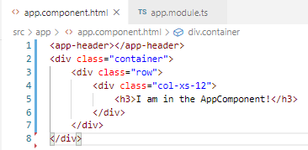
47.1 Code
https://www.udemy.com/course/the-complete-guide-to-angular-2/learn/lecture/7233704#overview
Code:
Create app/header/header.component.ts and header.component.html

Slide 5
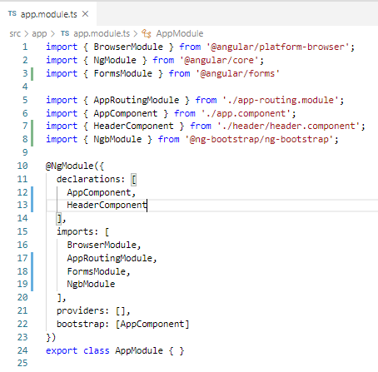
47.1 Code
https://www.udemy.com/course/the-complete-guide-to-angular-2/learn/lecture/7233704#overview
Code:
In app.module.ts:

Slide 6
47.2 Verify

Slide 7
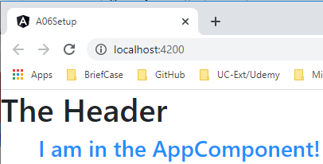
47.2 Verify
https://www.udemy.com/course/the-complete-guide-to-angular-2/learn/lecture/7233704#overview
Verify

Slide 8
47.3 Create Recipe Component

Slide 9
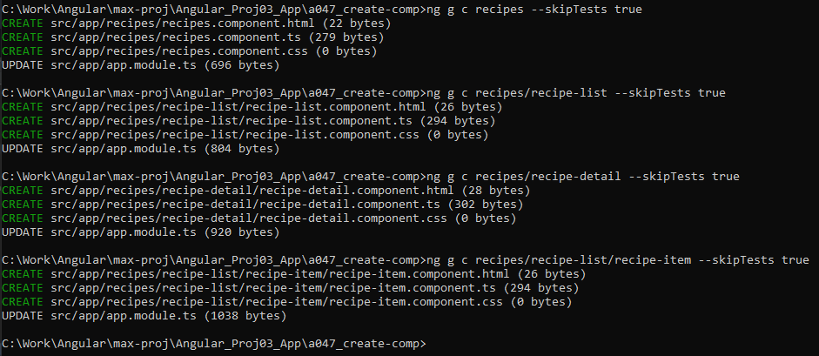
47.3 Create Recipe Component
https://www.udemy.com/course/the-complete-guide-to-angular-2/learn/lecture/7233704#overview
Create Recipe Component
> ng g c recipes --skipTests true
> ng g c recipes/recipe-list --skipTests true
> ng g c recipes/recipe-detail --skipTests true
> ng g c recipes/recipe-list/recipe-detail --skipTests true

Slide 10
47.4 Verify Recipe Component

Slide 11
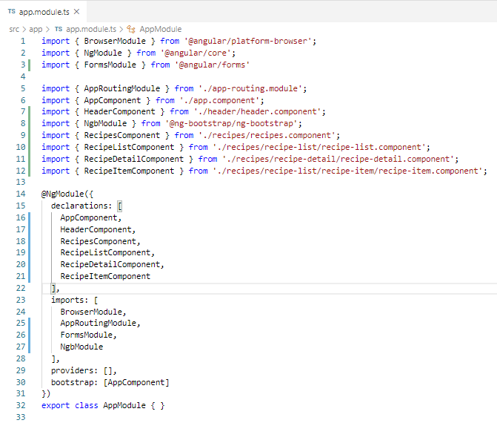
47.4 Verify Recipe Component
https://www.udemy.com/course/the-complete-guide-to-angular-2/learn/lecture/7233704#overview
Verify Recipe Component

Slide 12
47.5 Create Shopping-List Component

Slide 13
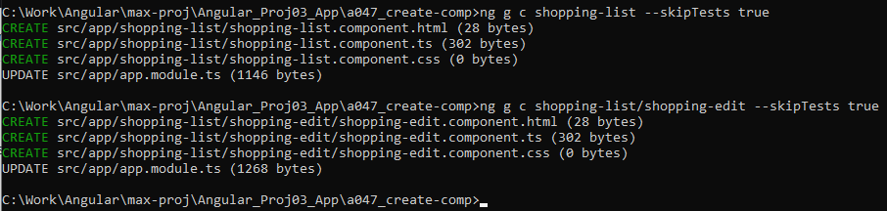
47.5 Create Shopping-List Component
https://www.udemy.com/course/the-complete-guide-to-angular-2/learn/lecture/7233704#overview
Create Shopping-list Component
> ng g c shopping-list --skipTests true
> ng g c shopping-list/shopping-edit --skipTests true

Slide 14
47.6 Verify Shopping-List Component

Slide 15
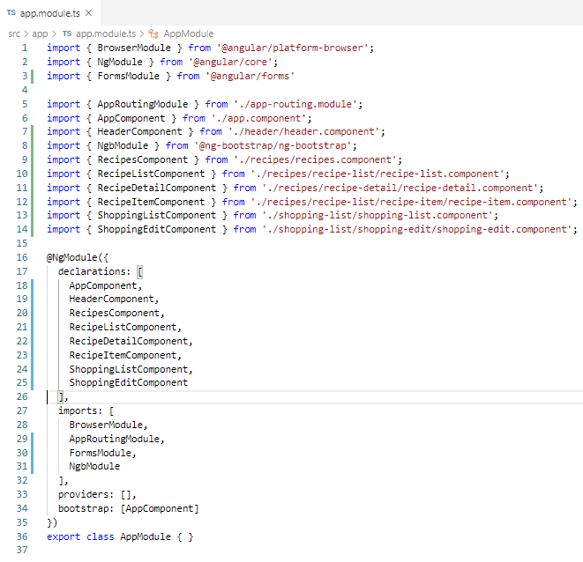
47.6 Verify Component
https://www.udemy.com/course/the-complete-guide-to-angular-2/learn/lecture/7233704#overview
Verify Recipe and Shopping-list Components
Now, we have all the components we need.

Slide 16
47.7 Verify

Slide 17
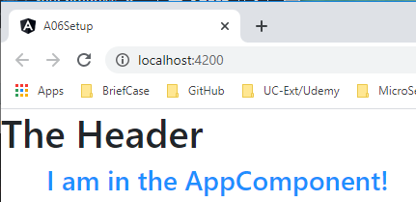
47.7 Verify
https://www.udemy.com/course/the-complete-guide-to-angular-2/learn/lecture/7233704#overview
Verify.

Slide 18
End of Chapter

