Slide 1

48 Use Component
Peter H. Chen

Slide 2
48 Use Component
https://www.udemy.com/course/the-complete-guide-to-angular-2/learn/lecture/6656016#overview
Use Component
We have our project setup with bootstrap.
Now, we want to add the component for our layout.
Root
Header
Shopping List
Recipe Book
Shopping List
Recipe List
Shopping List Edit
Recipe Item
Ingredient
Recipe Detail
Recipe
Model
Component
Feature

Slide 3
48.1 Use Component

Slide 4
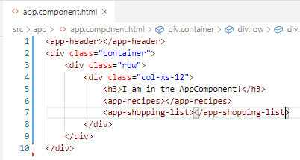
48.1 Use Component
https://www.udemy.com/course/the-complete-guide-to-angular-2/learn/lecture/7233704#overview
Code:
In app.component.html, add <app-recipes> and <app-shopping-list>.

Slide 5
48.2 Verify

Slide 6
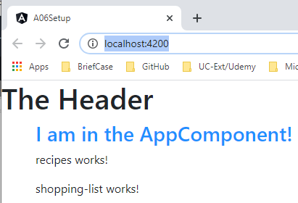
48.2 Verify
https://www.udemy.com/course/the-complete-guide-to-angular-2/learn/lecture/6656016#overview
Verify

Slide 7
48.3 Add Recipe List and Detail

Slide 8
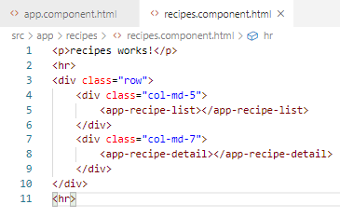
48.3 Add Recipe List and Detail
https://www.udemy.com/course/the-complete-guide-to-angular-2/learn/lecture/6656016#overview
Code:
In recipes.component.html, type “.row” (<div class=“row”)
Inside <div class=“row”>, type “.col-md-5” (<div class=“col-md-5”)
Inside <div class=“row”>, type “.col-md-7” (<div class=“col-md-7”)

Slide 9
48.4 Verify

Slide 10
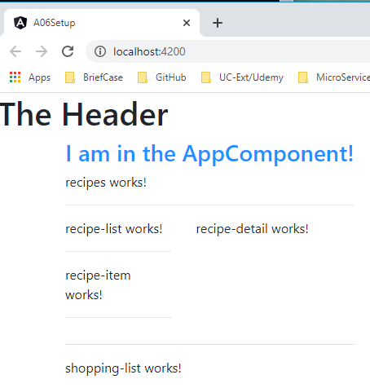
48.4 Verify
https://www.udemy.com/course/the-complete-guide-to-angular-2/learn/lecture/6656016#overview
Verify

Slide 11
48.5 Add Shopping List

Slide 12
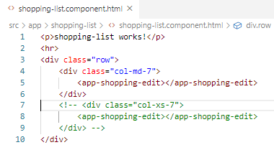
48.5 Add Shopping List
https://www.udemy.com/course/the-complete-guide-to-angular-2/learn/lecture/6656016#overview
Code:
In recipes.component.html, type “.row” (<div class=“row”)
Inside <div class=“row”>, type “.col-xs-10” (<div class=“col-xs-10”)
Add <app-shopping-edit> inside.

Slide 13
48.6 Verify

Slide 14
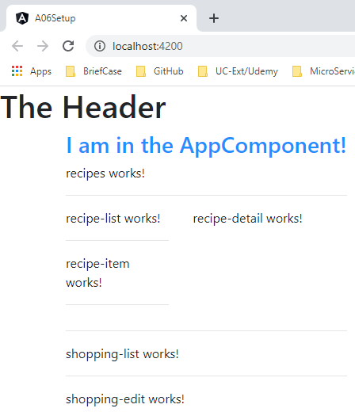
48.6 Verify
https://www.udemy.com/course/the-complete-guide-to-angular-2/learn/lecture/6656016#overview
Verify

Slide 15
End of Chapter

