Slide 1

49 Add Navigation Bar
Peter H. Chen

Slide 2
49 Add Navigation Bar
https://www.udemy.com/course/the-complete-guide-to-angular-2/learn/lecture/6656016#overview
Layout
Root
Header
Shopping List
Recipe Book
Shopping List
Recipe List
Shopping List Edit
Recipe Item
Ingredient
Recipe Detail
Recipe
Model
Component
Feature

Slide 3
49.1 Styles.css

Slide 4
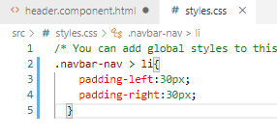
49.1 Styles.css
https://www.udemy.com/course/the-complete-guide-to-angular-2/learn/lecture/7233704#overview
Code:
https://www.w3schools.com/cssref/css_selectors.asp
> define class “.navbar-nav > li”
> .navbar-nav > li {
> padding-left: 30px;
> padding-right: 30px;
> }

Slide 5
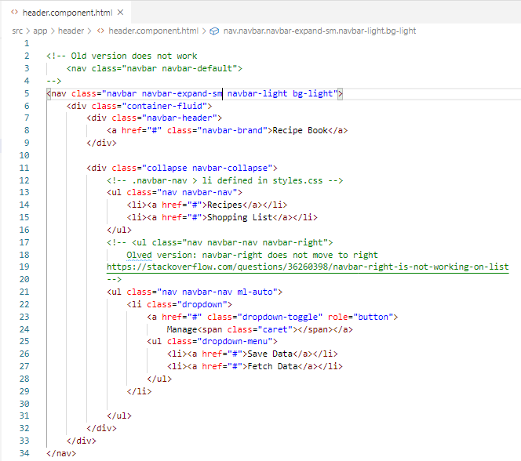
49.1 Styles.css
https://www.udemy.com/course/the-complete-guide-to-angular-2/learn/lecture/7233704#overview
Code:
<ul class="nav navbar-nav navbar-right">
Old version: navbar-right does not move to right
https://stackoverflow.com/questions/36260398/navbar-right-is-not-working-on-list
Use following:
<ul class="nav navbar-nav ml-auto">

Slide 6
49.2 Verify

Slide 7
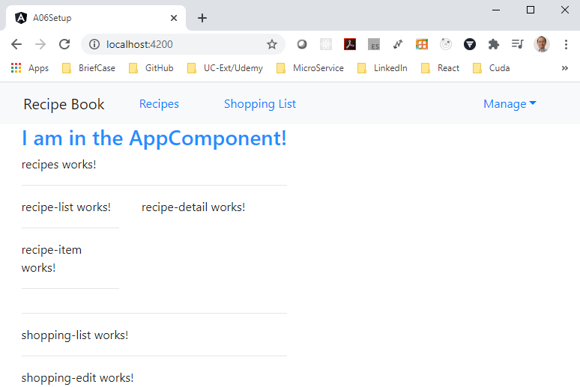
49.2 Verify
https://www.udemy.com/course/the-complete-guide-to-angular-2/learn/lecture/6656016#overview
Verify

Slide 8
End of Chapter

