Slide 1

51 Recipe Model
Peter H. Chen

Slide 2
51 Recipe Model
https://www.udemy.com/course/the-complete-guide-to-angular-2/learn/lecture/6656022#overview
Layout
Root
Header
Shopping List
Recipe Book
Shopping List
Recipe List
Shopping List Edit
Recipe Item
Ingredient
Recipe Detail
Recipe
Model
Component
Feature

Slide 3
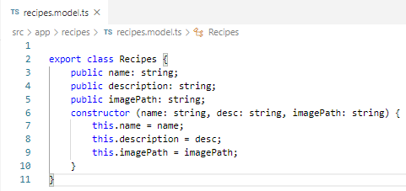
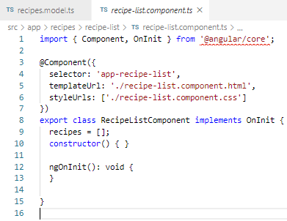
51 Recipe Model
https://www.udemy.com/course/the-complete-guide-to-angular-2/learn/lecture/6656022#overview
In recipes.model.ts:
> export class Recipes { … }

Slide 4
End of Chapter

