Slide 1

52 Recipe Component
Peter H. Chen

Slide 2
52 Recipe Component
https://www.udemy.com/course/the-complete-guide-to-angular-2/learn/lecture/6656030#overview
Layout
Root
Header
Shopping List
Recipe Book
Shopping List
Recipe List
Shopping List Edit
Recipe Item
Ingredient
Recipe Detail
Recipe
Model
Component
Feature

Slide 3
52.1 Code

Slide 4
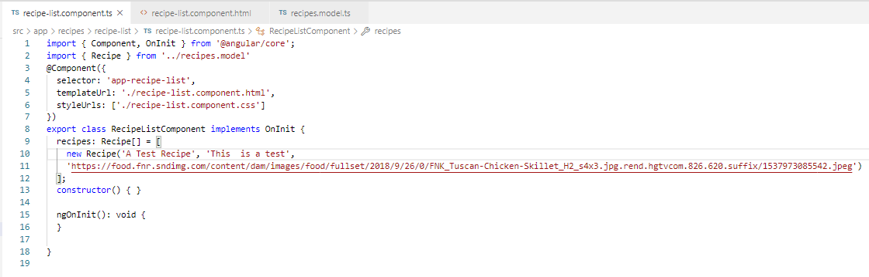
52.1 Code
https://www.udemy.com/course/the-complete-guide-to-angular-2/learn/lecture/6656030#overview
Code

Slide 5
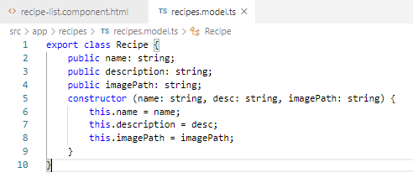
52.1 Code
https://www.udemy.com/course/the-complete-guide-to-angular-2/learn/lecture/6656030#overview
Code

Slide 6
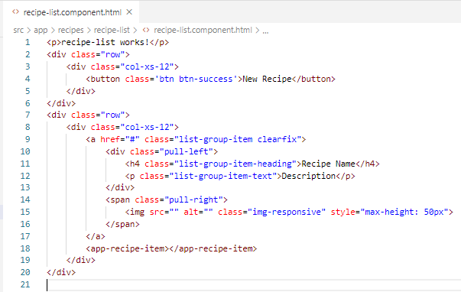
52.1 Code
https://www.udemy.com/course/the-complete-guide-to-angular-2/learn/lecture/6656030#overview
Code

Slide 7
52.2 Verify

Slide 8
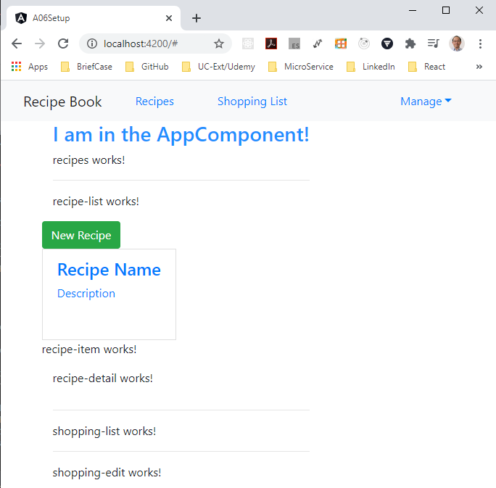
52.2 Verify
https://www.udemy.com/course/the-complete-guide-to-angular-2/learn/lecture/6656030#overview
Verify

Slide 9
End of Chapter

