Slide 1

53 List Recipe with ngFor
Peter H. Chen

Slide 2
53 Recipe Component
https://www.udemy.com/course/the-complete-guide-to-angular-2/learn/lecture/6656030#overview
Layout
Root
Header
Shopping List
Recipe Book
Shopping List
Recipe List
Shopping List Edit
Recipe Item
Ingredient
Recipe Detail
Recipe
Model
Component
Feature

Slide 3
53.1 Code

Slide 4
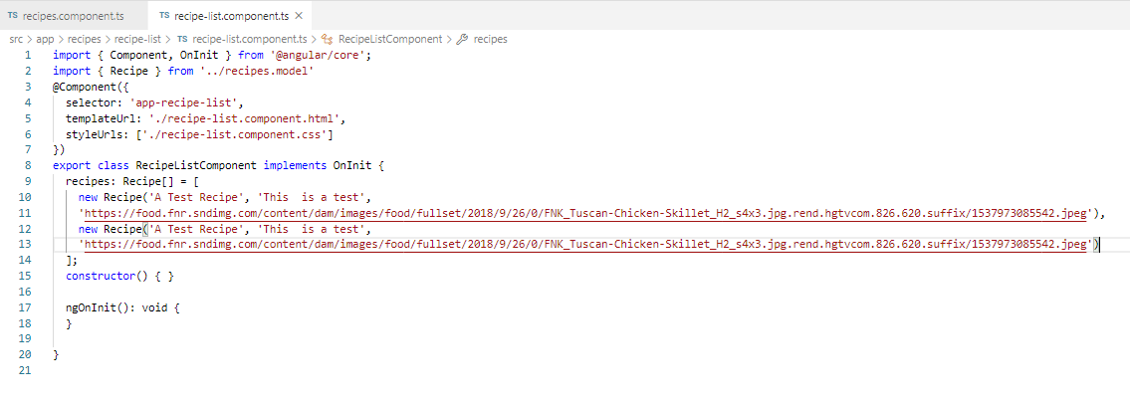
53.1 Code
https://www.udemy.com/course/the-complete-guide-to-angular-2/learn/lecture/6656030#overview
Code

Slide 5
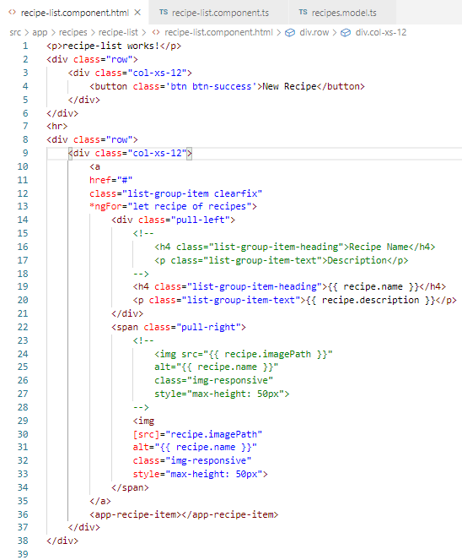
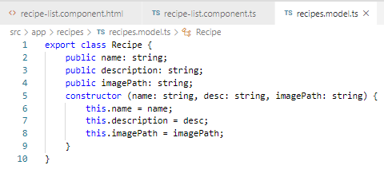
53.1 Code
https://www.udemy.com/course/the-complete-guide-to-angular-2/learn/lecture/6656030#overview
Code

Slide 6
53.2 Verify

Slide 7
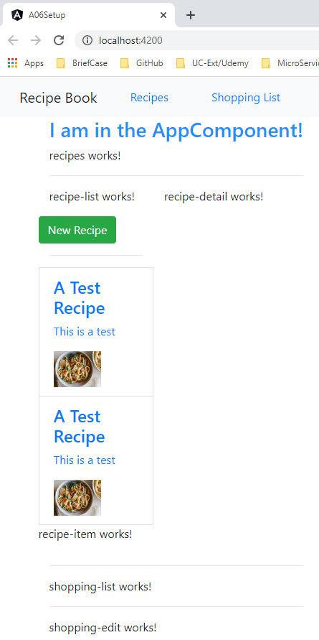
53.2 Verify
https://www.udemy.com/course/the-complete-guide-to-angular-2/learn/lecture/6656030#overview
Verify

Slide 8
End of Chapter

