Slide 1

54 Recipe Detail
Peter H. Chen

Slide 2
54 Recipe Detail
https://www.udemy.com/course/the-complete-guide-to-angular-2/learn/lecture/6656034#overview
Layout
Root
Header
Shopping List
Recipe Book
Shopping List
Recipe List
Shopping List Edit
Recipe Item
Ingredient
Recipe Detail
Recipe
Model
Component
Feature

Slide 3
54.1 Code

Slide 4
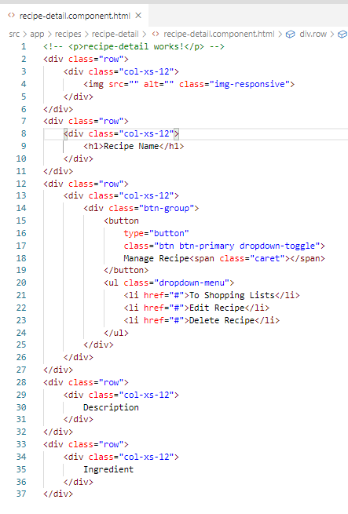
54.1 Code
https://www.udemy.com/course/the-complete-guide-to-angular-2/learn/lecture/6656034#overview
Code

Slide 5
54.2 Verify

Slide 6
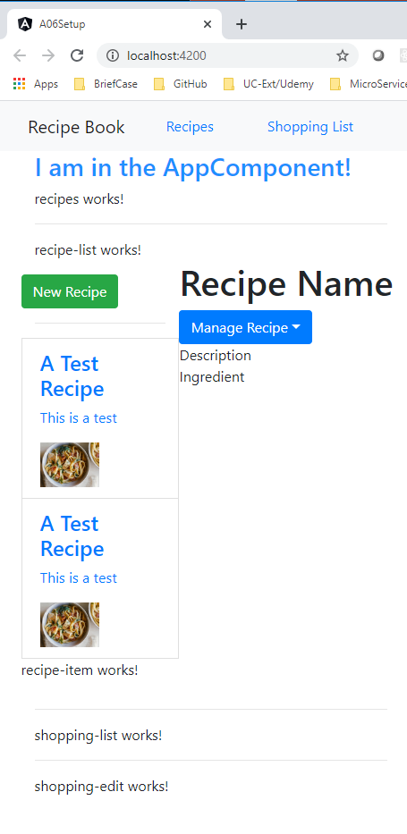
54.2 Verify
https://www.udemy.com/course/the-complete-guide-to-angular-2/learn/lecture/6656034#overview
Verify

Slide 7
End of Chapter

