Slide 1

104 Service and Dependency Injection
Peter H. Chen

Slide 2
104 Service and Dependency Injection
https://www.udemy.com/course/the-complete-guide-to-angular-2/learn/lecture/6656200#overview
Service and Dependency Injection
What are services?
Consider the following:
We have some methods (Log data to console, in yellow box) in the components.
In the userComponent, we want to access some data.
AppComponent
AboutComponent
UserComponent
Log data to console
Store user data
UserDetailComponent
Log data to console

Slide 3
104 Service and Dependency Injection
https://www.udemy.com/course/the-complete-guide-to-angular-2/learn/lecture/6656200#overview
Service and Dependency Injection
There are duplication of data.
Services are the central repository, a central business unit you can store data.
We can create a LogService to centralize our log.
LogService
Centralization
AppComponent
AboutComponent
UserComponent
Log data to console
Store user data
UserDetailComponent
Log data to console

Slide 4
104 Service and Dependency Injection
https://www.udemy.com/course/the-complete-guide-to-angular-2/learn/lecture/6656200#overview
Service and Dependency Injection
We can create the UserService to manage the data storage.
LogService
Centralization
AppComponent
UserService
AboutComponent
UserComponent
Log data to console
Store user data
Data Storage
UserDetailComponent
Log data to console

Slide 5
104.1 Verify

Slide 6
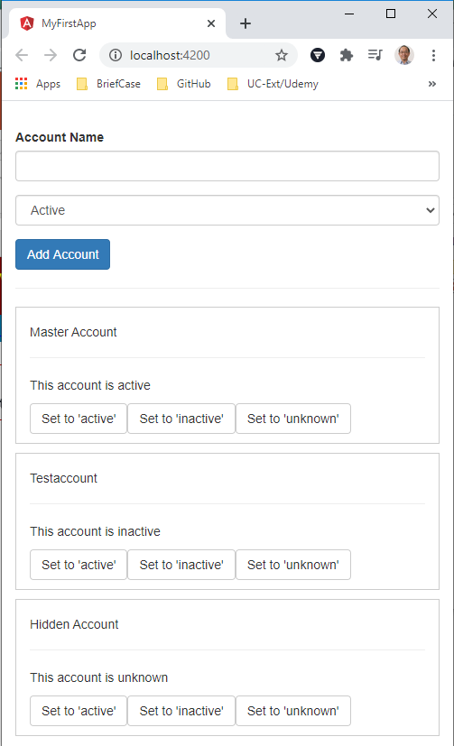
104.1 Verify
https://www.udemy.com/course/the-complete-guide-to-angular-2/learn/lecture/6656200#overview
Verify
Default Application Template

Slide 7
End of Chapter

