Slide 1

105 Log Service
Peter H. Chen

Slide 2
105 Log Service
https://www.udemy.com/course/the-complete-guide-to-angular-2/learn/lecture/6656206#overview
Log Service
LogService
Centralization
AppComponent
UserService
AboutComponent
UserComponent
Log data to console
Store user data
Data Storage
UserDetailComponent
Log data to console

Slide 3
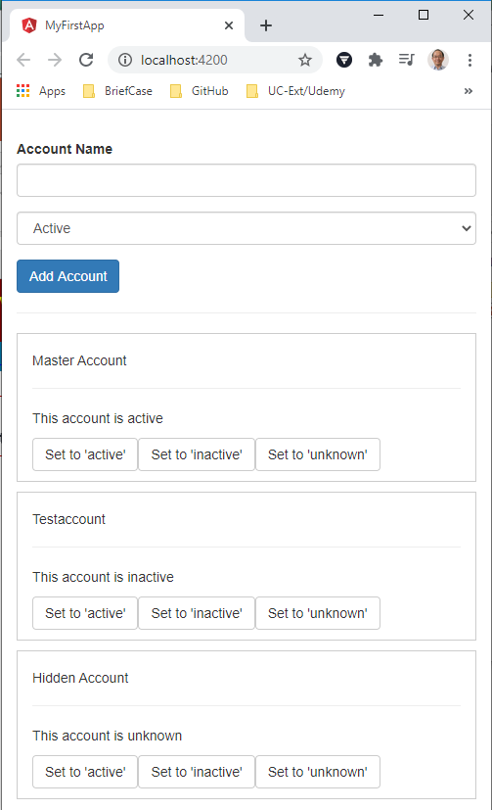
105 Log Service
https://www.udemy.com/course/the-complete-guide-to-angular-2/learn/lecture/6656206#overview
Log Service
If we create a new account, what we get there is the logging and the data storage. The general tasks can be centralized. We can communicate between these components. These information between components can be provided by services.

Slide 4
105.1 Code

Slide 5
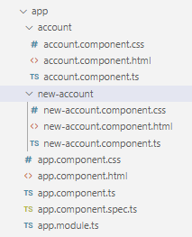
105.1 Code
https://www.udemy.com/course/the-complete-guide-to-angular-2/learn/lecture/6656206#overview
Code
We have three components: the app component, account component, and new-account component.
The app component is the parent of all the components. The App component embed the account component and new-account component.

Slide 6
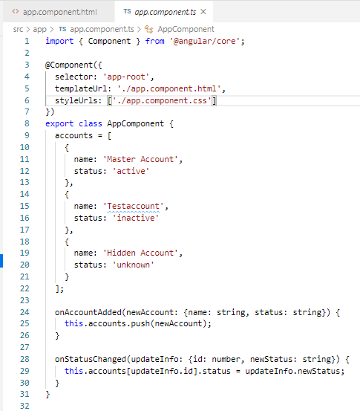
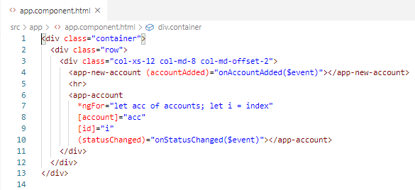
105.1 Code
https://www.udemy.com/course/the-complete-guide-to-angular-2/learn/lecture/6656206#overview
Code
Property bind the Data in the app component.

Slide 7
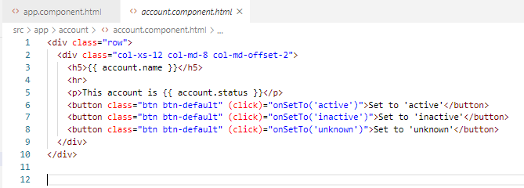
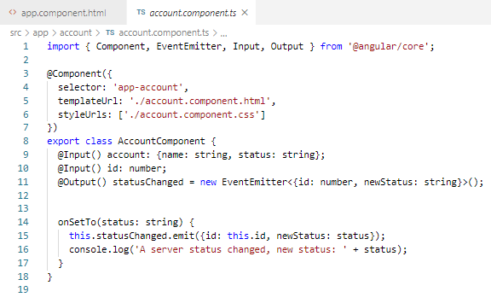
105.1 Code
https://www.udemy.com/course/the-complete-guide-to-angular-2/learn/lecture/6656206#overview
Code
In the account component, we have three change status buttons and associated methods. The onSetTo method emit the status change to the parent app component.

Slide 8
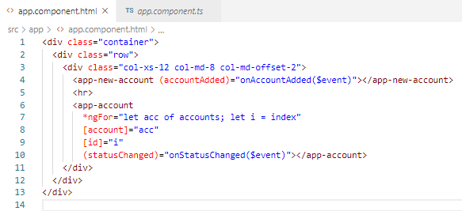
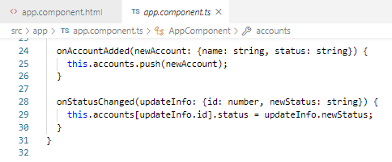
105.1 Code
https://www.udemy.com/course/the-complete-guide-to-angular-2/learn/lecture/6656206#overview
Code
The account component status changed will be displayed in app component.
Whenever something changes in the account component will be changed to the parent app component.

Slide 9
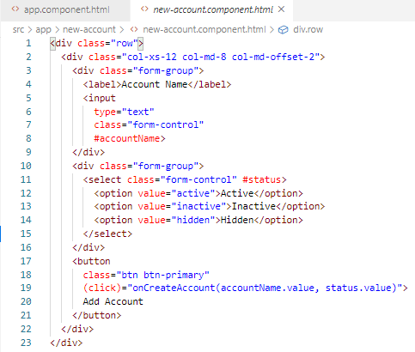
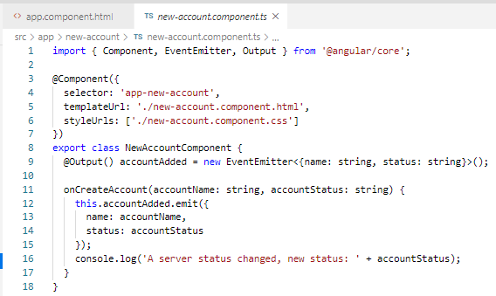
105.1 Code
https://www.udemy.com/course/the-complete-guide-to-angular-2/learn/lecture/6656206#overview
Code
The new-account component is same as account component.
When I click the new-account Active button, we emit some data to the parent app component.

Slide 10
105.2 Verify

Slide 11
105.2 Verify
https://www.udemy.com/course/the-complete-guide-to-angular-2/learn/lecture/6656206#overview
Verify
Default Application Template

Slide 12
End of Chapter

