Slide 1

106 Create Log Service
Peter H. Chen

Slide 2
106 Create Log Service
https://www.udemy.com/course/the-complete-guide-to-angular-2/learn/lecture/6656206#overview
Create Log Service
LogService
Centralization
AppComponent
UserService
AboutComponent
UserComponent
Log data to console
Store user data
Data Storage
UserDetailComponent
Log data to console

Slide 3
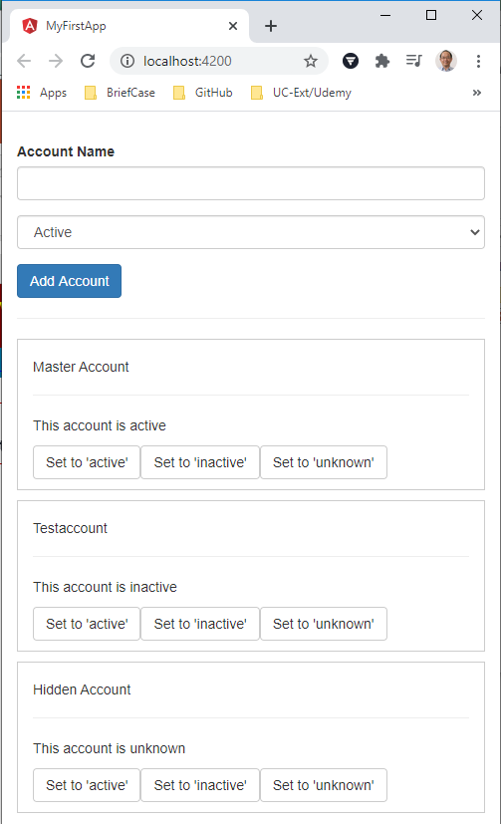
106 Create Log Service
https://www.udemy.com/course/the-complete-guide-to-angular-2/learn/lecture/6656206#overview
Create Log Service
We build the first service here.

Slide 4
106.1 Code

Slide 5
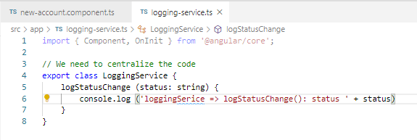
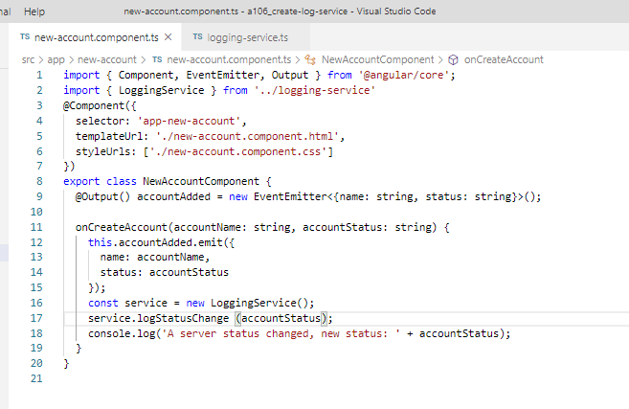
106.1 Code
https://www.udemy.com/course/the-complete-guide-to-angular-2/learn/lecture/6656206#overview
Code
Share class method LoggingService()

Slide 6
106.2 Verify

Slide 7
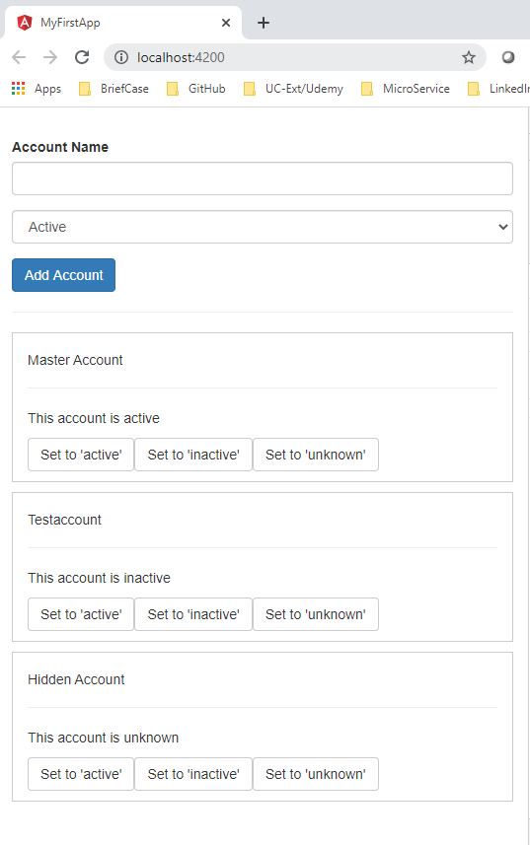
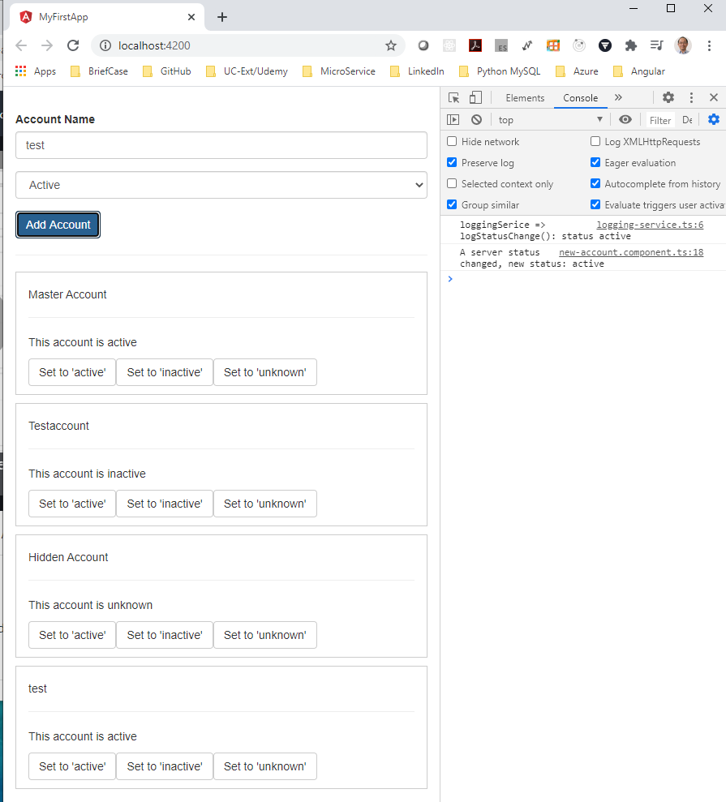
106.2 Verify
https://www.udemy.com/course/the-complete-guide-to-angular-2/learn/lecture/6656206#overview
Verify
Log Service worked!

Slide 8
End of Chapter

