Slide 1

107 Inject Log Service
Peter H. Chen

Slide 2
107 Inject Log Service
https://www.udemy.com/course/the-complete-guide-to-angular-2/learn/lecture/6656210#overview
Inject Log Service into Components
LogService
Centralization
AppComponent
UserService
AboutComponent
UserComponent
Log data to console
Store user data
Data Storage
UserDetailComponent
Log data to console

Slide 3
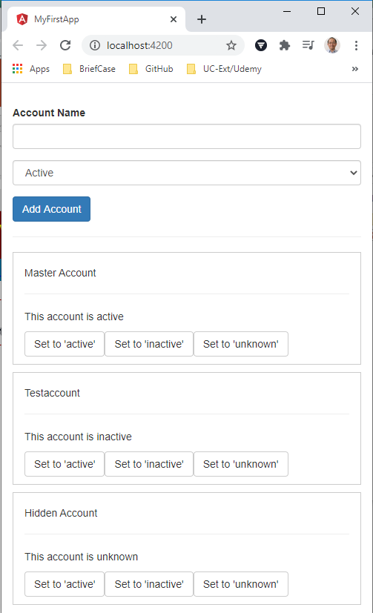
107 Inject Log Service
https://www.udemy.com/course/the-complete-guide-to-angular-2/learn/lecture/6656210#overview
Inject Log Service into Components
Inject the dependence:
How to inform Angular that we want to inject the class into our components?

Slide 4
107.1 Code

Slide 5
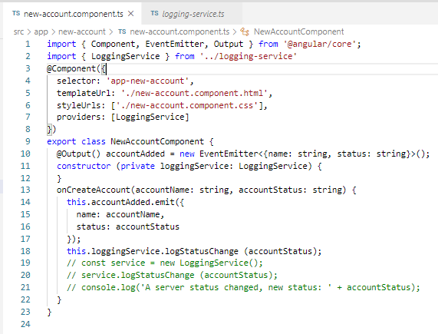
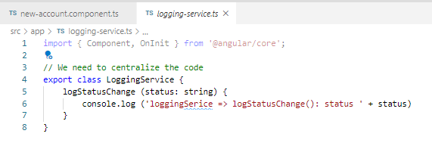
107.1 Code
https://www.udemy.com/course/the-complete-guide-to-angular-2/learn/lecture/6656210#overview
Code
Inject LoggingService: providers : [LoggingService]

Slide 6
107.2 Verify

Slide 7
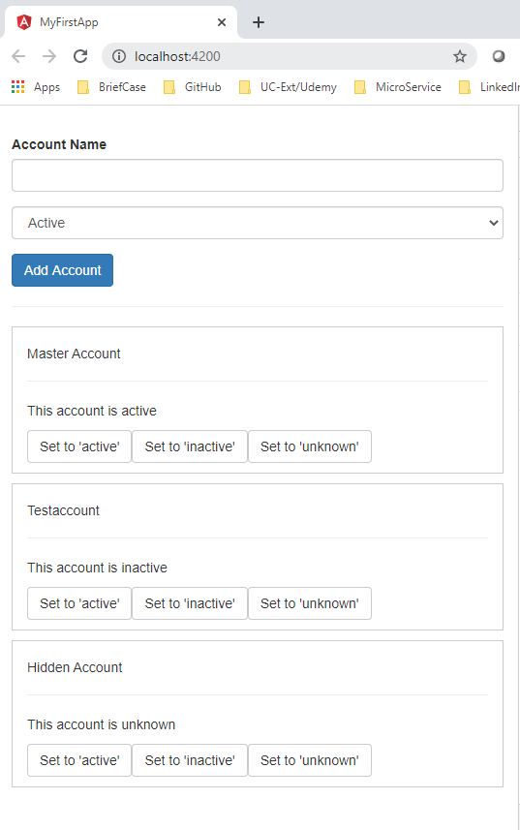
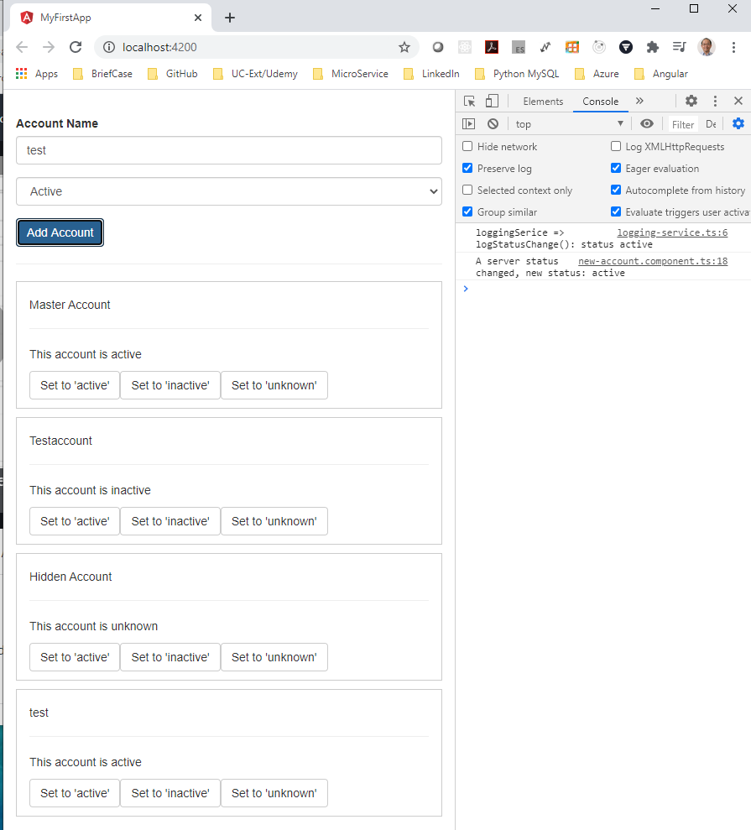
107.2 Verify
https://www.udemy.com/course/the-complete-guide-to-angular-2/learn/lecture/6656210#overview
Verify
Inject Log Service worked!

Slide 8
End of Chapter

