Slide 1

108 Create Data Service
Peter H. Chen

Slide 2
108 Create Data Service
https://www.udemy.com/course/the-complete-guide-to-angular-2/learn/lecture/6656214#overview
Create Data Service
LogService
Centralization
AppComponent
UserService
AboutComponent
UserComponent
Log data to console
Store user data
Data Storage
UserDetailComponent
Log data to console

Slide 3
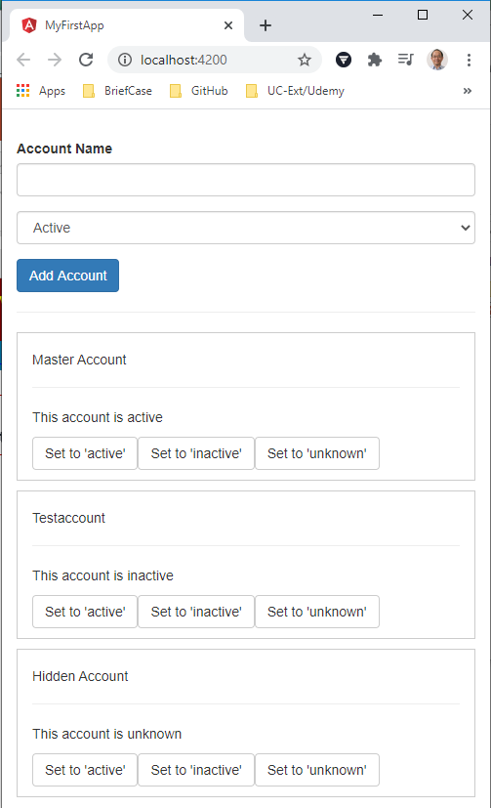
108 Create Data Service
https://www.udemy.com/course/the-complete-guide-to-angular-2/learn/lecture/6656214#overview
Create Data Service
We store account data in app component and then we have the chain of property and event binding to get data to the app component so that we can update our accounts.
We create an account serverice
> account.server.ts

Slide 4
108.1 Code

Slide 5
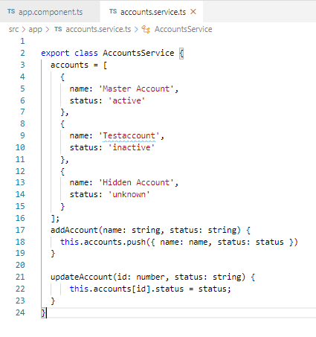
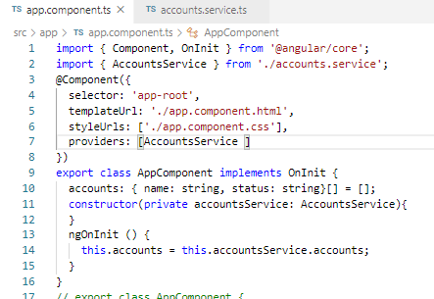
108.1 Code
https://www.udemy.com/course/the-complete-guide-to-angular-2/learn/lecture/6656214#overview
Code
Create AccountsService() and parent app component data initialization.

Slide 6
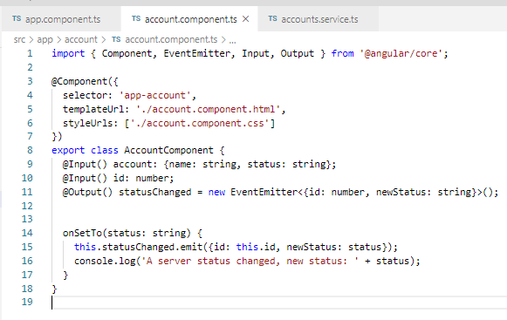
108.1 Code
https://www.udemy.com/course/the-complete-guide-to-angular-2/learn/lecture/6656214#overview
Code
Pass data from parent to child component.

Slide 7
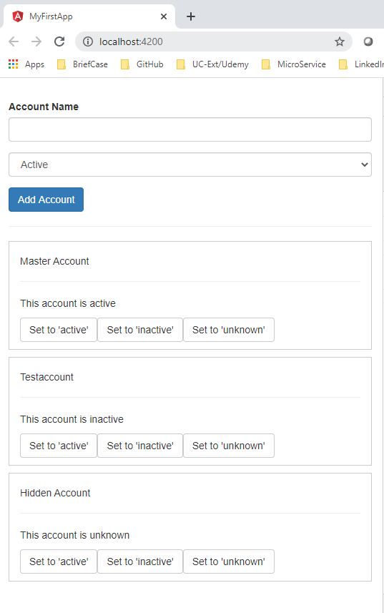
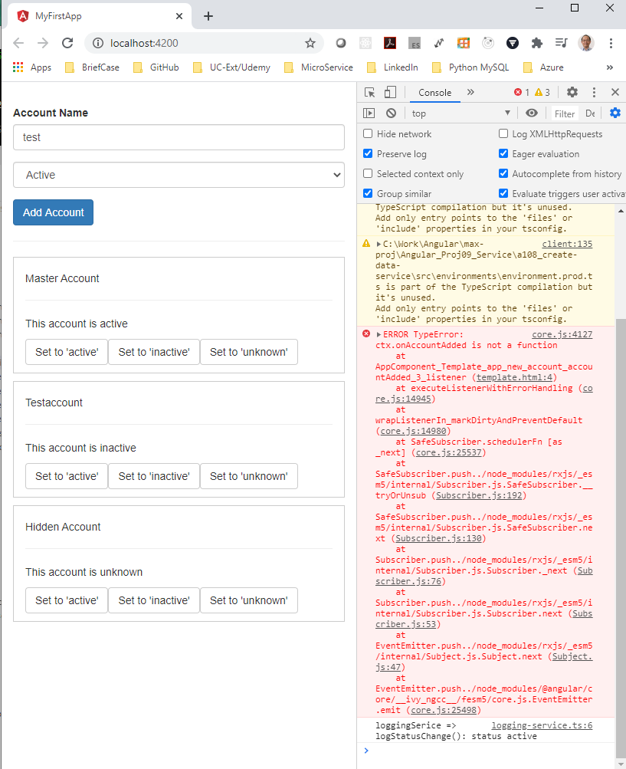
108.1 Verify
https://www.udemy.com/course/the-complete-guide-to-angular-2/learn/lecture/6656214#overview
Verify
Create Data Service worked! There are some undefined functions.

Slide 8
108.2 Code

Slide 9
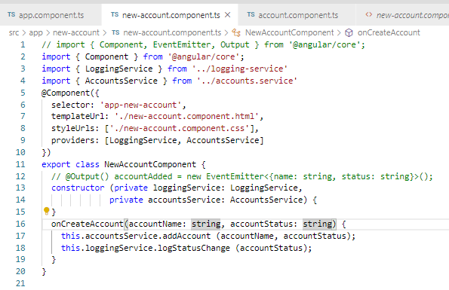
108.1 Code
https://www.udemy.com/course/the-complete-guide-to-angular-2/learn/lecture/6656214#overview
Code
Add code for new-account.service.ts

Slide 10
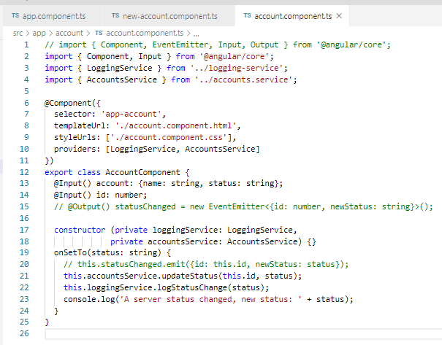
108.1 Code
https://www.udemy.com/course/the-complete-guide-to-angular-2/learn/lecture/6656214#overview
Code
Add code for account.service.ts

Slide 11
108.3 Verify

Slide 12
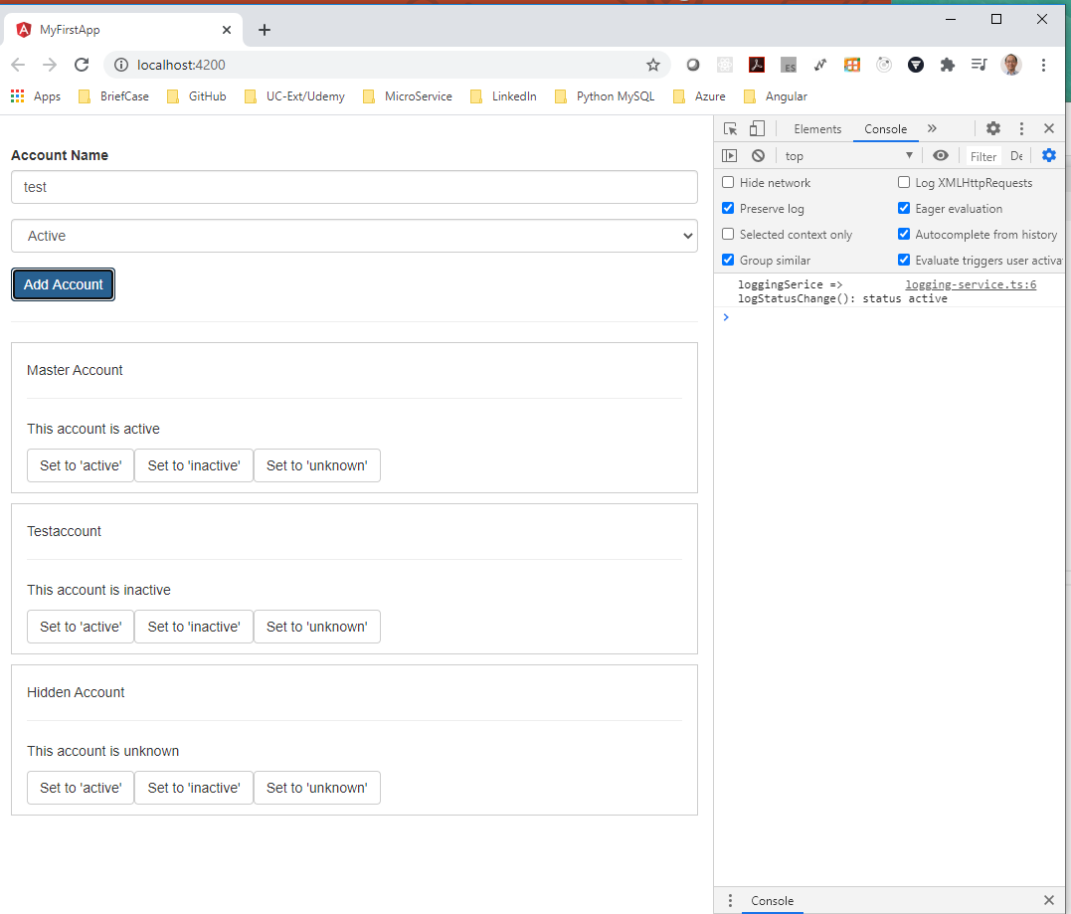
108.2 Verify
https://www.udemy.com/course/the-complete-guide-to-angular-2/learn/lecture/6656214#overview
Verify
Create Data Service worked! There are some undefined functions.

Slide 13
End of Chapter

