Slide 1

110 Service Instances
Peter H. Chen

Slide 2
110 Service Instances
https://www.udemy.com/course/the-complete-guide-to-angular-2/learn/lecture/6656218#overview
Service Instances
LogService
Centralization
AppComponent
UserService
AboutComponent
UserComponent
Log data to console
Store user data
Data Storage
UserDetailComponent
Log data to console

Slide 3
110.1 Code

Slide 4
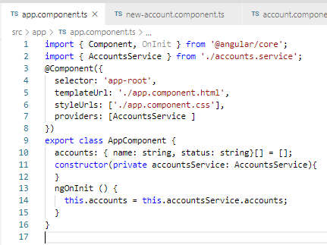
110.1 Code
https://www.udemy.com/course/the-complete-guide-to-angular-2/learn/lecture/6656218#overview
Code
Keep the AccountServer in the AppComponent.
Remove the AccountService from providers array in account Component and NewAccount Component.

Slide 5
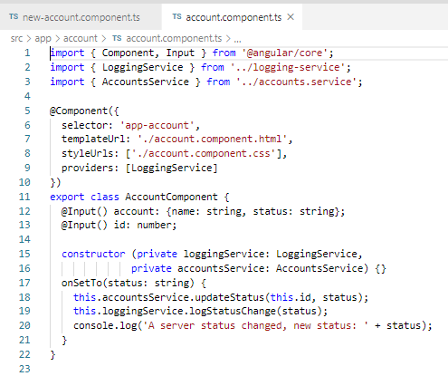
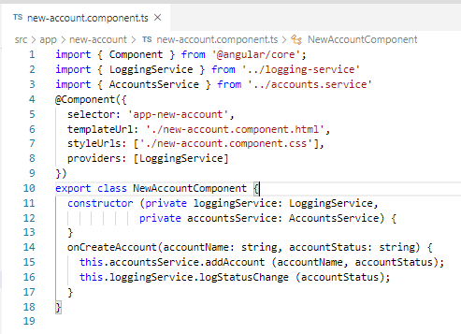
110.1 Code
https://www.udemy.com/course/the-complete-guide-to-angular-2/learn/lecture/6656218#overview
Code
Keep the AccountServer in the AppComponent.
Remove the AccountService from providers array in account Component and NewAccount Component.

Slide 6
110.2 Verify

Slide 7
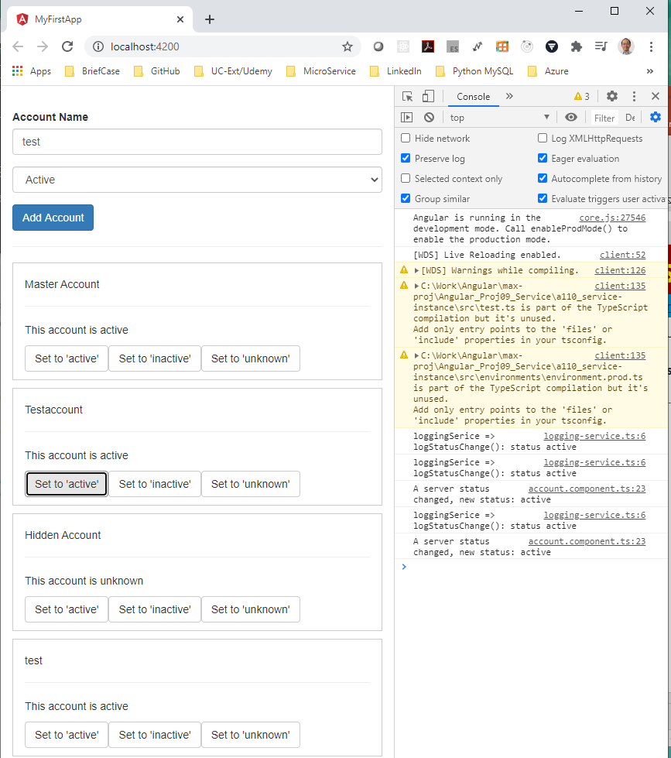
110.2 Verify
https://www.udemy.com/course/the-complete-guide-to-angular-2/learn/lecture/6656218#overview
Verify

Slide 8
End of Chapter

