Slide 1

111 Inject Service
Peter H. Chen

Slide 2
111 Inject Service
https://www.udemy.com/course/the-complete-guide-to-angular-2/learn/lecture/6656224#overview
Service Instances
LogService
Centralization
AppComponent
UserService
AboutComponent
UserComponent
Log data to console
Store user data
Data Storage
UserDetailComponent
Log data to console

Slide 3
111.1 Code

Slide 4
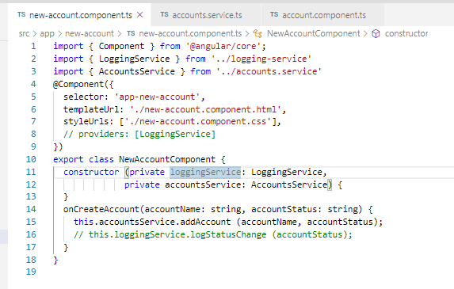
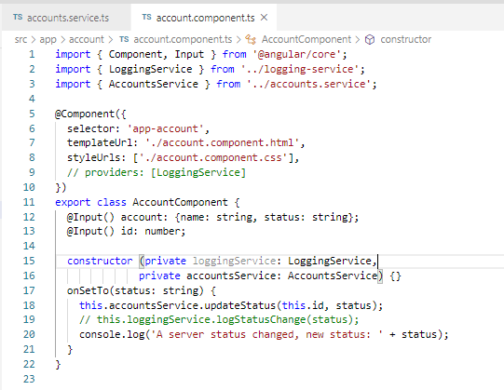
111.1 Code
https://www.udemy.com/course/the-complete-guide-to-angular-2/learn/lecture/6656224#overview
Code: Move the Service from App Component level to app Module level.
Remove the Accounts Service Component and Logging Service Component from App Component.
Add the Account Service Component and Logging Service Component to app.module.ts.
Add @Injectable() decorator to accounts.service.ts.

Slide 5
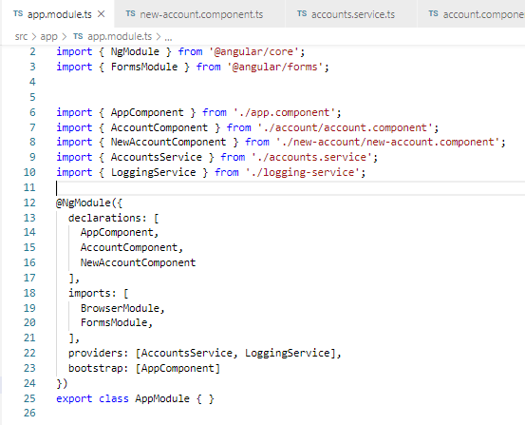
111.1 Code
Code: Move the Service from App Component level to app Module level.
Remove the Accounts Service Component and Logging Service Component from App Component.
Add the Account Service Component and Logging Service Component to app.module.ts.
Add @Injectable() decorator to accounts.service.ts
https://www.udemy.com/course/the-complete-guide-to-angular-2/learn/lecture/6656224#overview

Slide 6
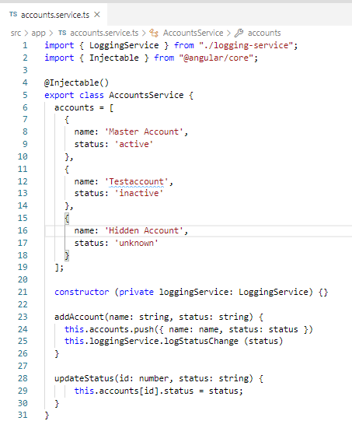
111.1 Code
https://www.udemy.com/course/the-complete-guide-to-angular-2/learn/lecture/6656224#overview
Code: Move the Service from App Component level to app Module level.
Remove the Accounts Service Component and Logging Service Component from App Component.
Add the Account Service Component and Logging Service Component to app.module.ts.
Add @Injectable() decorator to accounts.service.ts.

Slide 7
111.2 Verify

Slide 8
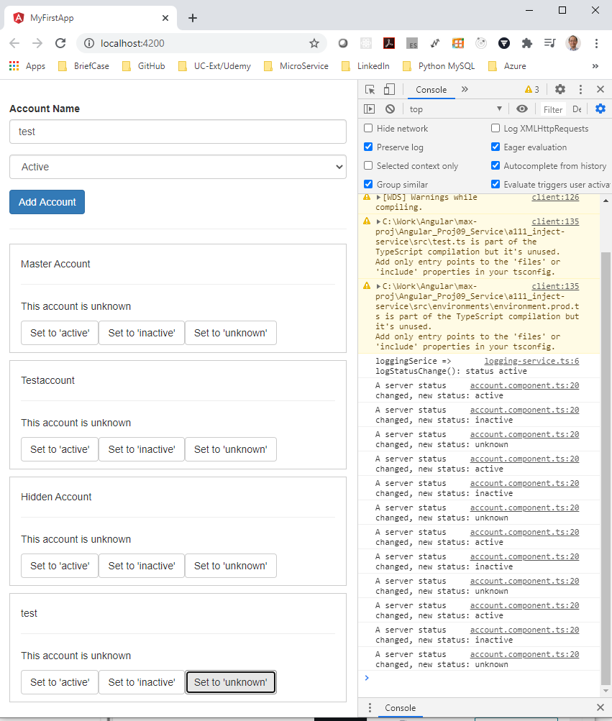
111.2 Verify
https://www.udemy.com/course/the-complete-guide-to-angular-2/learn/lecture/6656224#overview
Verify

Slide 9
End of Chapter

