Slide 1

112 Cross Component Communication
Peter H. Chen

Slide 2
112 Cross Component Communication
https://www.udemy.com/course/the-complete-guide-to-angular-2/learn/lecture/6656224#overview
Cross Component Communication
Services make out code cleaner, more centralized, and easier to maintain.
LogService
Centralization
AppComponent
UserService
AboutComponent
UserComponent
Log data to console
Store user data
Data Storage
UserDetailComponent
Log data to console

Slide 3
112 Cross Component Communication
https://www.udemy.com/course/the-complete-guide-to-angular-2/learn/lecture/6656224#overview
Cross Component Communication
If we click button in the account component and we want the data from the new account component, without the service, we would have to emit an event in the new account component that something was clicked.
We would have to catch the event in the parent app component. Then, we have to pass the new data down through property binding to the account component.
Pass the data between the component by the property and event binding is not the most convenient wat of writing code.
It is so much easier with services.
With services, we can provide some event and we can trigger the event in one component and listen the event in another component.

Slide 4
112 Cross Component Communication
https://www.udemy.com/course/the-complete-guide-to-angular-2/learn/lecture/6656224#overview
Cross Component Communication
Account component triggers an event and update the data.
New-account component get the update data and display.
account.component
new-account.component
Get Status Updated
Emit event and Status Updated
account.service.ts

Slide 5
112.1 Code

Slide 6
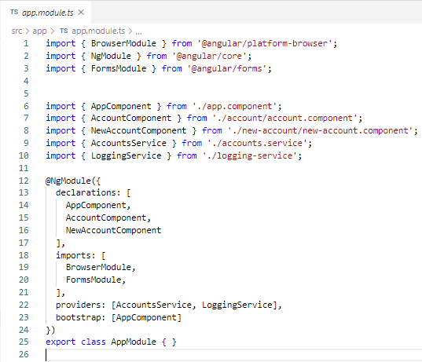
112.1 Code
https://www.udemy.com/course/the-complete-guide-to-angular-2/learn/lecture/6656224#overview
We want the communications between the Account Component and New Account Component.
We declare two components: AccountComponent and NewAccountComponent.
We give providers: AccountService.

Slide 7
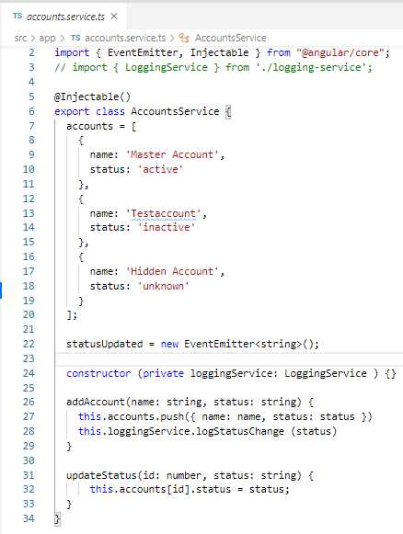
112.1 Code
https://www.udemy.com/course/the-complete-guide-to-angular-2/learn/lecture/6656224#overview
We want the communications between the Account Component and New Account Component.
In the account.service.ts:
We provide the Emmitter() in the accounts.services.ts

Slide 8
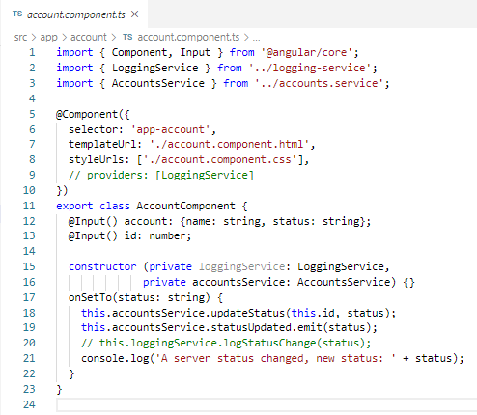
112.1 Code
https://www.udemy.com/course/the-complete-guide-to-angular-2/learn/lecture/6656224#overview
We want the communications between the Account Component and New Account Component.
In the account.component.ts:
We emit an event and use the statusUpdated from accounts.service.ts.

Slide 9
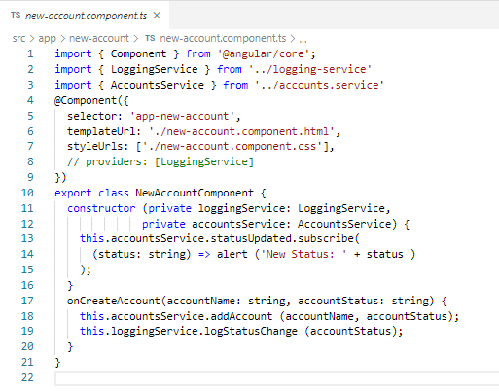
112.1 Code
https://www.udemy.com/course/the-complete-guide-to-angular-2/learn/lecture/6656224#overview
We want the communications between the Account Component and New Account Component.
In the new-account.component.ts:
We got the statusUpdated from account component.

Slide 10
112.2 Verify

Slide 11
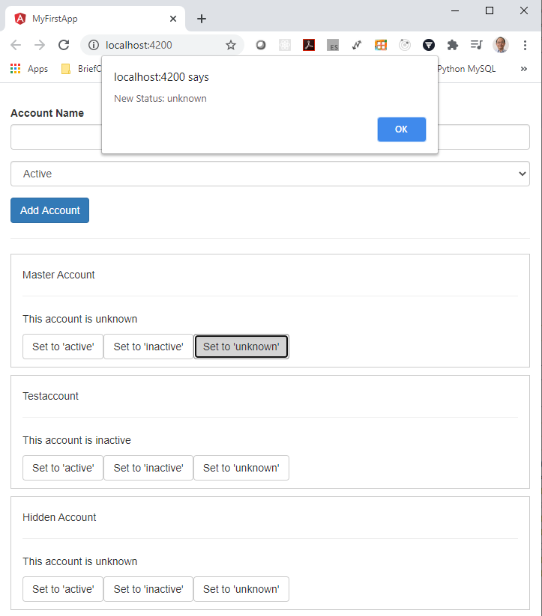
112.2 Verify
https://www.udemy.com/course/the-complete-guide-to-angular-2/learn/lecture/6656224#overview
Verify
Click any button in Account will emit an event to new-account and popup an alert dialog.

Slide 12
End of Chapter

