Slide 1

114 Assignment 5: Service
Peter H. Chen

Slide 2
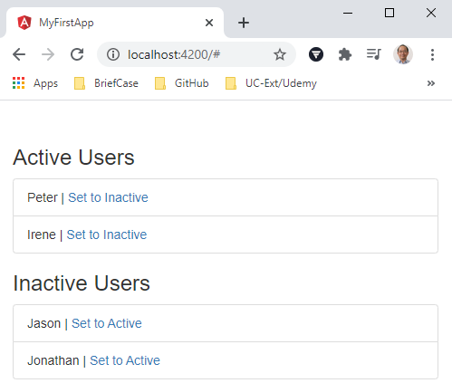
114 Assignment 5: Service
https://www.udemy.com/course/the-complete-guide-to-angular-2/learn/lecture/12982448#overview
Assignment 5: Services
We have two group of users (active and inactive users).
Add a UsersService which manages the active and inactive users.
Add a CounterService which counts the number of active -> inactive and inactive -> active actions.

Slide 3
114.1 Code

Slide 4
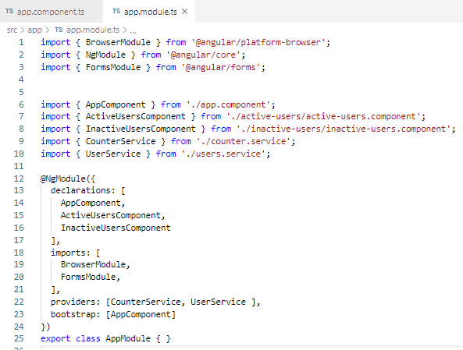
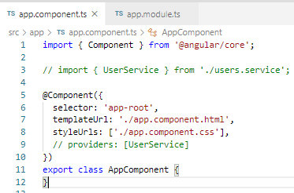
114.1 Code
https://www.udemy.com/course/the-complete-guide-to-angular-2/learn/lecture/12982448#overview
Code:
Components: [ActiveUsersComponent and InactiveUsersComponent].
Providers: [CounterService, UserService]. The UserService can be moved to app component. As long as the service are on the top of the modules.

Slide 5
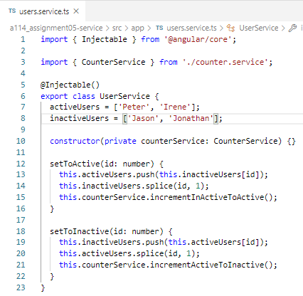
114.1 Code
https://www.udemy.com/course/the-complete-guide-to-angular-2/learn/lecture/12982448#overview
Code:
users.service.ts
> @Injectable ()
> export class UserService { … }
> activeUsers = [ … ]
> inactiveUsers = […]
> setToActive (id) {
> push to ActiveUsers
> remove (slice) from inactiveUsers
> Increase Active Users
> }
> setToInactive (id) { … }

Slide 6
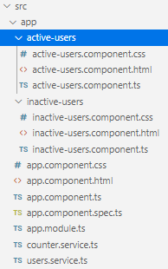
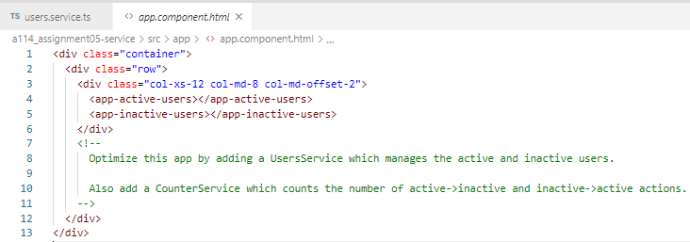
114.1 Code
https://www.udemy.com/course/the-complete-guide-to-angular-2/learn/lecture/12982448#overview
Code:
App.component.html
> active-users component <app-active-users>
> inactive-users component <app-inactive-users>

Slide 7
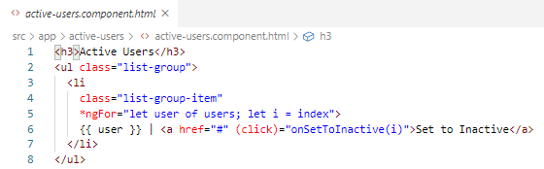
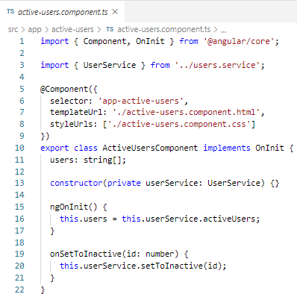
114.1 Code
https://www.udemy.com/course/the-complete-guide-to-angular-2/learn/lecture/12982448#overview
Code: acitive-users component:
Get active users from userService.
*ngFor to loop for active users and set the index of id.
click to onSetToInactive(i)

Slide 8

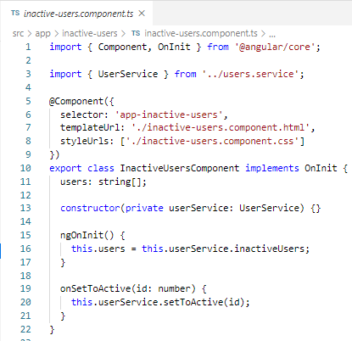
114.1 Code
https://www.udemy.com/course/the-complete-guide-to-angular-2/learn/lecture/12982448#overview
Code: inacitive-users component:
Get inactive users from the user services.
*ngFor to loop for inactive users and set the index of id.
click to onSetToActive(i)

Slide 9
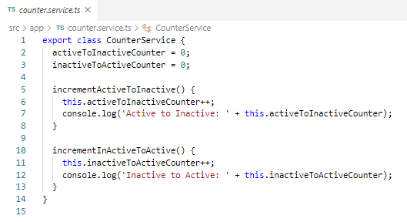
114.1 Code
https://www.udemy.com/course/the-complete-guide-to-angular-2/learn/lecture/12982448#overview
Code: counter.service.ts
Increase the Inactive and Active user.

Slide 10
114.2 Verify

Slide 11
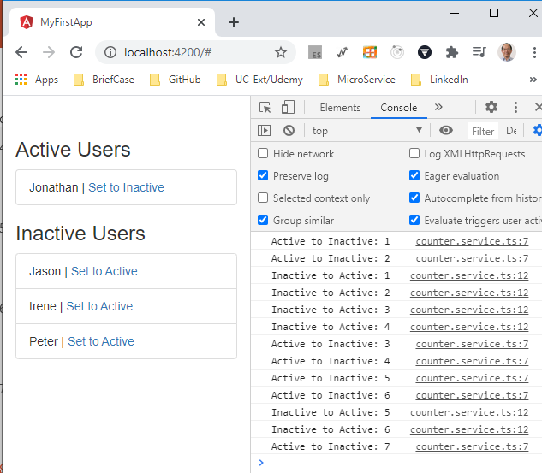
114.2 Verify
https://www.udemy.com/course/the-complete-guide-to-angular-2/learn/lecture/12982448#overview
Verify

Slide 12
End of Chapter

