Slide 1

1 Angular Introduction
Peter H. Chen

Slide 2
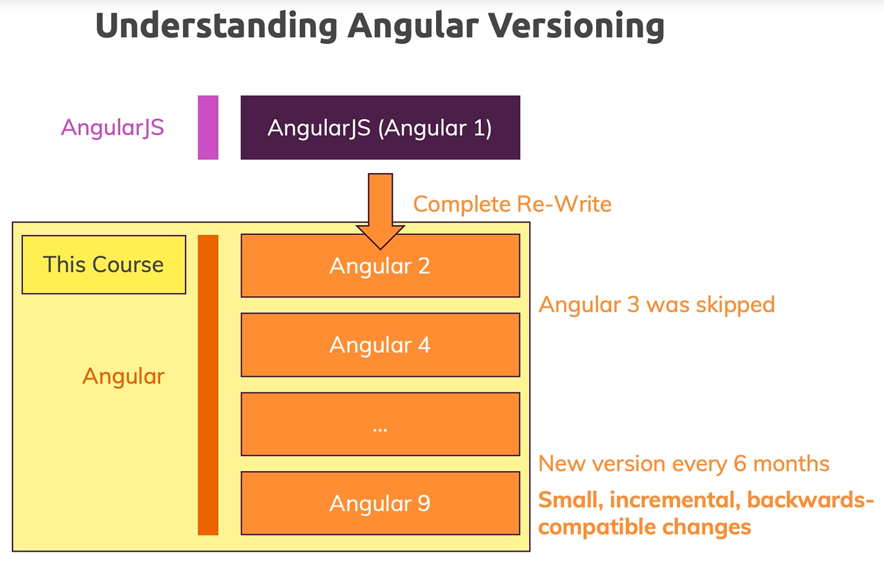
1 Angular Introduction
https://www.udemy.com/course/the-complete-guide-to-angular-2/learn/lecture/6655670#overview
AngularJS and Angular.

Slide 3
1.1 Project Setup

Slide 4
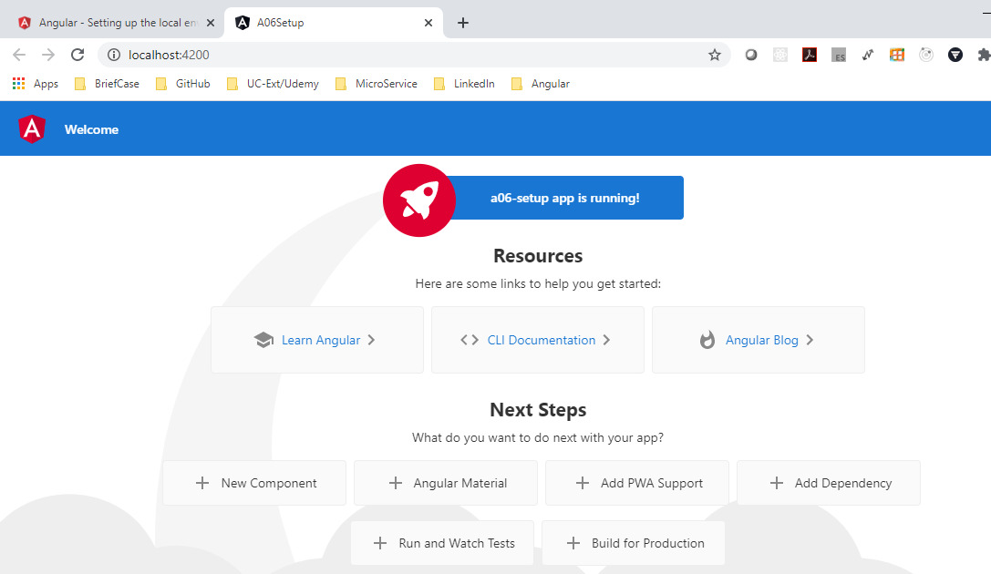
1.1 Project Setup
https://www.udemy.com/course/the-complete-guide-to-angular-2/learn/lecture/10415888#overview
Project Setup
https://angular.io/guide/setup-local
> npm install -g @angular/cli
> ng new a007-data-bind
> cd a007-data-bind
> ng serve --open
Or
> ng serve
> open chrome
Enter “localhost:4200”

Slide 5
1.2 Project Folder

Slide 6
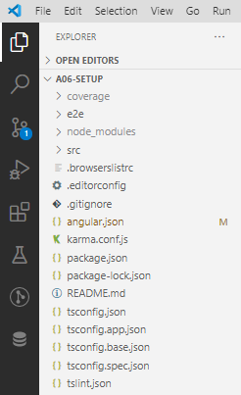
1.2 Project Folder
https://www.udemy.com/course/the-complete-guide-to-angular-2/learn/lecture/10415888#overview
Project folder
The project folder is Angular CLI create for us.
package.json has the package dependencies.
e2e: end-to-end testing.
node_modules: all the packages.
app folder: app.component.ts, app.component.css, app.component.html, app.compoment.spec.ts (TypeScript file to dynamic content to HTML code), app.module.ts

Slide 7
1.3 First App

Slide 8
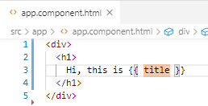
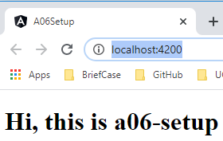
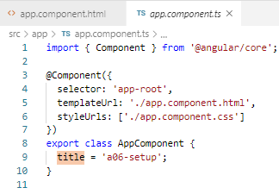
1.3 First App
https://www.udemy.com/course/the-complete-guide-to-angular-2/learn/lecture/10415888#overview
Code change:
Change app.component.html: {{ }} is data binding.
@component will be discussed in next section.
Title is defined in app.component.ts: This is TypeScript will be converted into JavaScript.

Slide 9
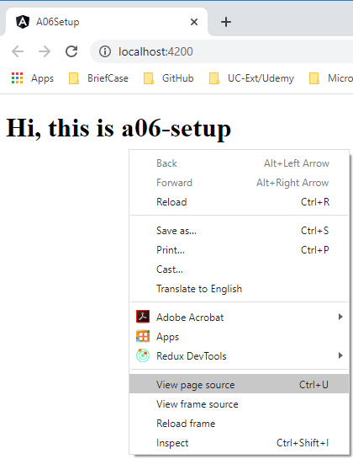
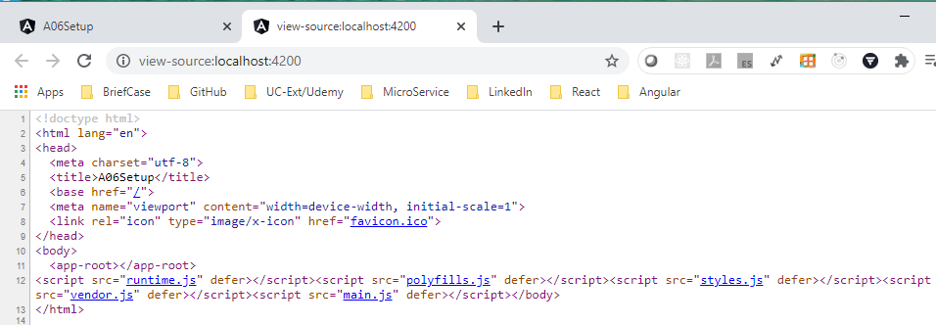
1.3 First App
https://www.udemy.com/course/the-complete-guide-to-angular-2/learn/lecture/10415888#overview
View Page Source
We only see the script imported at the bottom. This the Angular framework.

Slide 10
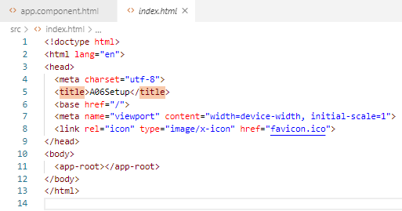
1.3 First App
https://www.udemy.com/course/the-complete-guide-to-angular-2/learn/lecture/10415888#overview
View Page Source
<app-root> is seen in app.component.ts.
This <app-root> will be dynamically import in index.html file.
We can have more components import dynamically.

Slide 11
1.4 Data Binding

Slide 12
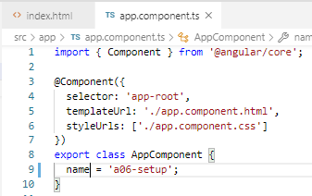
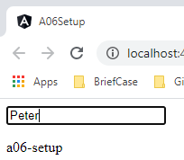

1.4 Data Binding
https://www.udemy.com/course/the-complete-guide-to-angular-2/learn/lecture/10415888#overview
Change app.component.ts and app.component.html.

Slide 13
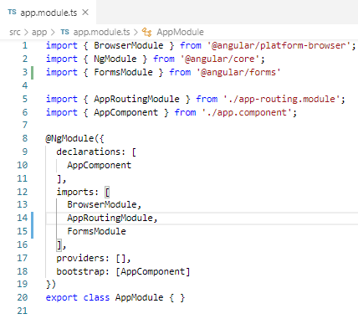

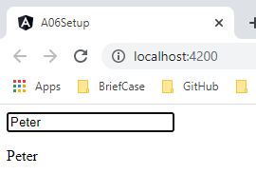
1.4 Data Binding
https://www.udemy.com/course/the-complete-guide-to-angular-2/learn/lecture/10415888#overview
How to bind the data in the text field to the displayed text?
Step 4 and 5 is not Angular. That is the form module for TypeScript.
4
1
5
3
2

Slide 14
1.5 Project Template

Slide 15
1.5 Project Template
https://www.udemy.com/course/the-complete-guide-to-angular-2/learn/lecture/6655700#overview
Setup Project template
> npm install
> npm audit fix # if necessary

Slide 16
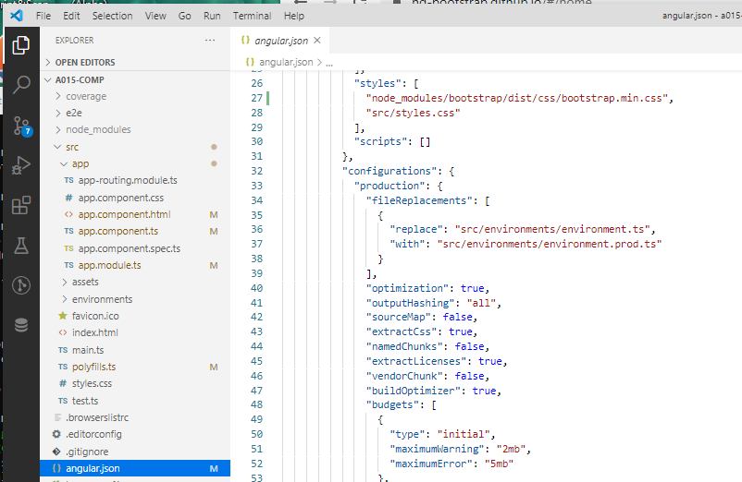
1.5 Project Template
https://www.udemy.com/course/the-complete-guide-to-angular-2/learn/lecture/6655700#overview
Setup Project template
Add bootstrap
https://ng-bootstrap.github.io/#/home
// Installation for Angular CLI
> ng add @ng-bootstrap/ng-bootstrap

Slide 17
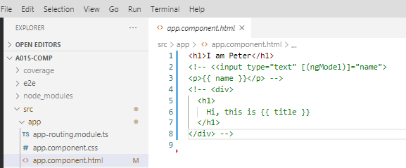
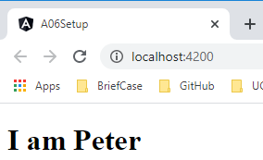
1.5 Project Template
https://www.udemy.com/course/the-complete-guide-to-angular-2/learn/lecture/6655700#overview
Start Project
> ng serve –open

Slide 18
End of Chapter

