Slide 1

123 Routing Introduction
Peter H. Chen

Slide 2
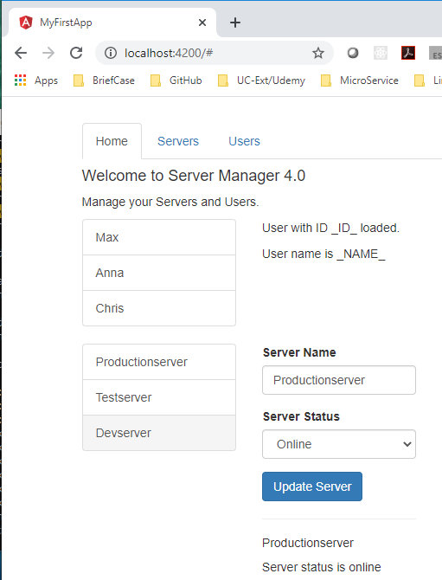
123 Routing Introduction
https://www.udemy.com/course/the-complete-guide-to-angular-2/learn/lecture/6656272#overview
Routing Introduction
We built all application under SPA (Single Page Application).
If you look at the URL at the top, it is always at localhost:4200.
Now, if you wanted to have a page where you actually display serval pages, such as, /users or /accounts page. You might think this is multiple pages, multiple index.html files.
Angular allow you to change URL in the URL bar and still use one page but exchange major parts or a lot of parts of that page.

Slide 3
123 Routing Introduction
https://www.udemy.com/course/the-complete-guide-to-angular-2/learn/lecture/6656272#overview
Routing Introduction
To the user, it really like a new page was loaded.
The hearer is the same but behind the scenes, it is still JavaScript changing a lot of parts in your DOM, in your pages, making it look like a new page was rendered but you are still in the Angular World in your SPA (Single Page Application).

Slide 4
End of Chapter

