Slide 1

124 Router
Peter H. Chen

Slide 2
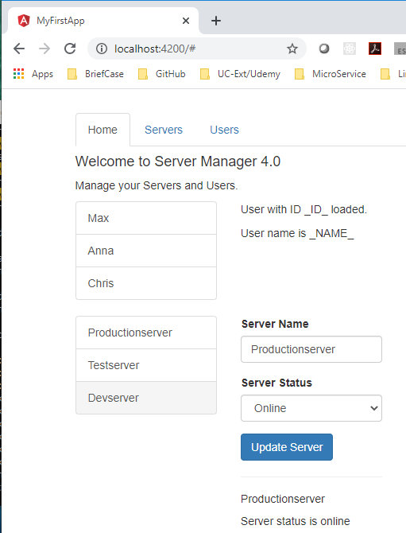
124 Router
https://www.udemy.com/course/the-complete-guide-to-angular-2/learn/lecture/6656274#overview
Router
We cannot switch the page from the tabs at the top.
We will work on the Home, Servers, Users buttons for switching the pages.
We will split this page into multiple pages, such as, localhost:4200, localhost:4200/users, localhost:4200/servers, and etc.
We need the router to do this.
Angular router needs to know which front end application has.

Slide 3
End of Chapter

