Slide 1

125 Understand Router Project
Peter H. Chen

Slide 2
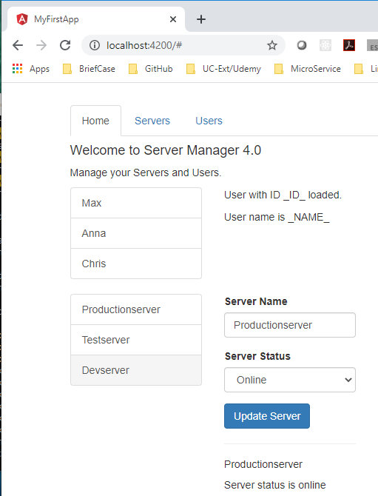
125 Understand Router Project
https://www.udemy.com/course/the-complete-guide-to-angular-2/learn/lecture/6656274#overview
Understand Router Project
In our app, we got three sections:
Home
Servers
View and Edit Servers
A Service is used to load and update Servers
Users
View Users
This app will be improved by adding routing but definitely feel free to play around with it - besides routing, everything should be working fine.

Slide 3
End of Chapter

