Slide 1

126 Router Setup
Peter H. Chen

Slide 2
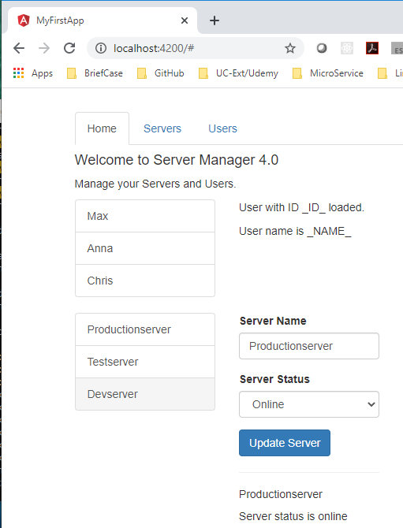
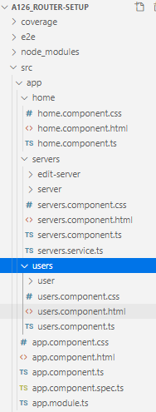
126 Router Setup
https://www.udemy.com/course/the-complete-guide-to-angular-2/learn/lecture/6656280#overview
Router Setup
We have three major components: home, servers, and users.

Slide 3
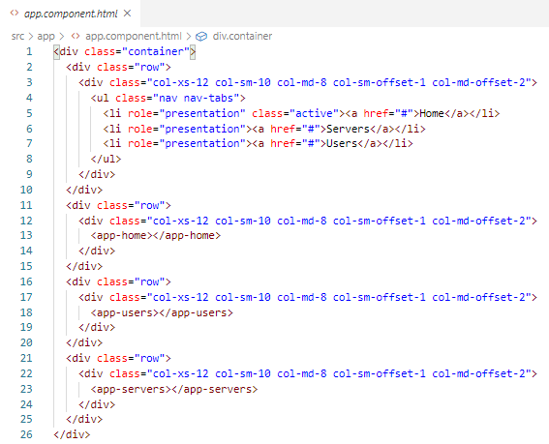
126 Router Setup
https://www.udemy.com/course/the-complete-guide-to-angular-2/learn/lecture/6656280#overview
Router Setup
In the app.component.html, we load the home component, users component, and servers component.

Slide 4
126 Router Setup
https://www.udemy.com/course/the-complete-guide-to-angular-2/learn/lecture/6656280#overview
Router Setup
We will display the component one at a time.
When we click at the top, we will load a different route in our app.

Slide 5
126 Router Setup
https://www.udemy.com/course/the-complete-guide-to-angular-2/learn/lecture/6656280#overview
Router Setup
Where do we register these router? These routes are responsible for our whole app.
Everywhere in our application.
If we enter /users, we want to load the users component as our main page.

Slide 6
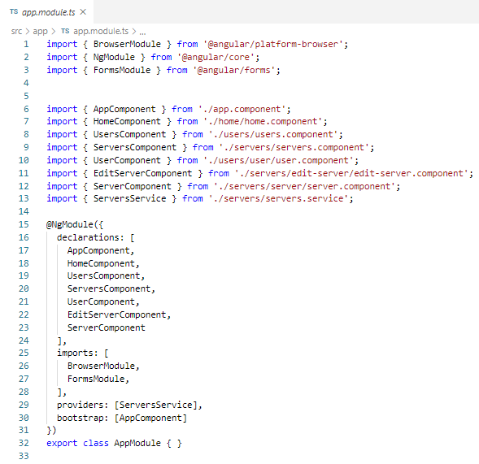
126 Router Setup
https://www.udemy.com/course/the-complete-guide-to-angular-2/learn/lecture/6656280#overview
Router Setup
The app.modules.ts is a good place to register. It is the place where we configure our app.
The app.modules.ts is a place to inform Angular about the routes of our application.

Slide 7
126.1 Code

Slide 8
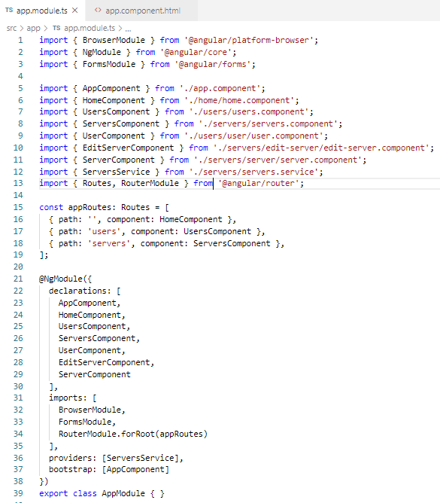
126.1 Code
https://www.udemy.com/course/the-complete-guide-to-angular-2/learn/lecture/6656280#overview
Code
In app.modules.ts, add const appRoutes: Routes = [].
appRoutes is the router instance.
Routes is an array contains all the router paths and router components.
Where do we put the appRoutes?
We put the appRoutes in the RouteModule.forRoot (appRoutes).

Slide 9
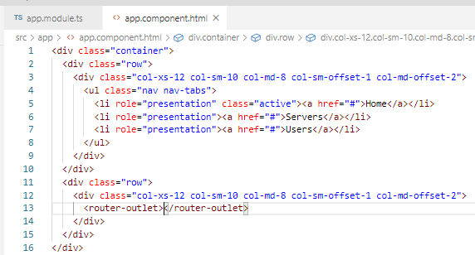
126.1 Code
https://www.udemy.com/course/the-complete-guide-to-angular-2/learn/lecture/6656280#overview
Code
How to we display the route instead of all the components?
In the app.component.html, in stead of displaying all three components, we use <router-outlet>.
The <router-outlet> looks like a component, but it is an angular directive.

Slide 10
126.2 Verfiy

Slide 11
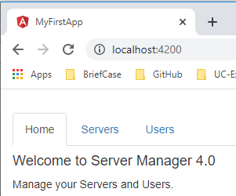
126.2 Verify
https://www.udemy.com/course/the-complete-guide-to-angular-2/learn/lecture/6656280#overview
Verify

Slide 12
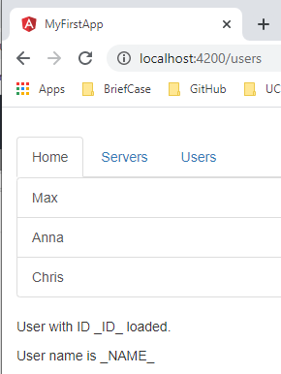
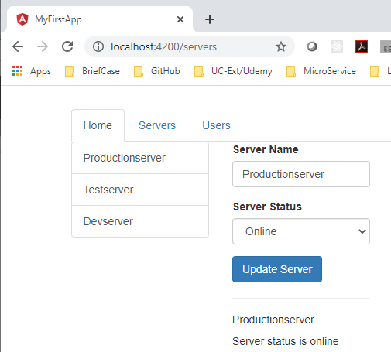
126.2 Verify
https://www.udemy.com/course/the-complete-guide-to-angular-2/learn/lecture/6656280#overview
Verify
> localhost:4200/users
> localhost:4200/servers

Slide 13
End of Chapter

