Slide 1

127 Navigation with Router Link
Peter H. Chen

Slide 2
127 Navigation with Router Link
https://www.udemy.com/course/the-complete-guide-to-angular-2/learn/lecture/6656284#overview
Navigation with Router Link
We have three major components: home, servers, and users.

Slide 3
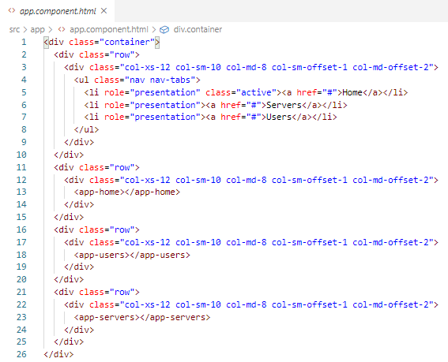
126 Router Setup
https://www.udemy.com/course/the-complete-guide-to-angular-2/learn/lecture/6656284#overview
Router Setup
In the app.component.html, we load the home component, users component, and servers component.

Slide 4
126.1 Code

Slide 5
126.1 Code
https://www.udemy.com/course/the-complete-guide-to-angular-2/learn/lecture/6656284#overview
Code
In app.modules.ts, add const appRoutes: Routes = [].
appRoutes is the router instance.
Routes is an array contains all the router paths and router components.
Where do we put the appRoutes?
We put the appRoutes in the RouteModule.forRoot (appRoutes).

Slide 6
126.2 Verfiy

Slide 7
126.2 Verify
https://www.udemy.com/course/the-complete-guide-to-angular-2/learn/lecture/6656284#overview
Verify

Slide 8
End of Chapter

