Slide 1

91 *ngFor and *ngIf
Peter H. Chen

Slide 2
91 *ngFor and *ngIf
https://www.udemy.com/course/the-complete-guide-to-angular-2/learn/lecture/6656162#overview
Structural Directives: *mgFor and *ngIf

Slide 3
91.1 Code

Slide 4
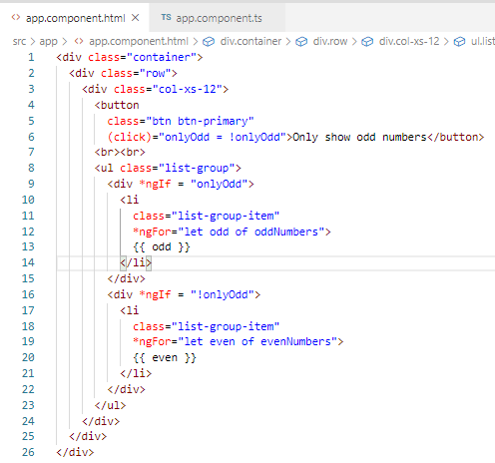
91.1 Code
https://www.udemy.com/course/the-complete-guide-to-angular-2/learn/lecture/6656164#overview
Code

Slide 5
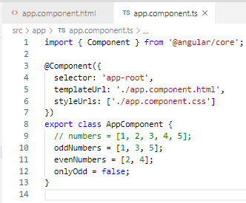
91.1 Code
https://www.udemy.com/course/the-complete-guide-to-angular-2/learn/lecture/6656164#overview
Code

Slide 6
91.2 Verify

Slide 7
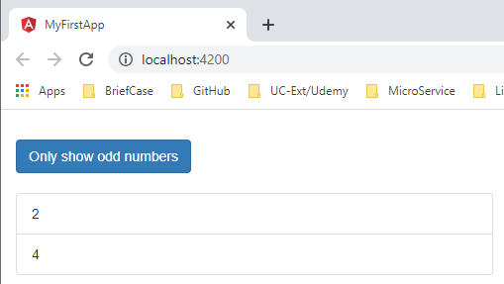
91.2 Verify
https://www.udemy.com/course/the-complete-guide-to-angular-2/learn/lecture/6656164#overview
Verify

Slide 8
End of Chapter

