Slide 1

92 ngClass and ngStyle
Peter H. Chen

Slide 2
92 ngClass and ngStyle
https://www.udemy.com/course/the-complete-guide-to-angular-2/learn/lecture/6656166#overview
ngClass and ngStyle:
[ngClass]: [] means binding to some property on our ngClass directive.

Slide 3
92.1 Code

Slide 4
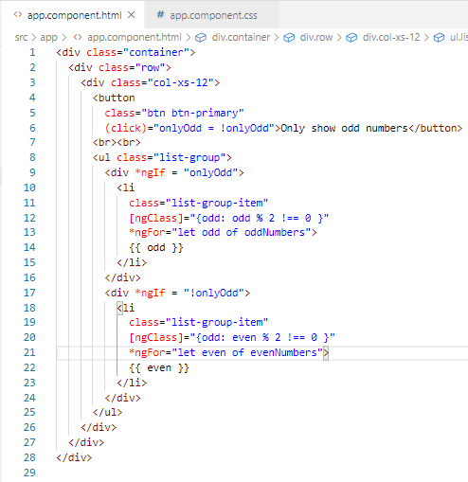
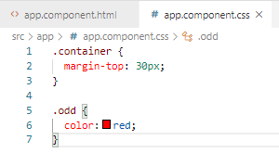
92.1 Code
https://www.udemy.com/course/the-complete-guide-to-angular-2/learn/lecture/6656166#overview
Code

Slide 5
92.2 Verify

Slide 6
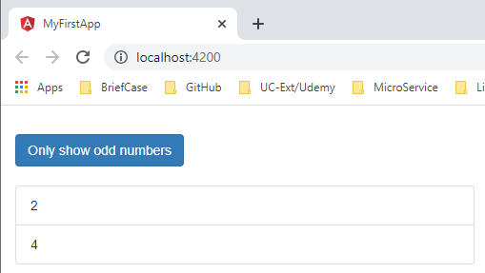
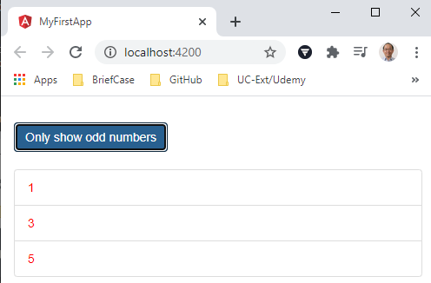
92.2 Verify
https://www.udemy.com/course/the-complete-guide-to-angular-2/learn/lecture/6656166#overview
Verify

Slide 7
92.3 Code

Slide 8
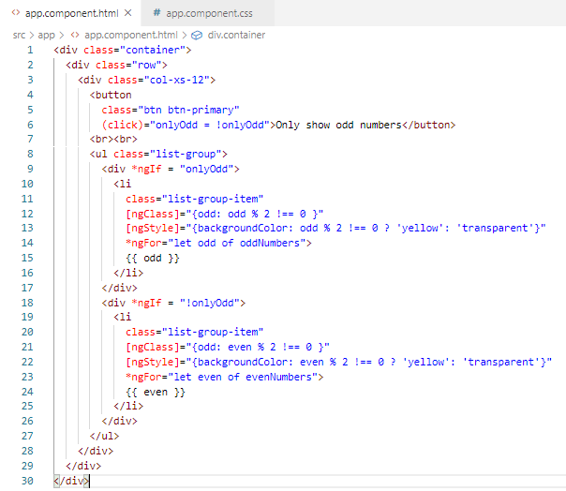
92.3 Code
https://www.udemy.com/course/the-complete-guide-to-angular-2/learn/lecture/6656166#overview
Code

Slide 9
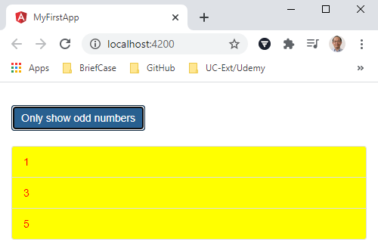
92.2 Verify
https://www.udemy.com/course/the-complete-guide-to-angular-2/learn/lecture/6656166#overview
Verify

Slide 10
End of Chapter

