Slide 1

93 Attribute Directive
Peter H. Chen

Slide 2
93 Attribute Directive
https://www.udemy.com/course/the-complete-guide-to-angular-2/learn/lecture/13193718#overview
Attribute Directive

Slide 3
93.1 Code

Slide 4
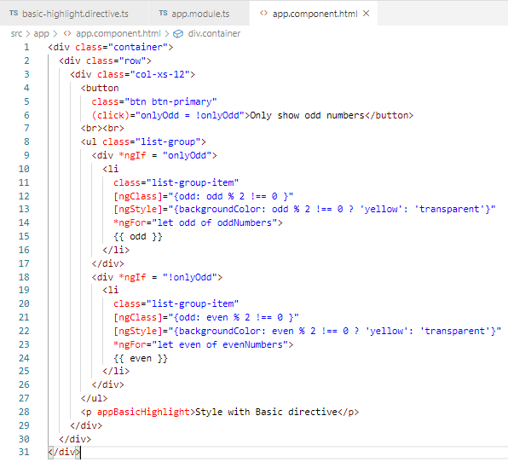
93.1 Code
https://www.udemy.com/course/the-complete-guide-to-angular-2/learn/lecture/13193718#overview
Code

Slide 5
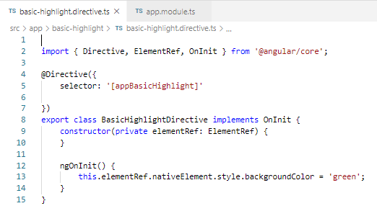
93.1 Code
https://www.udemy.com/course/the-complete-guide-to-angular-2/learn/lecture/13193718#overview
Code

Slide 6
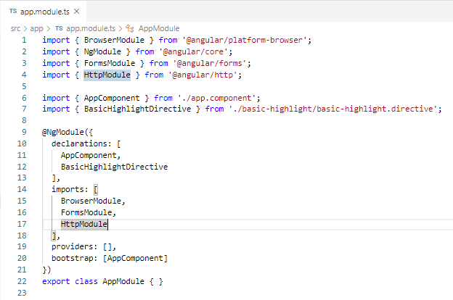
93.1 Code
https://www.udemy.com/course/the-complete-guide-to-angular-2/learn/lecture/13193718#overview
Code

Slide 7
93.2 Verify

Slide 8
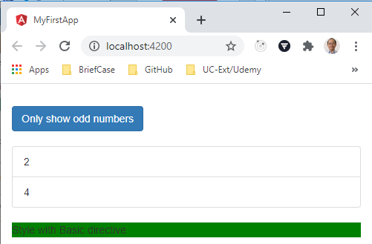
93.2 Verify
https://www.udemy.com/course/the-complete-guide-to-angular-2/learn/lecture/13193718#overview
Verify

Slide 9
End of Chapter

