Slide 1

94 Render Attribute Directive
Peter H. Chen

Slide 2
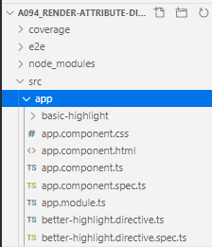
94 Render Attribute Directive
https://www.udemy.com/course/the-complete-guide-to-angular-2/learn/lecture/6656172#overview
Use Render Attribute Directive is the better way
> ng g directive better-highlight
Or
> ng g d better-highlight

Slide 3
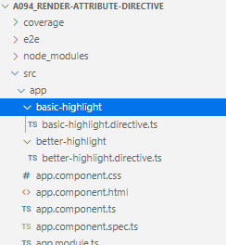
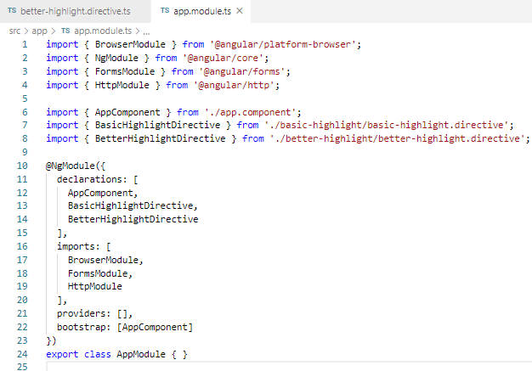
94 Render Attribute Directive
https://www.udemy.com/course/the-complete-guide-to-angular-2/learn/lecture/6656172#overview
Use Render Attribute Directive is the better way
Create folder better-highlight and put the better-highlight.directive.ts inside.
> better-highlight/better-highlight.directive.ts

Slide 4
94.1 Code

Slide 5
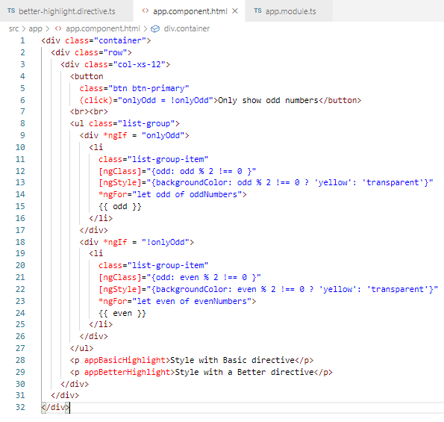
94.1 Code
https://www.udemy.com/course/the-complete-guide-to-angular-2/learn/lecture/6656172#overview
Code

Slide 6
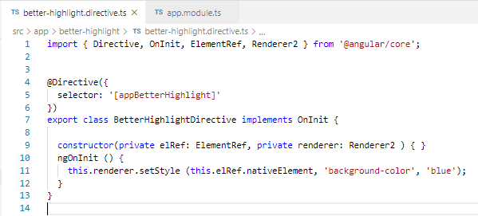
94.1 Code
https://www.udemy.com/course/the-complete-guide-to-angular-2/learn/lecture/6656172#overview
Code

Slide 7
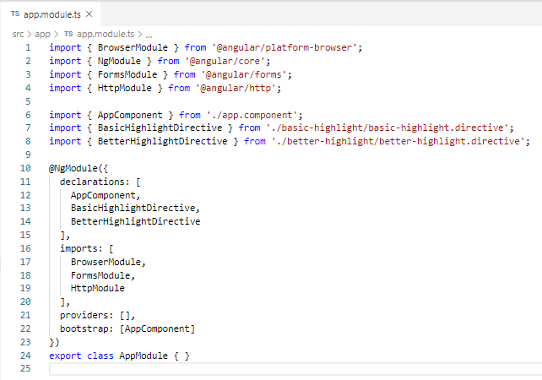
94.1 Code
https://www.udemy.com/course/the-complete-guide-to-angular-2/learn/lecture/6656172#overview
Code

Slide 8
94.2 Verify

Slide 9
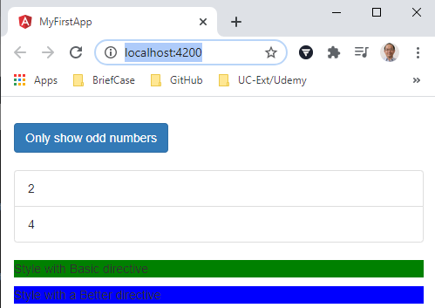
94.2 Verify
https://www.udemy.com/course/the-complete-guide-to-angular-2/learn/lecture/6656172#overview
Verify

Slide 10
End of Chapter

