Slide 1

97 Host Property
Peter H. Chen

Slide 2
97 Host Property
https://www.udemy.com/course/the-complete-guide-to-angular-2/learn/lecture/6656176#overview
Host Event
Host Listener

Slide 3
97.1 Code

Slide 4
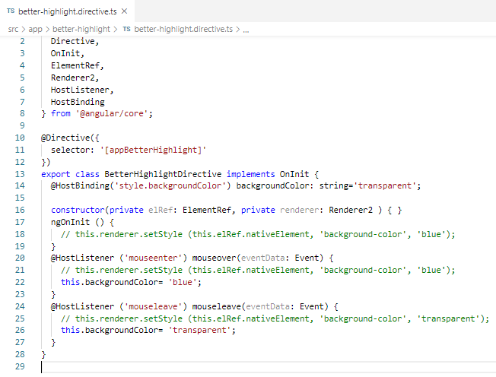
97.1 Code
https://www.udemy.com/course/the-complete-guide-to-angular-2/learn/lecture/6656176#overview
Code

Slide 5
97.2 Verify

Slide 6
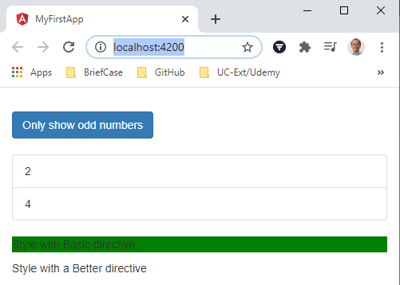
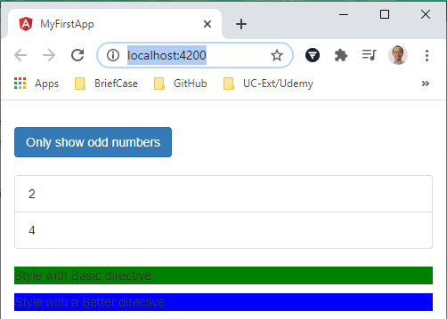
97.2 Verify
https://www.udemy.com/course/the-complete-guide-to-angular-2/learn/lecture/6656176#overview
Verify

Slide 7
End of Chapter

