Slide 1

98 Binding to Directive Property
Peter H. Chen

Slide 2
98 Binding to Directive Property
https://www.udemy.com/course/the-complete-guide-to-angular-2/learn/lecture/6656180#overview
Binding to Directive Property

Slide 3
98.1 Code

Slide 4
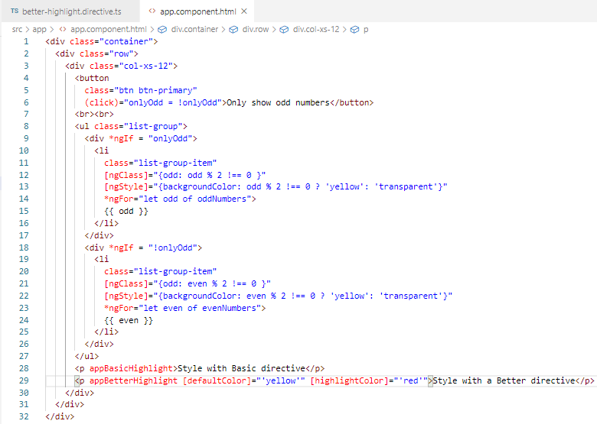
98.1 Code
https://www.udemy.com/course/the-complete-guide-to-angular-2/learn/lecture/6656180#overview
Code:
Pass the initial colors

Slide 5
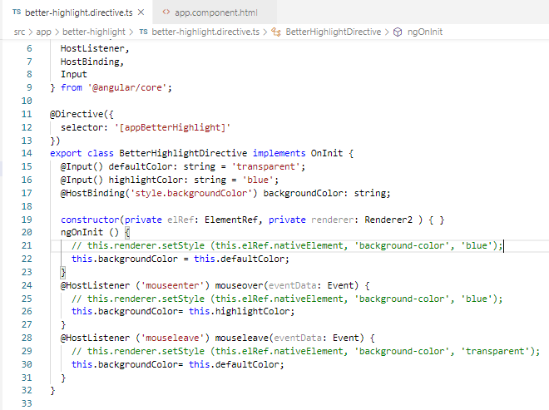
98.1 Code
https://www.udemy.com/course/the-complete-guide-to-angular-2/learn/lecture/6656180#overview
Code
Set initial color: default yellow
Mouse enter: highlight color red
Mouse leave: default color yellow

Slide 6
98.2 Verify

Slide 7
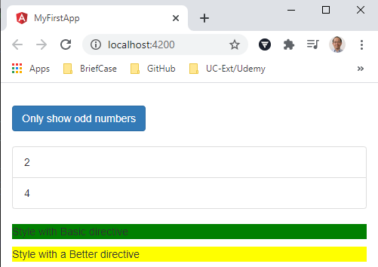
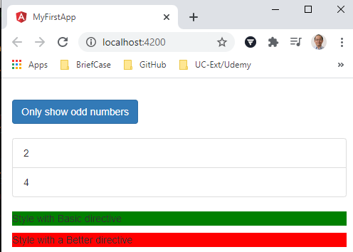
98.2 Verify
https://www.udemy.com/course/the-complete-guide-to-angular-2/learn/lecture/6656180#overview
Verify

Slide 8
End of Chapter

