Slide 1

100 Build Structure Directive
Peter H. Chen

Slide 2
100 Build Structure Directive
https://www.udemy.com/course/the-complete-guide-to-angular-2/learn/lecture/6656186#overview
Create Structure Directive
> ng g d unless

Slide 3
100.1 Code

Slide 4
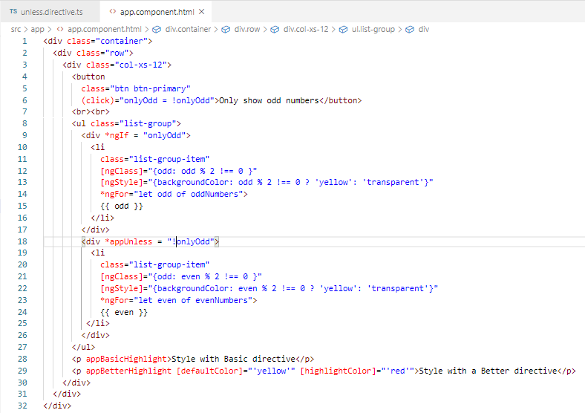
100.1 Code
https://www.udemy.com/course/the-complete-guide-to-angular-2/learn/lecture/6656186#overview
Code

Slide 5
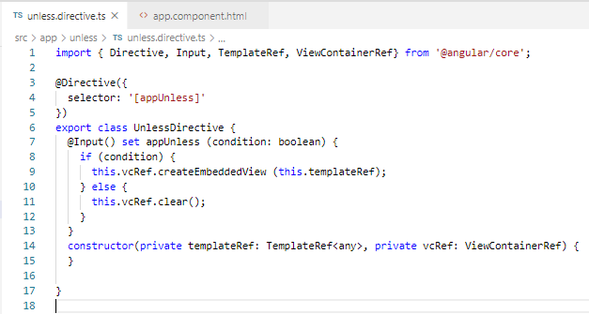
100.1 Code
https://www.udemy.com/course/the-complete-guide-to-angular-2/learn/lecture/6656186#overview
Code

Slide 6
100.2 Verify

Slide 7
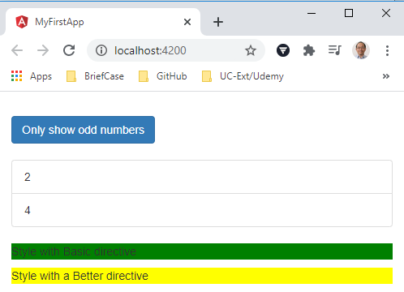
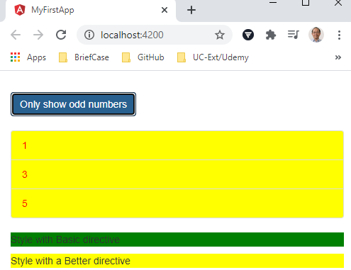
100.2 Verify
https://www.udemy.com/course/the-complete-guide-to-angular-2/learn/lecture/6656186#overview
Verify

Slide 8
End of Chapter

