Slide 1

101 ngSwitch
Peter H. Chen

Slide 2
101 ngSwitch
https://www.udemy.com/course/the-complete-guide-to-angular-2/learn/lecture/6656188#overview
ngSwitch
> ng g d unless

Slide 3
101.1 Code

Slide 4
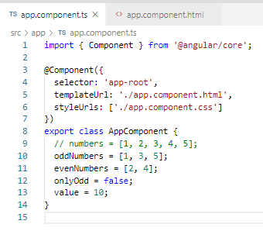
101.1 Code
https://www.udemy.com/course/the-complete-guide-to-angular-2/learn/lecture/6656188#overview
Code

Slide 5
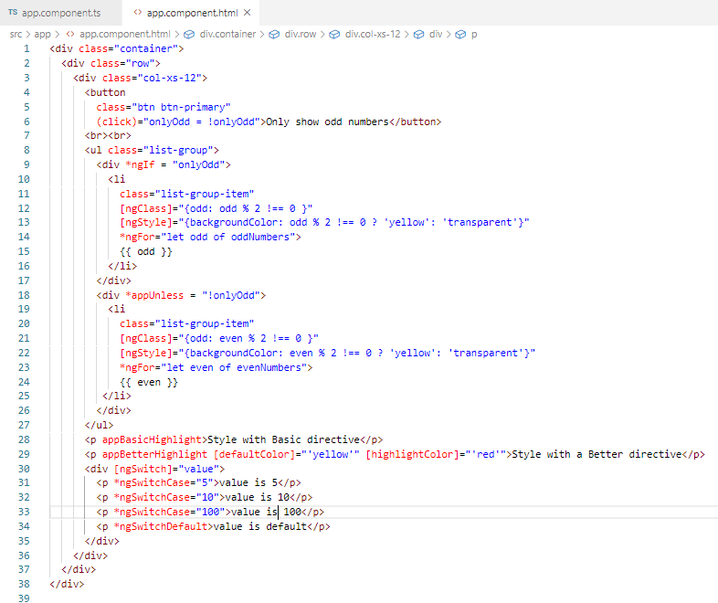
101.1 Code
https://www.udemy.com/course/the-complete-guide-to-angular-2/learn/lecture/6656188#overview
Code

Slide 6
101.2 Verify

Slide 7
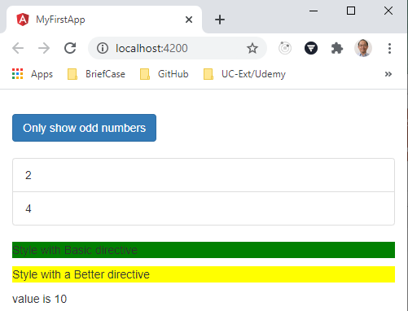
101.2 Verify
https://www.udemy.com/course/the-complete-guide-to-angular-2/learn/lecture/6656188#overview
Verify

Slide 8
End of Chapter

