Slide 1

63 Introduction
Peter H. Chen

Slide 2
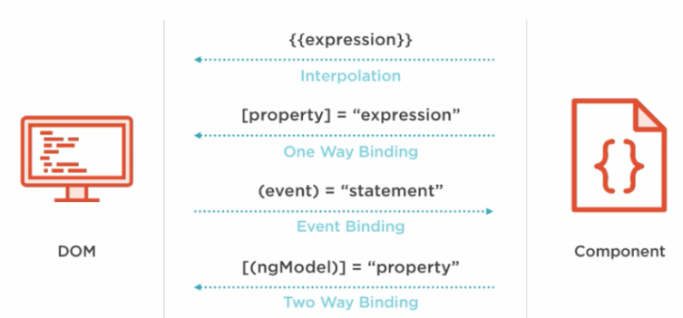
63 Introduction
https://www.udemy.com/course/the-complete-guide-to-angular-2/learn/lecture/6656058#overview
Understand Component Databinding
App Component
Cockpit
Server

Slide 3
63.1 Code

Slide 4
63.1 Code
https://www.udemy.com/course/the-complete-guide-to-angular-2/learn/lecture/6656058#overview
When using Angular 10, if the app was built in by Angular 9.0. It has the error message of missing Angular 10 library, how to fix it?
https://stackoverflow.com/questions/62586650/constructorparametersdownleveltransform-is-not-a-function-in-angular

Slide 5
63.2 Verify

Slide 6
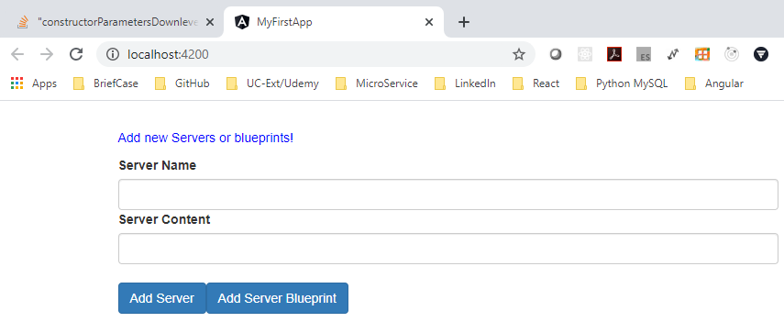
63.2 Verify
https://www.udemy.com/course/the-complete-guide-to-angular-2/learn/lecture/6656058#overview
Verify

Slide 7
End of Chapter

