Slide 1

64 Split Components
Peter H. Chen

Slide 2
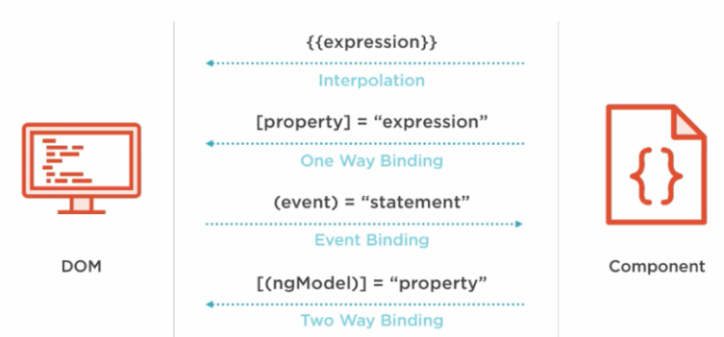
64 Split Components
https://www.udemy.com/course/the-complete-guide-to-angular-2/learn/lecture/6656060#overview
Understand Component Databinding
app
app-cockpit
app-server-element

Slide 3
64.1 Generate Components

Slide 4
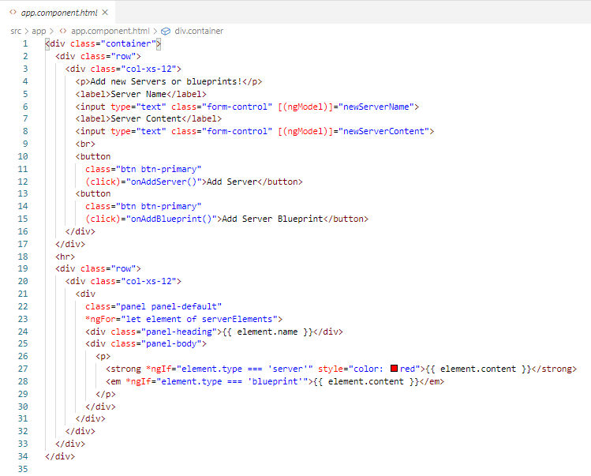
64.1 Generate Components
https://www.udemy.com/course/the-complete-guide-to-angular-2/learn/lecture/6656060#overview
> app.component.html

Slide 5
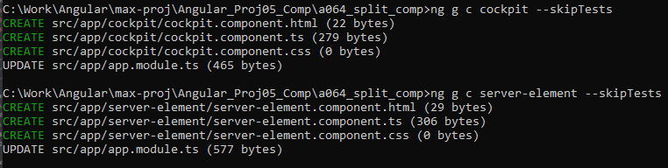
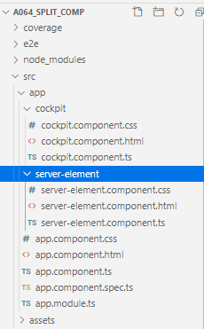
64.1 Generate Components
https://www.udemy.com/course/the-complete-guide-to-angular-2/learn/lecture/6656060#overview
> ng g c cockpit --skipTests
> ng g c server-element --skipTests

Slide 6
64.2 Move Cockpit Component

Slide 7
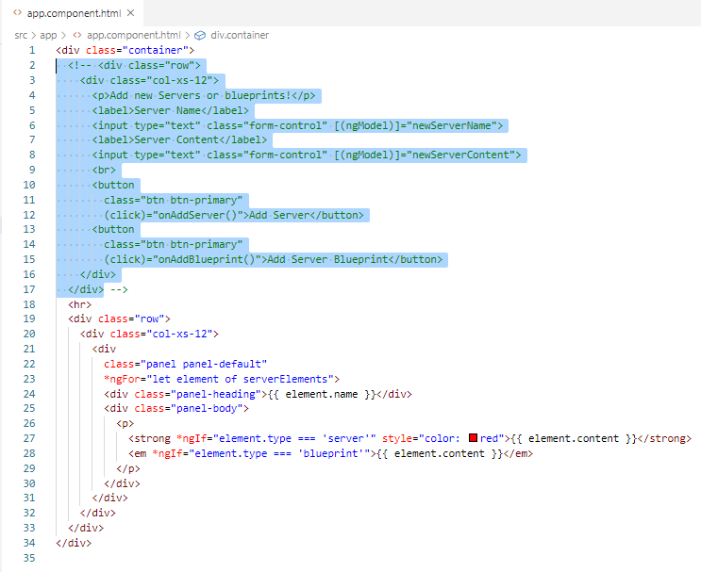
64.2 Move Cockpit Component
https://www.udemy.com/course/the-complete-guide-to-angular-2/learn/lecture/6656060#overview
Remove Server or Blueprint from app.component.html

Slide 8
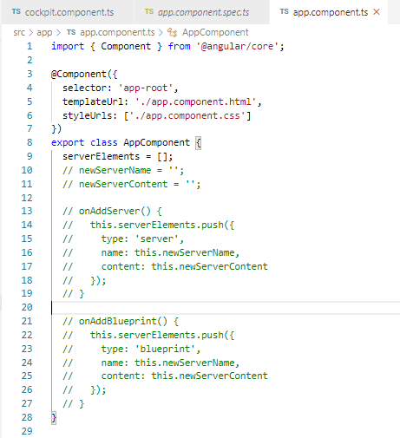
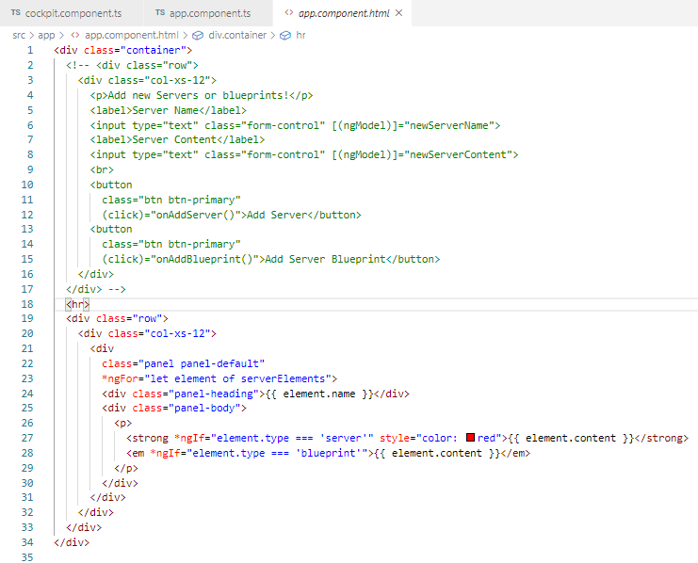
64.2 Move Cockpit Component
https://www.udemy.com/course/the-complete-guide-to-angular-2/learn/lecture/6656060#overview
Remove Server or Blueprint codes from app.component.ts.
App.ccomponent.html still need the serverElements.

Slide 9
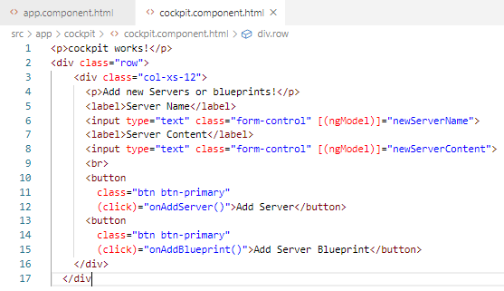
64.2 Move Cockpit Component
https://www.udemy.com/course/the-complete-guide-to-angular-2/learn/lecture/6656060#overview
Add Server or Blueprint to cockpit.component.html

Slide 10
64.3 Move Server Component

Slide 11
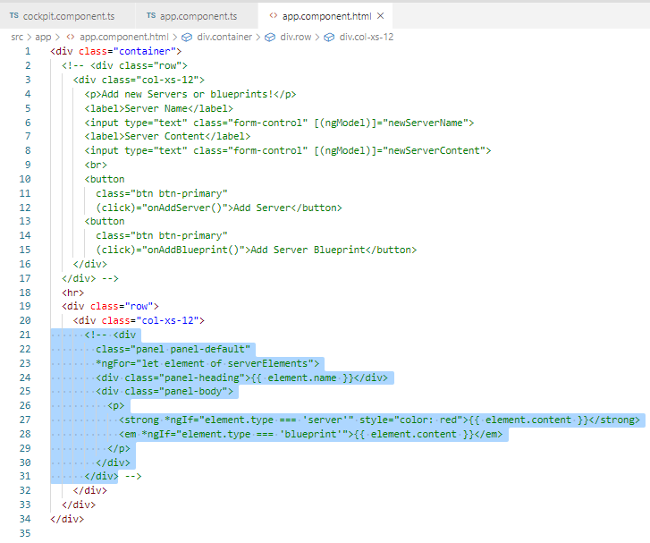
64.3 Move Server Component
https://www.udemy.com/course/the-complete-guide-to-angular-2/learn/lecture/6656060#overview
Remove Server from app.component.html

Slide 12
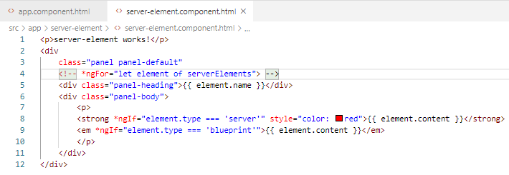
64.3 Move Server Component
https://www.udemy.com/course/the-complete-guide-to-angular-2/learn/lecture/6656060#overview
Move the server element from app.component.html to server-element.component.html.
Remove the *ngFor here. This will be managing by cockpit component.
This server is a single element of server, not a array of servers.

Slide 13
64.4 Connect Components

Slide 14
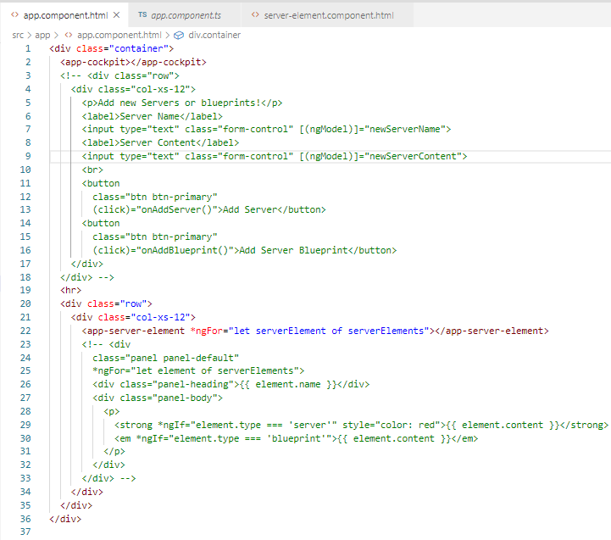
64.4 Connect Components
https://www.udemy.com/course/the-complete-guide-to-angular-2/learn/lecture/6656060#overview
In app.component, add <app-cockpit> and <app-server-element>
app
cockpit
server-element

Slide 15
64.5 Verify

Slide 16
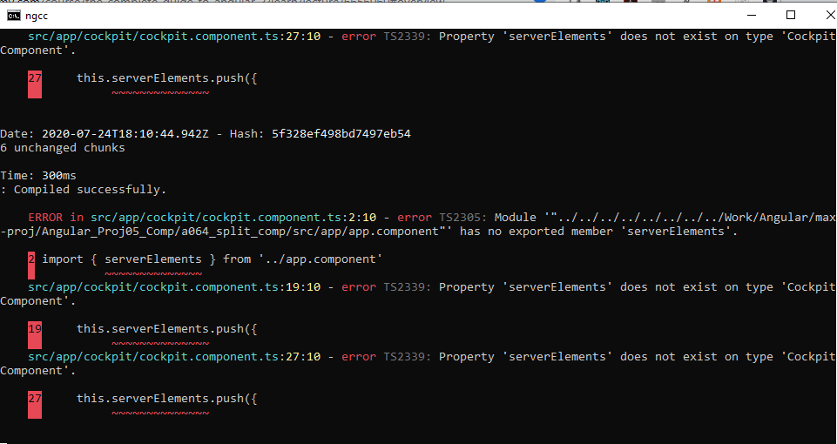
64.4 Connect Components
https://www.udemy.com/course/the-complete-guide-to-angular-2/learn/lecture/6656060#overview
We have error message of missing component information.

Slide 17
End of Chapter

