Slide 1

65 Property and Event Binding
Peter H. Chen

Slide 2
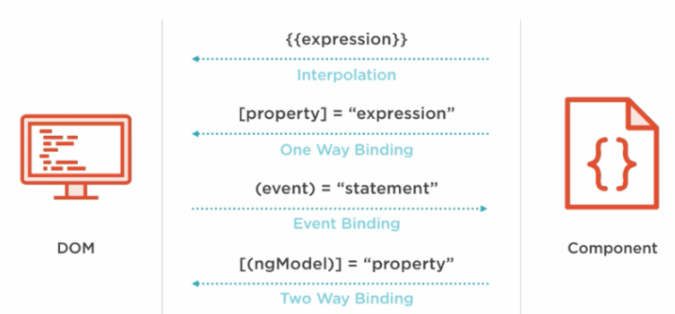
65 Property and Event Binding
https://www.udemy.com/course/the-complete-guide-to-angular-2/learn/lecture/6656062#overview
Property and Event Binding
HTML Elements
Directives
Components
Native Properties and Events
Custom Properties and Events
Custom Properties and Events

Slide 3
End of Chapter

