Slide 1

66 Bind Property
Peter H. Chen

Slide 2
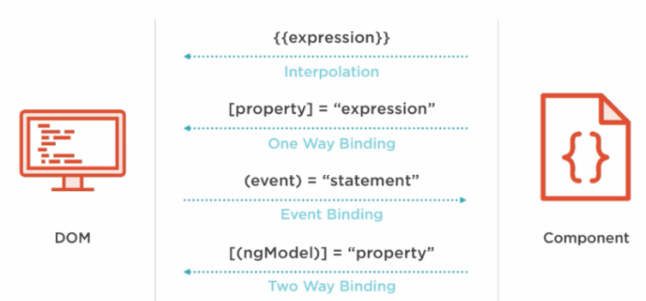
66 Bind Property
https://www.udemy.com/course/the-complete-guide-to-angular-2/learn/lecture/6666062#overview
Property and Event Binding
HTML Elements
Directives
Components
Native Properties and Events
Custom Properties and Events
Custom Properties and Events

Slide 3
66.1 Parent Component

Slide 4
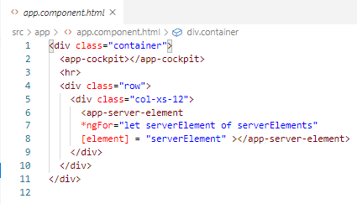
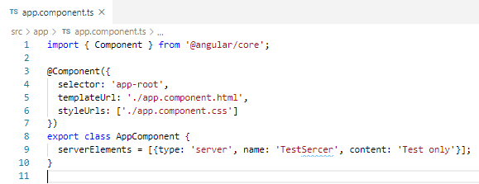
66.1 Parent Component
https://www.udemy.com/course/the-complete-guide-to-angular-2/learn/lecture/6666060#overview
Parent Component:
app.component.html
app.component.ts

Slide 5
66.2 Child Component

Slide 6
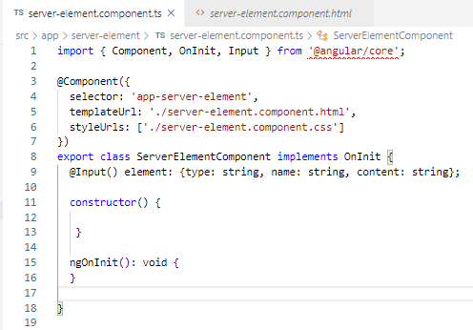
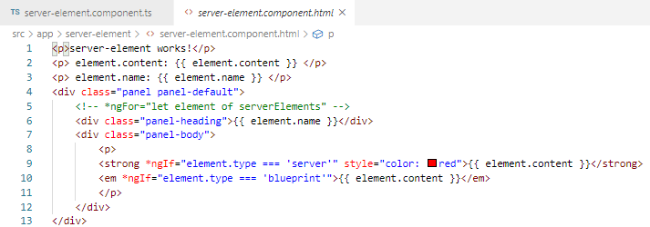
66.2 Child Component
https://www.udemy.com/course/the-complete-guide-to-angular-2/learn/lecture/6666060#overview
Child Component:
server-element.component.ts
server-element.component.html

Slide 7
66.3 Verify

Slide 8
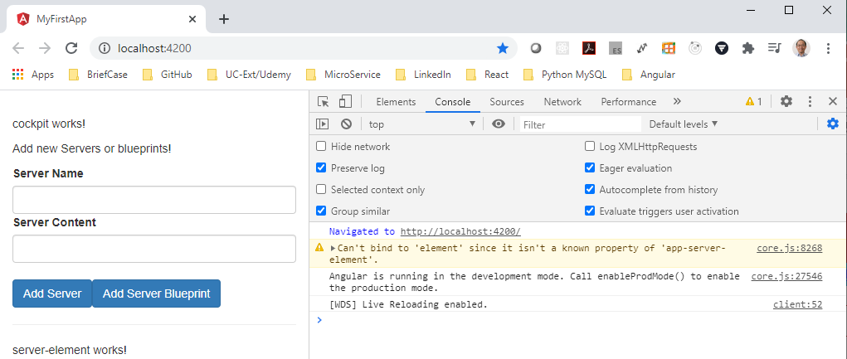
66.3 Verify
https://www.udemy.com/course/the-complete-guide-to-angular-2/learn/lecture/6666060#overview
Verify: Cannot find the element. Why?
All the property only accessible inside the component, not outside the component.
Generally, it is a good. You do not want the property accessible from outside.

Slide 9
66.4 Bind Property

Slide 10
66.4 Bind Property
https://www.udemy.com/course/the-complete-guide-to-angular-2/learn/lecture/6666060#overview
Bind Property
We wan to explicitly bind the property between the components.
We wan the parent component to be able to bind the property of the child component (element in the server-element.component.ts).
We need to add a decorator.
> import { …, Input} from ‘@angular/core’;
> @Input () element: { type: …}
We this, we explicitly expose this property to the world of Angular.
So any parent component, any component hosting the server-element.component is able to bind the element property of child component (server-element.component)

Slide 11
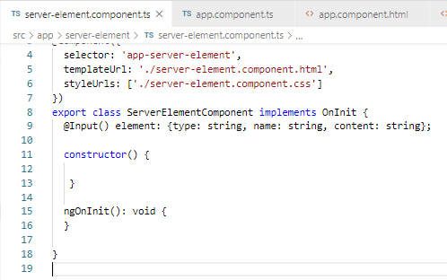
66.4 Bind Property
https://www.udemy.com/course/the-complete-guide-to-angular-2/learn/lecture/6666060#overview
Bind Property

Slide 12
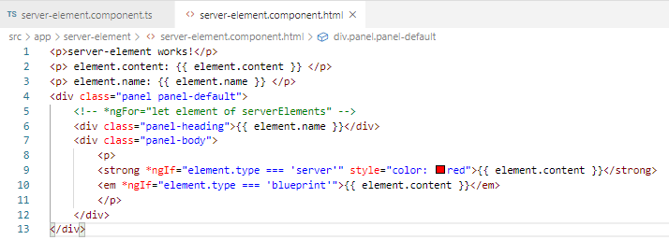
66.4 Bind Property
https://www.udemy.com/course/the-complete-guide-to-angular-2/learn/lecture/6666060#overview
Bind Property

Slide 13
66.4 Bind Property

Slide 14
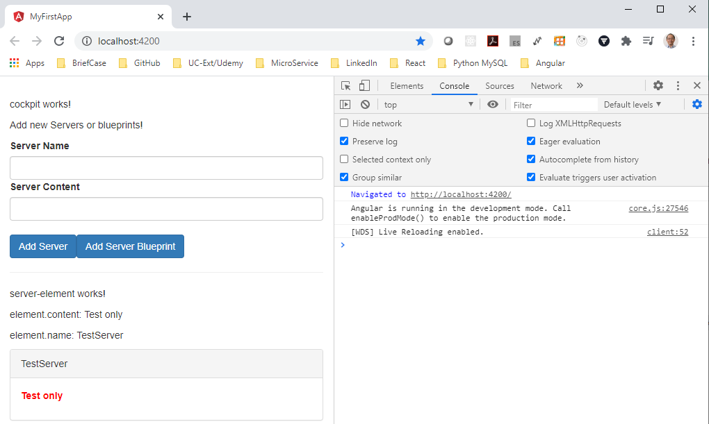
66.5 Verify Bind Property
https://www.udemy.com/course/the-complete-guide-to-angular-2/learn/lecture/6666060#overview
Verify Bind Property

Slide 15
End of Chapter

