Slide 1

67 Bind Alias Element
Peter H. Chen

Slide 2
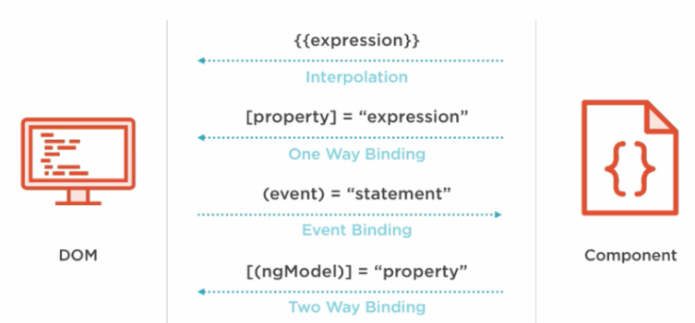
67 Bind Alias Element
https://www.udemy.com/course/the-complete-guide-to-angular-2/learn/lecture/6767062#overview
Bind Alias Element
HTML Elements
Directives
Components
Native Properties and Events
Custom Properties and Events
Custom Properties and Events

Slide 3
67.1 Parent Component

Slide 4
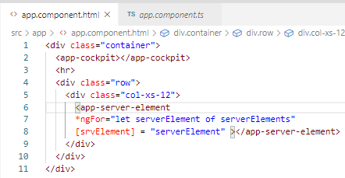
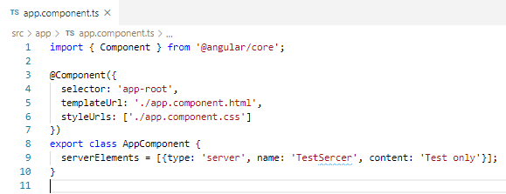
67.1 Parent Component
https://www.udemy.com/course/the-complete-guide-to-angular-2/learn/lecture/6767060#overview
Parent Component:
app.component.ts
app.component.html
Parent pass out Alias name: srvElement

Slide 5
67.2 Child Component

Slide 6
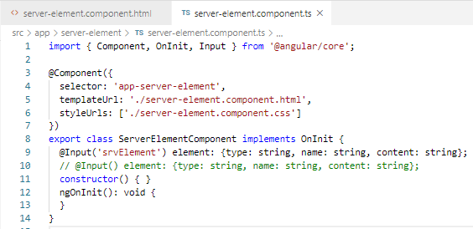
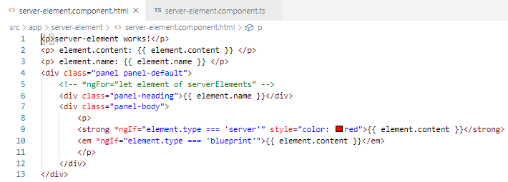
67.2 Child Component
https://www.udemy.com/course/the-complete-guide-to-angular-2/learn/lecture/6767060#overview
Code:
server-element.component.ts
server-element.component.html
Parent pass in Alias name: srvElement

Slide 7
67.3 Verify

Slide 8
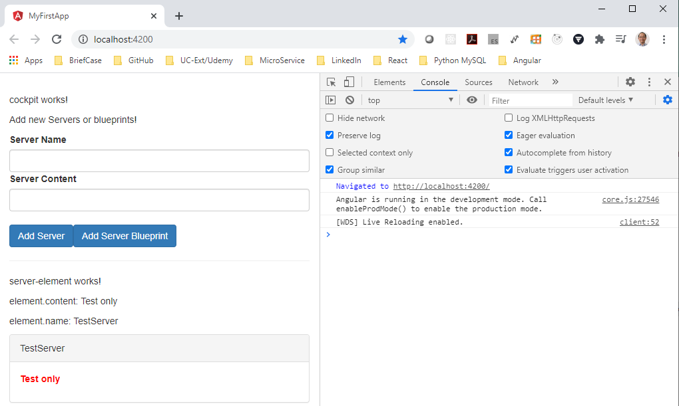
67.3 Verify
https://www.udemy.com/course/the-complete-guide-to-angular-2/learn/lecture/6767060#overview
Verify

Slide 9
End of Chapter

