Slide 1

68 Bind Event
Peter H. Chen

Slide 2
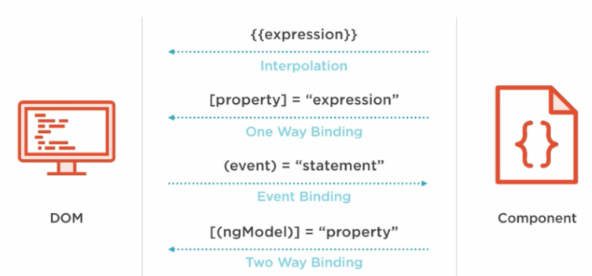
68 Bind Event
https://www.udemy.com/course/the-complete-guide-to-angular-2/learn/lecture/6656076#overview
Bind Event
We click from the child component (cockpit.component) and access the function in the parent component (app.component).
Cock: male chicken, pit: cave. Cockpit: pilot room.
HTML Elements
Directives
Components
Native Properties and Events
Custom Properties and Events
Custom Properties and Events

Slide 3
68.1 Child Component

Slide 4
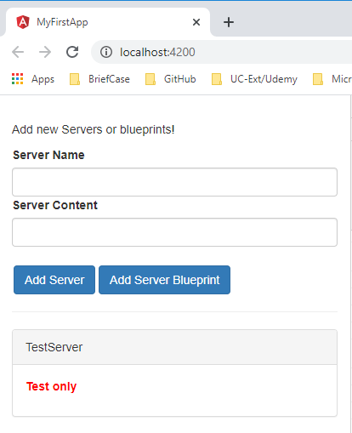
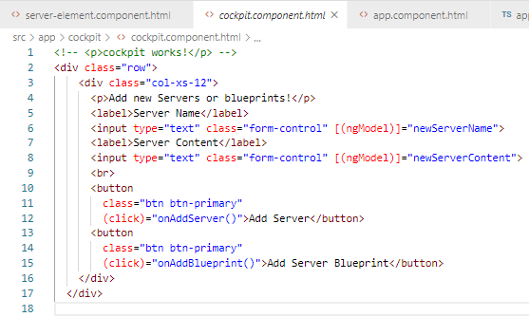
68.1 Child Component
https://www.udemy.com/course/the-complete-guide-to-angular-2/learn/lecture/6656076#overview
Child Component:
cockpit.component.html:

Slide 5
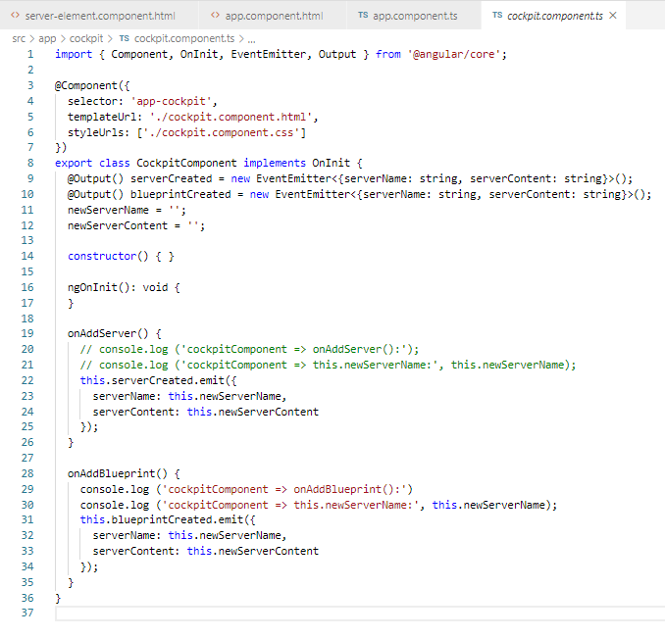
68.1 Child Component
https://www.udemy.com/course/the-complete-guide-to-angular-2/learn/lecture/6656076#overview
Child Component:
cockpit.component.ts: Emit Output data to parent

Slide 6
68.2 Parent Component

Slide 7
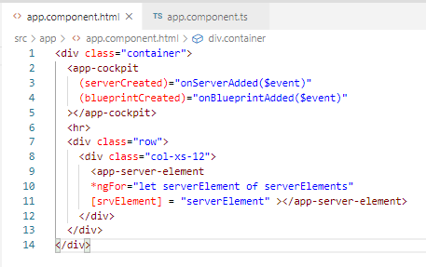
68.2 Child Component
https://www.udemy.com/course/the-complete-guide-to-angular-2/learn/lecture/6656076#overview
Code:
app.component.html: parent component get data (serverCreated) and callback onxxx ($event)

Slide 8
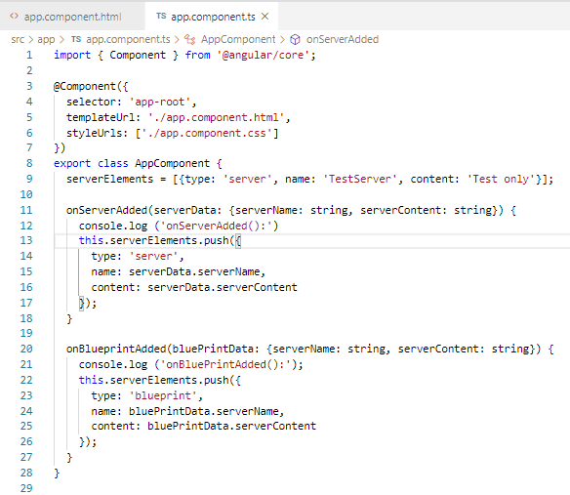
68.2 Child Component
https://www.udemy.com/course/the-complete-guide-to-angular-2/learn/lecture/6656076#overview
Code:
app.component.ts: parent component callback function.

Slide 9
68.3 Verify

Slide 10
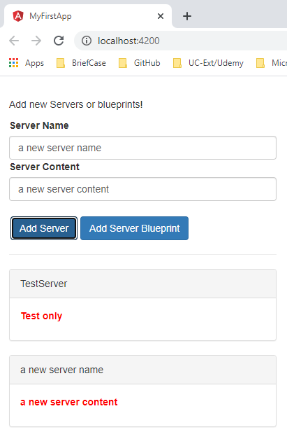
68.3 Verify
https://www.udemy.com/course/the-complete-guide-to-angular-2/learn/lecture/6656076#overview
Verify

Slide 11
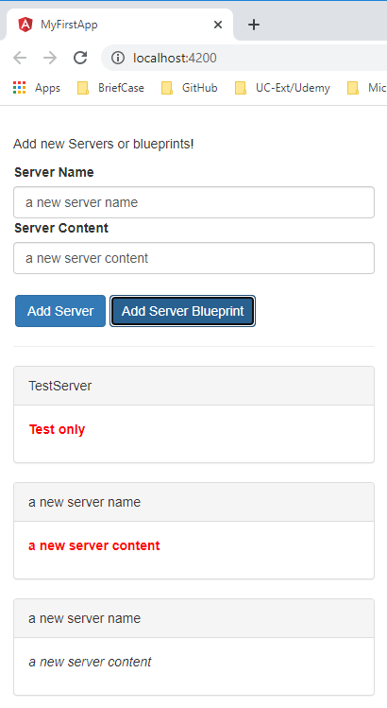
68.3 Verify
https://www.udemy.com/course/the-complete-guide-to-angular-2/learn/lecture/6656076#overview
Verify

Slide 12
End of Chapter

