Slide 1

70 Bind Property and Event Summary
Peter H. Chen

Slide 2
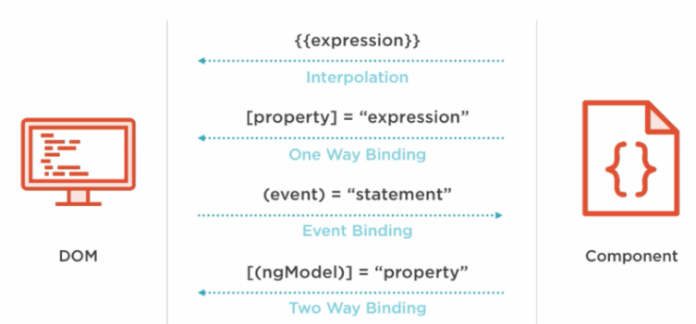
70 Bind Property and Event Summary
https://www.udemy.com/course/the-complete-guide-to-angular-2/learn/lecture/6656080#overview
Bind Alias Output Event
We can add the alias for the output.
HTML Elements
Directives
Components
Native Properties and Events
Custom Properties and Events
Custom Properties and Events

Slide 3
70.1 Child Component

Slide 4
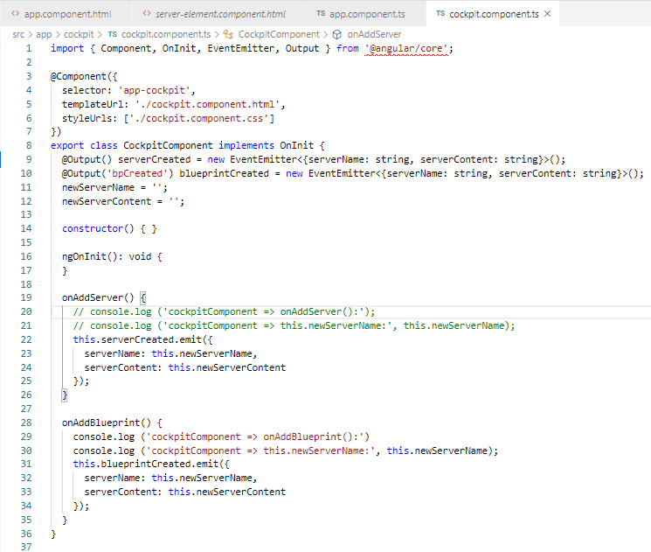
70.1 Child Component
https://www.udemy.com/course/the-complete-guide-to-angular-2/learn/lecture/6656080#overview
Child Component:
cockpit.component.ts:

Slide 5
70.2 Parent Component

Slide 6
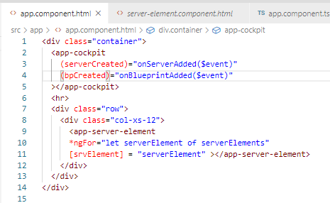
70.2 Child Component
https://www.udemy.com/course/the-complete-guide-to-angular-2/learn/lecture/6656080#overview
Code:
app.component.html: parent component get data with alias event name.

Slide 7
70.3 Verify

Slide 8
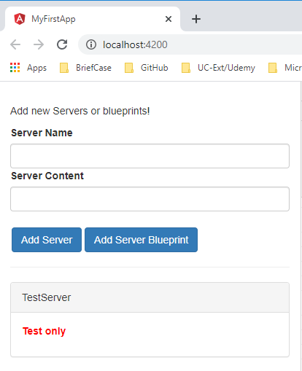
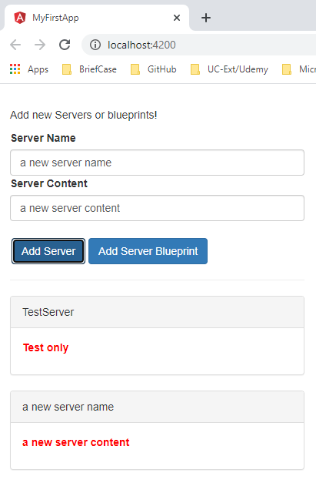
70.3 Verify
https://www.udemy.com/course/the-complete-guide-to-angular-2/learn/lecture/6656080#overview
Verify

Slide 9
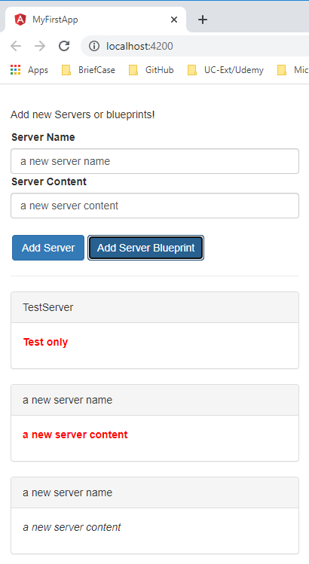
70.3 Verify
https://www.udemy.com/course/the-complete-guide-to-angular-2/learn/lecture/6656080#overview
Verify

Slide 10
End of Chapter

