Slide 1

71 View Encapsulation
Peter H. Chen

Slide 2
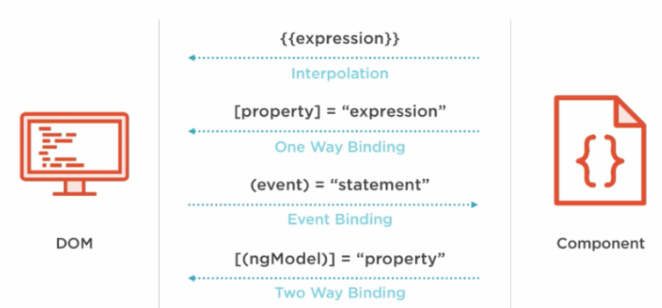
71 View Encapsulation
https://www.udemy.com/course/the-complete-guide-to-angular-2/learn/lecture/6656082#overview
View Encapsulation
Each component color is encapsulated in each CSS file.
HTML Elements
Directives
Components
Native Properties and Events
Custom Properties and Events
Custom Properties and Events

Slide 3
71.1 Add Color for Child Component

Slide 4
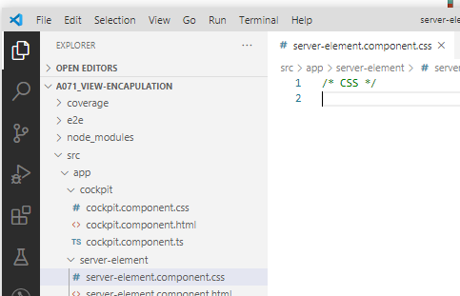
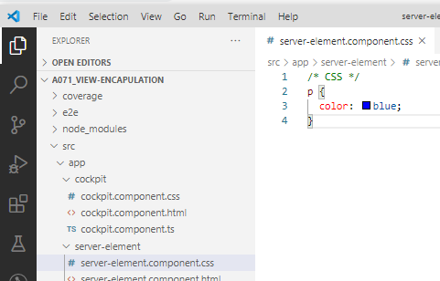
71.1 Add Color for Child Component
https://www.udemy.com/course/the-complete-guide-to-angular-2/learn/lecture/6656082#overview
View Encapsulation
Each component color is encapsulated in each CSS file.
For example, <p> element defined blue in app.component.css.
The blue color does not apply to server-element.component.css.
We define the blue color in the child server-element
server-element.components.css: add p { color: blue }

Slide 5
71.2 Verify

Slide 6
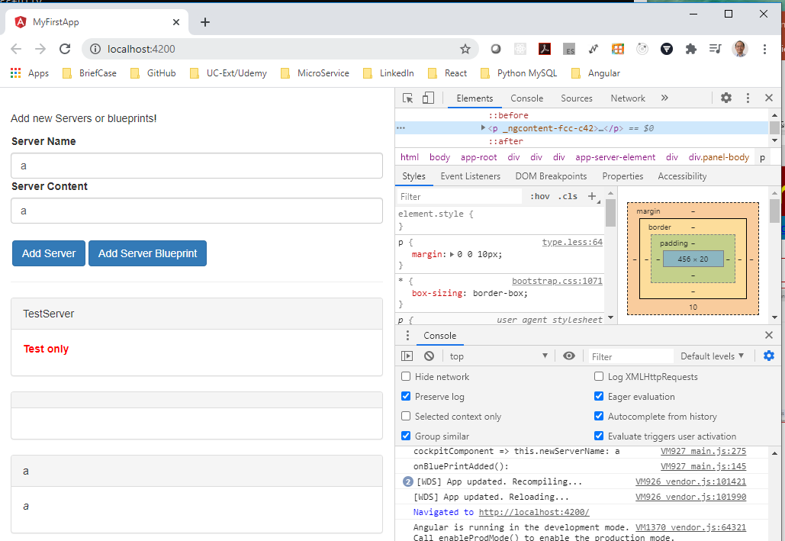
71.2 Verify
https://www.udemy.com/course/the-complete-guide-to-angular-2/learn/lecture/6656082#overview
Verify: Before add color, it was black

Slide 7
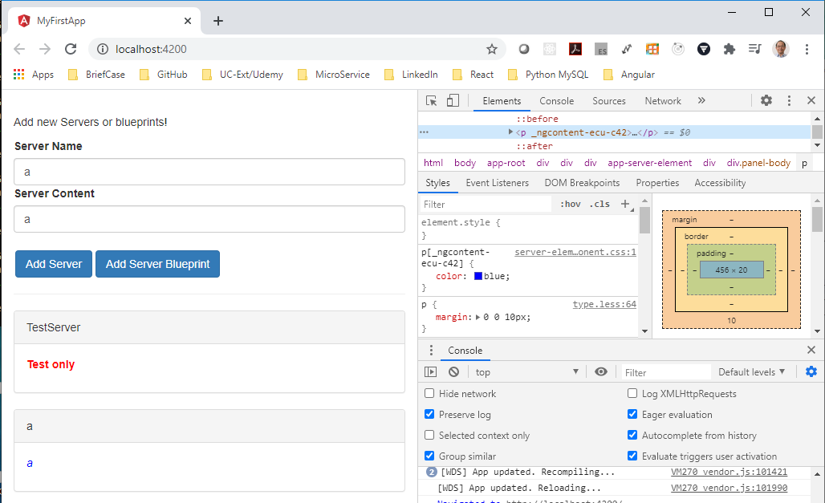
71.2 Verify
https://www.udemy.com/course/the-complete-guide-to-angular-2/learn/lecture/6656082#overview
Verify: after added, the server element change from block to blue.

Slide 8
End of Chapter

