Slide 1

71 View Encapsulation
Peter H. Chen

Slide 2
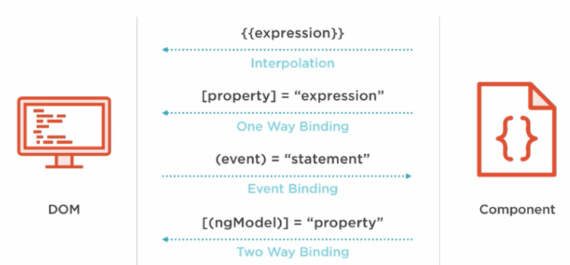
71 View Encapsulation
https://www.udemy.com/course/the-complete-guide-to-angular-2/learn/lecture/6656082#overview
More View Encapsulation
Each component color is encapsulated in attribute of component option.
HTML Elements
Directives
Components
Native Properties and Events
Custom Properties and Events
Custom Properties and Events

Slide 3
71.1 Add Color for Child Component

Slide 4
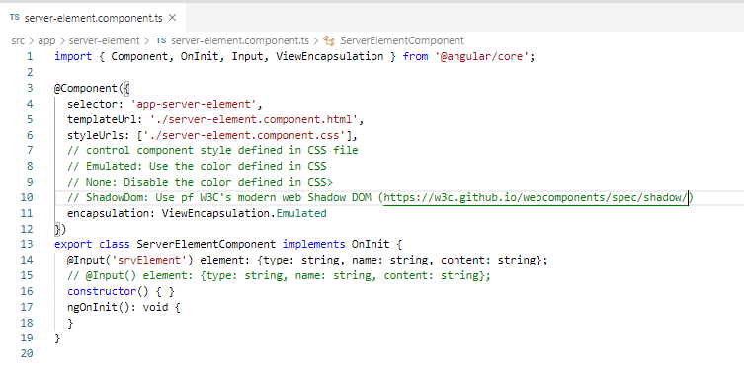
71.1 Add Color for Child Component
https://www.udemy.com/course/the-complete-guide-to-angular-2/learn/lecture/6656082#overview
View Encapsulation
You can add encapsulation attribute to define more options for encapsulation:
Emulated: Use the templated define in CSS.
None: Disable the template defined in CSS.
ShadowDom: Use W3C’s modern web specification.

Slide 5
71.2 Verify

Slide 6
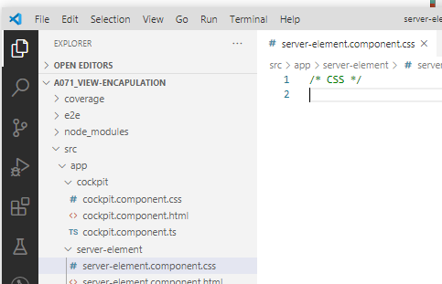
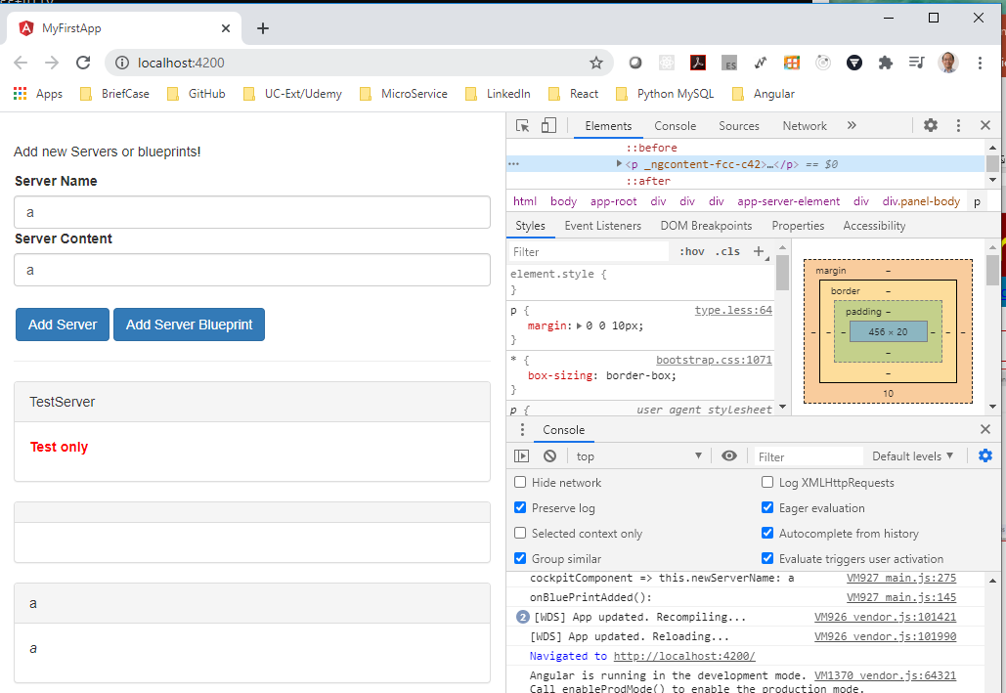
71.2 Verify
https://www.udemy.com/course/the-complete-guide-to-angular-2/learn/lecture/6656082#overview
Verify: Before add color, it was black

Slide 7
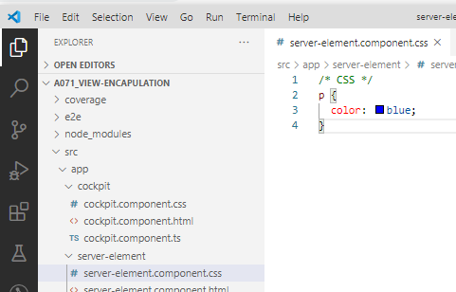
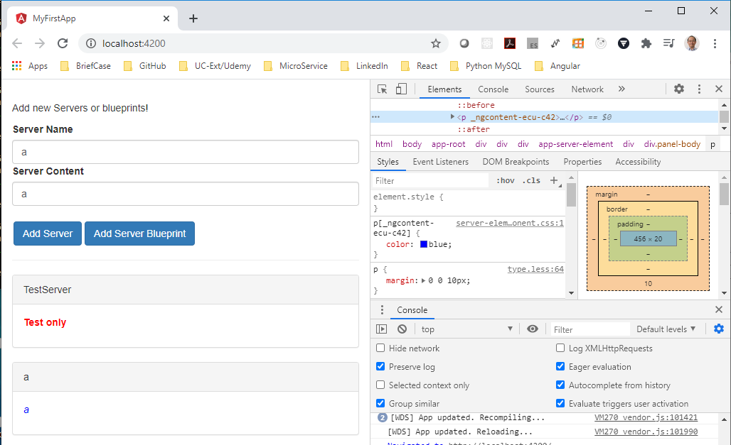
71.2 Verify
https://www.udemy.com/course/the-complete-guide-to-angular-2/learn/lecture/6656082#overview
Verify: after added, the server element change from block to blue.

Slide 8
End of Chapter

