Slide 1

78 Lifecycle Hook
Peter H. Chen

Slide 2
78 Lifecycle Hook
https://www.udemy.com/course/the-complete-guide-to-angular-2/learn/lecture/6656106#overview
Lifecycle Hook
Angular supports several lifecycle hooks.
The hooks are the methods during the execution.
ngOnChanges
Called after one of the bound input properties changes. The properties decorated with @input. Whenever the property received new values, the ngOnChanged is called.
ngOnInit
Called once the component is initialized.
ngDoCheck
Called whenever the component or property, template, event, or timer fire changes are detected. It is used for performance tune up if you disable this check.
ngAftreContentInit
Called after content (ng-content) has been projected into view.
ngAfterContentChecked
Called every time the projected content has been checked.
ngAfterViewInit
Called after the component’s view (and child views) as been initialized.
ngAfterViewChecked
Called every time the view (and child views) have been checked.
ngDestroyComponent
Called once the component is about to be destroyed.

Slide 3
78.1 Lifecycle Hook

Slide 4
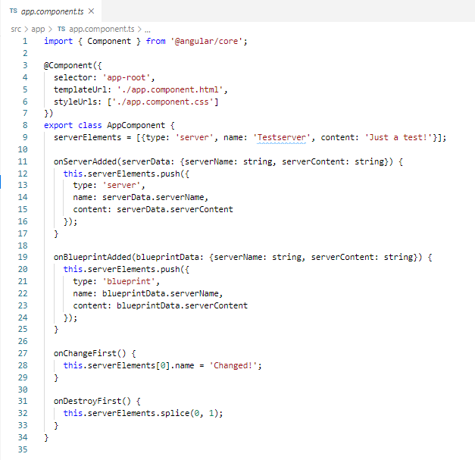
78.1 Lifecycle Hook
https://www.udemy.com/course/the-complete-guide-to-angular-2/learn/lecture/6656106#overview
Lifecycle Hook
Constructor(), ngOnInit(), onChangeFirst(), onDestroyFirst().

Slide 5
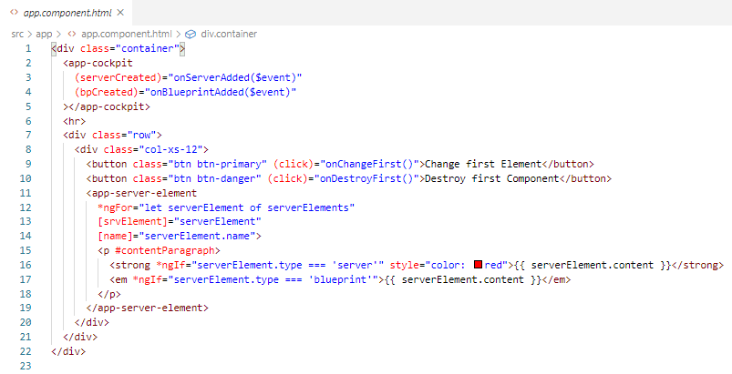
78.1 Lifecycle Hook
https://www.udemy.com/course/the-complete-guide-to-angular-2/learn/lecture/6656106#overview
Lifecycle Hook
onChangeFirst(), onDestroyFirst().

Slide 6
78.2 Verify

Slide 7
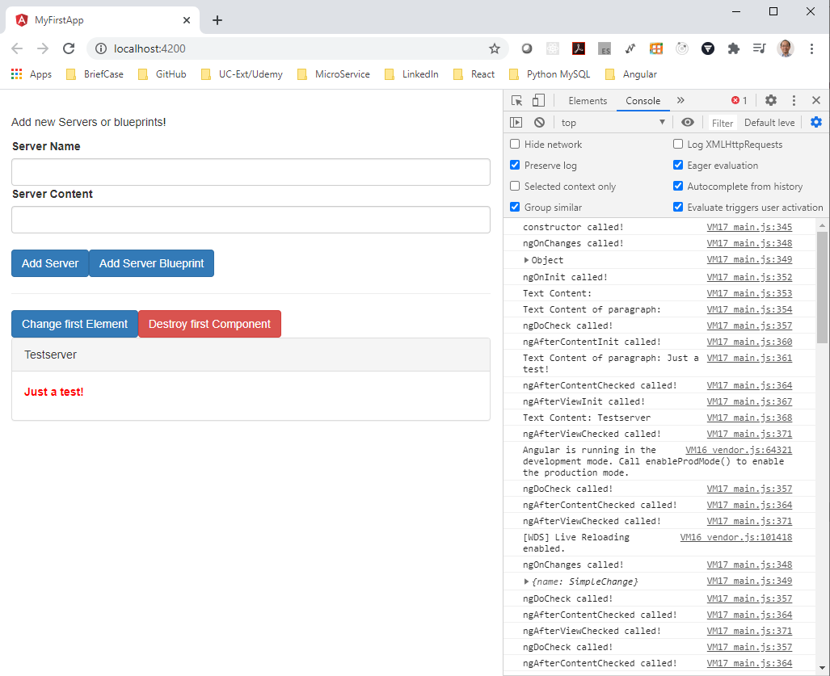
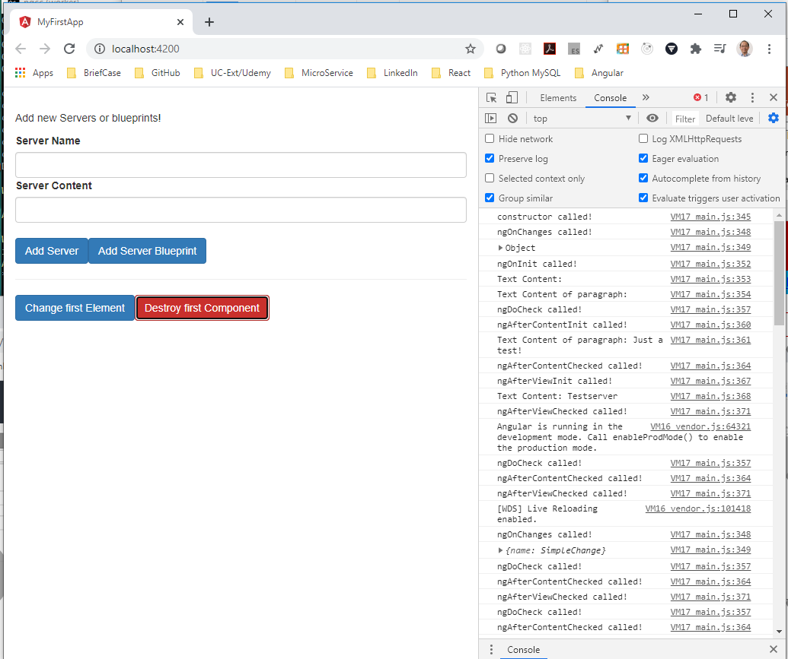
78.2 Verify
https://www.udemy.com/course/the-complete-guide-to-angular-2/learn/lecture/6656106#overview
Verify

Slide 8
End of Chapter

