Slide 1

83 Assignment 04: Bind and Encapsulation
Peter H. Chen

Slide 2
83 Assignment 04: Bind and Encapsulation
https://www.udemy.com/course/the-complete-guide-to-angular-2/learn/lecture/6656106#overview
Assignment 04: Property Bind, Event Bind, and Encapsulation
Bind it!
Create three new components: GameControl, Odd and Even
The GameControl Component should have buttons to start and stop the game
When starting the game, an event (holding a incrementing number) should get emitted each second (ref = setInterval())
The event should be listenable from outside the component
When stopping the game, no more events should get emitted (clearInterval(ref))
A new Odd component should get created for every odd number emitted, the same should happen for the Even Component (on even numbers)
Simply output Odd - NUMBER or Even - NUMBER in the two components
Style the element (e.g. paragraph) holding your output text differently in both components

Slide 3
83.1 Create New Components

Slide 4
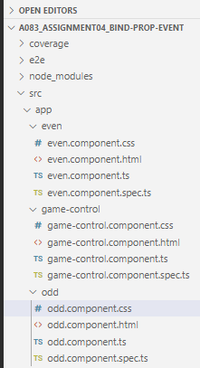
83.1 Create New Components
https://www.udemy.com/course/the-complete-guide-to-angular-2/learn/lecture/6656106#overview
Create New Components: game-control, odd, and even
> ng gc c game-control
> ng g c odd
> ng g c even

Slide 5
83.2 Create Add and Even Buttons

Slide 6
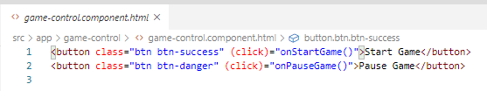
83.2 Create Add and Even Buttons
https://www.udemy.com/course/the-complete-guide-to-angular-2/learn/lecture/6656106#overview
Add Start Game and Pause Game
In game-control.component.ts, add buttons

Slide 7
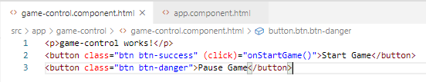
83.2 Create Add and Even Buttons
https://www.udemy.com/course/the-complete-guide-to-angular-2/learn/lecture/6656106#overview
Add Start Game and Pause Game
In game-control.component.html, add (click)=“onStartGame()”

Slide 8
83.3 Emit Event at Each Interval

Slide 9
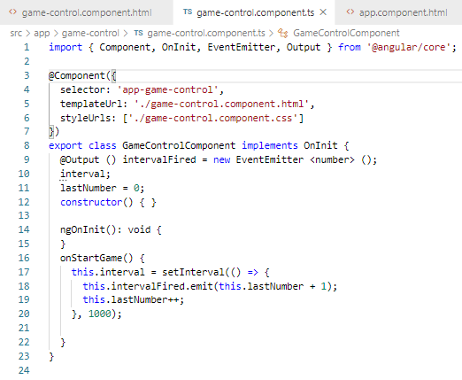
83.3 Emit Event at Each Interval
https://www.udemy.com/course/the-complete-guide-to-angular-2/learn/lecture/6656106#overview
Emit Event at Each Interval

Slide 10
83.4 Output Event to Outside

Slide 11
83.4 Output Event to Outside
https://www.udemy.com/course/the-complete-guide-to-angular-2/learn/lecture/6656106#overview
Output Event to Outside

Slide 12
83.5 Stop and Clear Event

Slide 13
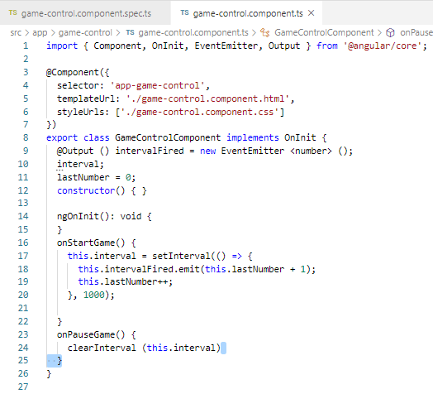
83.5 Stop and Clear Event
https://www.udemy.com/course/the-complete-guide-to-angular-2/learn/lecture/6656106#overview
Bind and Encapsulation
Add onPauseGame() { clearInterval() }

Slide 14
83.5 Create Event

Slide 15
83.5 Create Event
https://www.udemy.com/course/the-complete-guide-to-angular-2/learn/lecture/6656106#overview
Create Event

Slide 16
83.6 Loop Odd and Even Array

Slide 17
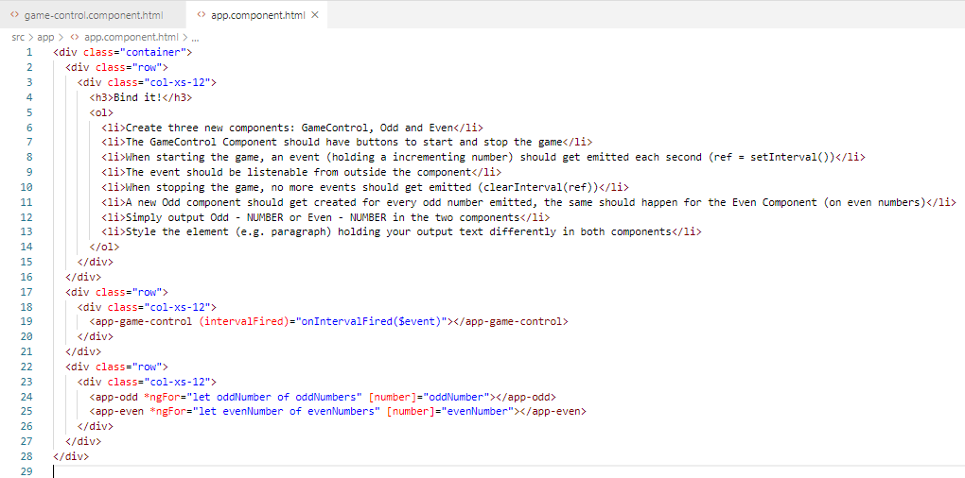
83.6 Loop Odd and Even Array
https://www.udemy.com/course/the-complete-guide-to-angular-2/learn/lecture/6656106#overview
Loop for Odd and Even Array
In app.component.html, add <app-game-control>

Slide 18
83.7 Display Log Information

Slide 19
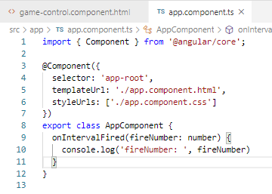
83.7 Display Log Information
https://www.udemy.com/course/the-complete-guide-to-angular-2/learn/lecture/6656106#overview
Display Log Information
Parent app.component pass to child game-control parameter IntervalFired.

Slide 20
83.8 Verify

Slide 21
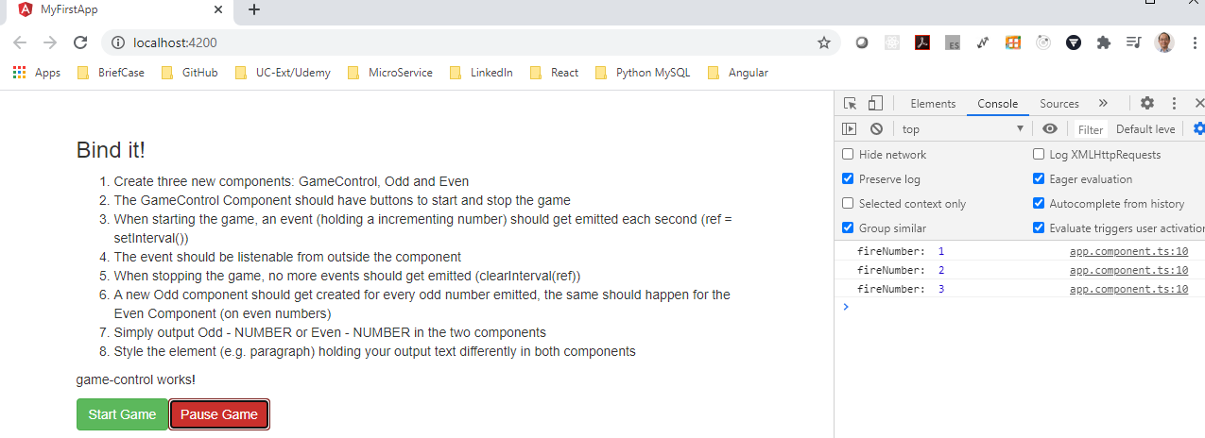
83.8 Verify
https://www.udemy.com/course/the-complete-guide-to-angular-2/learn/lecture/6656106#overview
Verify: We can start and pause the timer.

Slide 22
83.9 Display Odd Number

Slide 23
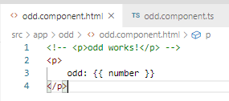
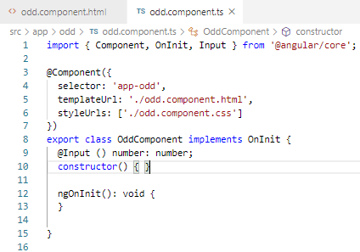
83.3 Display Odd Number
https://www.udemy.com/course/the-complete-guide-to-angular-2/learn/lecture/6656106#overview
Display Number from Outside component.
In odd.component, pass in the number form parent component.

Slide 24
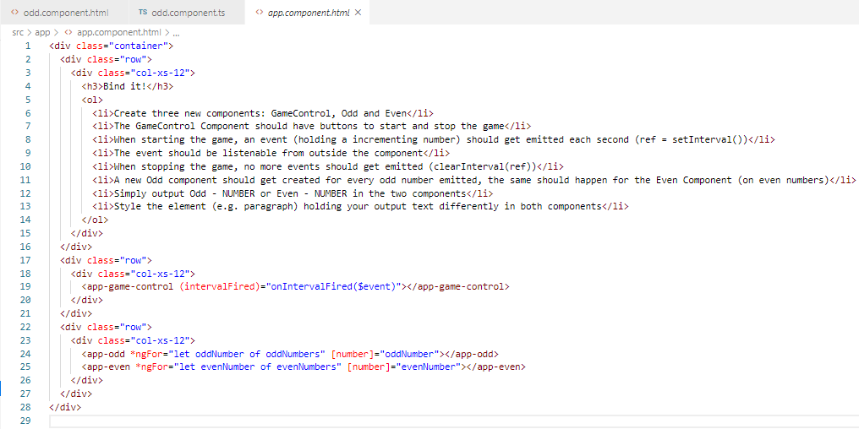
83.9 Display Odd Number
https://www.udemy.com/course/the-complete-guide-to-angular-2/learn/lecture/6656106#overview
Display Number from Outside component.
In parent app.component, pass the [number] to child odd.component.

Slide 25
83.10 Verify Display Odd Number

Slide 26
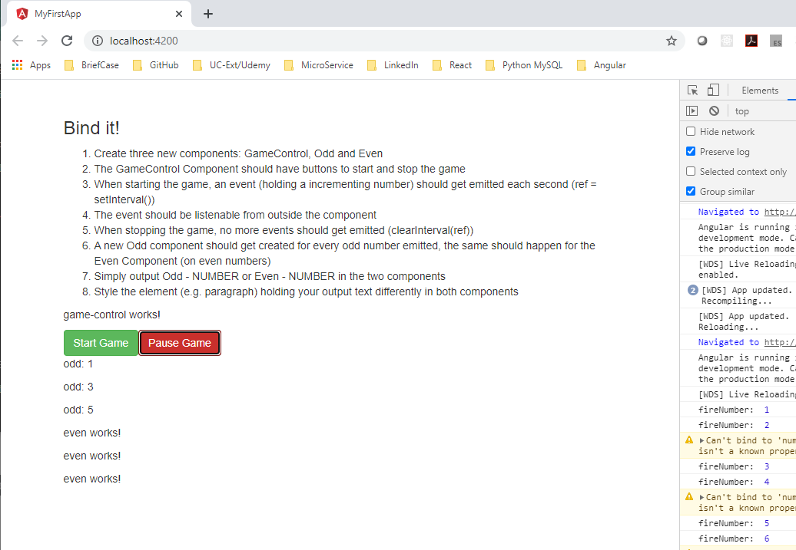
83.10 Verify Display Odd Number
https://www.udemy.com/course/the-complete-guide-to-angular-2/learn/lecture/6656106#overview
Verify Display Odd Number from Outside component.

Slide 27
83.11 Display Even Number

Slide 28

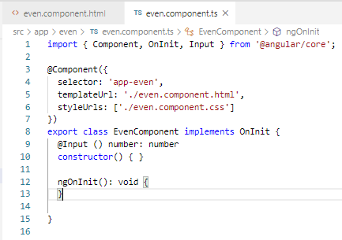
83.11 Display Even Number
https://www.udemy.com/course/the-complete-guide-to-angular-2/learn/lecture/6656106#overview
Display Number from Outside component.
In even.component, pass in the number form parent component.

Slide 29
83.11 Display Odd Number
https://www.udemy.com/course/the-complete-guide-to-angular-2/learn/lecture/6656106#overview
Display Number from Outside component.
In parent app.component, pass the [number] to child odd.component.

Slide 30
83.12 Verify Display Even Number

Slide 31
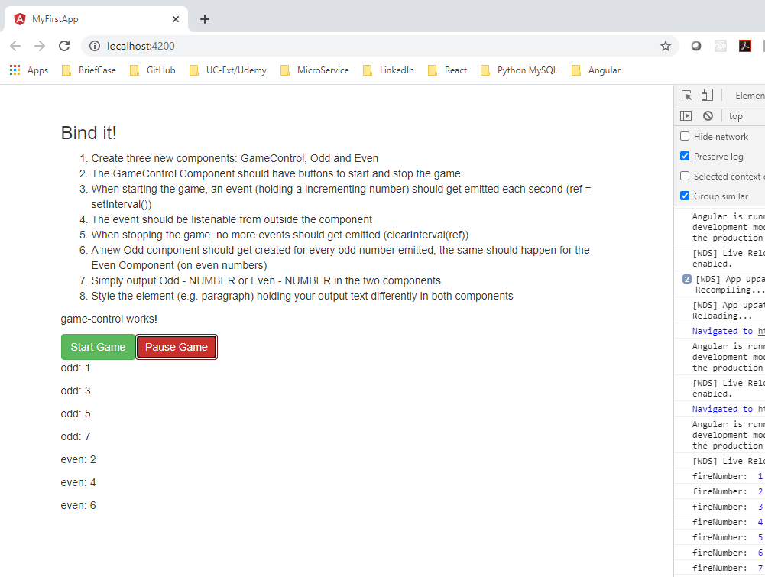
83.12 Verify Display Odd Number
https://www.udemy.com/course/the-complete-guide-to-angular-2/learn/lecture/6656106#overview
Verify Display even Number from Outside component.

Slide 32
83.13 Change Style Color

Slide 33
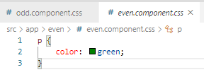

83.13 Change Style Color
https://www.udemy.com/course/the-complete-guide-to-angular-2/learn/lecture/6656106#overview
For even.component.css, we add green.
For odd.component.css, we add blue.

Slide 34
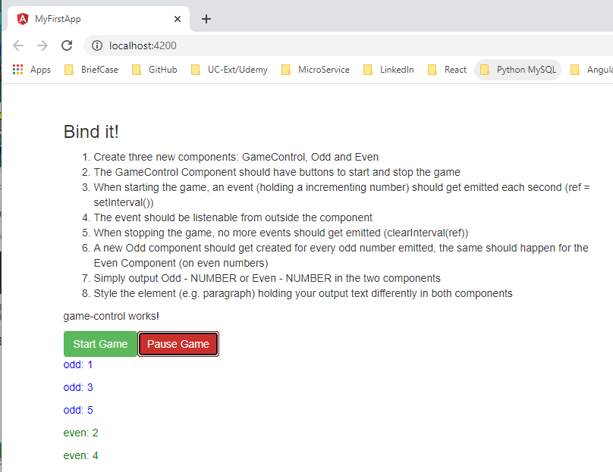
83.13 Verify Display Color
https://www.udemy.com/course/the-complete-guide-to-angular-2/learn/lecture/6656106#overview
Verify Display Color.

Slide 35
End of Chapter

