Slide 1

115 Introduction
Peter H. Chen

Slide 2
115 Introduction
https://www.udemy.com/course/the-complete-guide-to-angular-2/learn/lecture/6656232#overview
Introduction
We add the service to our project.
Which services do we need?
Services allow us to centralize tasks, manage data in a central place and etc.

Slide 3
115 Introduction
https://www.udemy.com/course/the-complete-guide-to-angular-2/learn/lecture/6656232#overview
Adding Services: We will add “Shopping List Service” and “Recipe Service” in our application to manage the database.
Root
Header
Shopping List
Recipe Book
Shopping List Service
Recipe
Service
Shopping List
Recipe List
Shopping List Item
Recipe Item
Ingredient
Recipe Details
Recipe
Model
Component
Feature

Slide 4
115.1 Verify

Slide 5
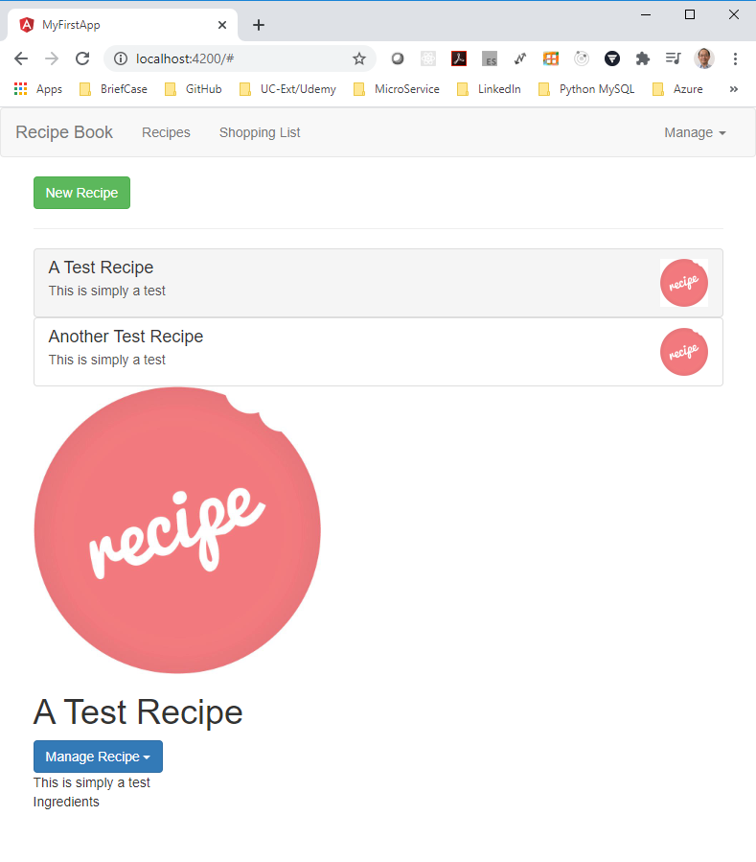
115.1 Verify
https://www.udemy.com/course/the-complete-guide-to-angular-2/learn/lecture/6656232#overview
Verify

Slide 6
End of Chapter

