Slide 1

116 Setup Service
Peter H. Chen

Slide 2
116 Introduction
https://www.udemy.com/course/the-complete-guide-to-angular-2/learn/lecture/6656234#overview
Setup Service
Root
Header
Shopping List
Recipe Book
Shopping List Service
Recipe
Service
Shopping List
Recipe List
Shopping List Item
Recipe Item
Ingredient
Recipe Details
Recipe
Model
Component
Feature

Slide 3
116.1 Code

Slide 4
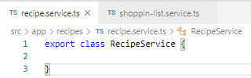
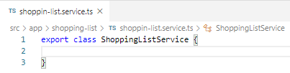
116.1 Code
https://www.udemy.com/course/the-complete-guide-to-angular-2/learn/lecture/6656234#overview
Code
In recipes folder, create recipe.service.ts.
Remember, service is a type of class. We do not need any special decorator to it if you do not plan on injecting a service into the service.
In the shopping-list folder, create shopping-list.service.ts.
These are two service files.

Slide 5
116.2 Verify

Slide 6
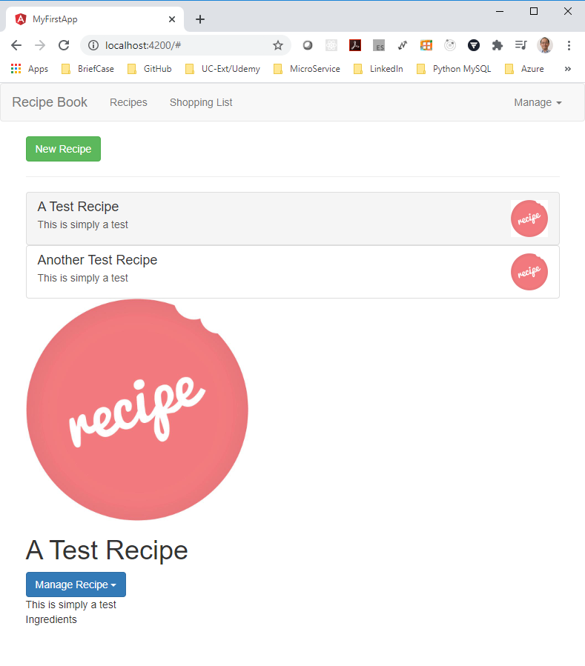
116.2 Verify
https://www.udemy.com/course/the-complete-guide-to-angular-2/learn/lecture/6656234#overview
Verify

Slide 7
End of Chapter

