Slide 1

117 Manage Recipe Service
Peter H. Chen

Slide 2
117 Manage Recipe Service
https://www.udemy.com/course/the-complete-guide-to-angular-2/learn/lecture/6656236#overview
Manage Recipe Service
Root
Header
Shopping List
Recipe Book
Shopping List Service
Recipe
Service
Shopping List
Recipe List
Shopping List Item
Recipe Item
Ingredient
Recipe Details
Recipe
Model
Component
Feature

Slide 3
117.1 Code

Slide 4
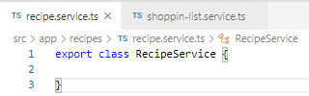
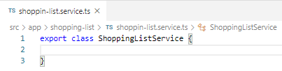
117.1 Code
https://www.udemy.com/course/the-complete-guide-to-angular-2/learn/lecture/6656236#overview
Code
In recipes folder, create recipe.service.ts.
Remember, service is a type of class. We do not need any special decorator to it if you do not plan on injecting a service into the service.
In the shopping-list folder, create shopping-list.service.ts.
These are two service files.

Slide 5
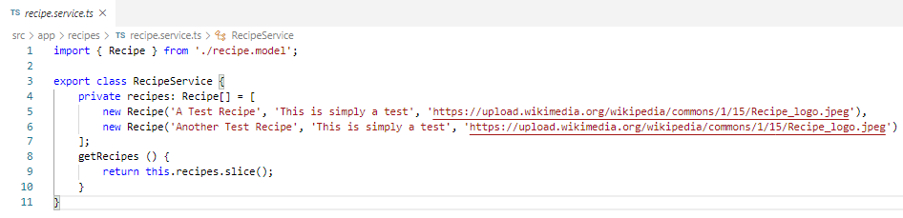
117.1 Code
https://www.udemy.com/course/the-complete-guide-to-angular-2/learn/lecture/6656236#overview
Code
In the recipe.service.ts, we add the data array.

Slide 6
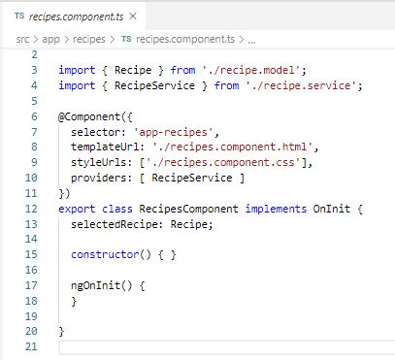
117.1 Code
https://www.udemy.com/course/the-complete-guide-to-angular-2/learn/lecture/6656236#overview
Code
In the recipe.component.ts, we add the providers: [ RecipeService].
Recipe Component
recipes
Recipe Service

Slide 7
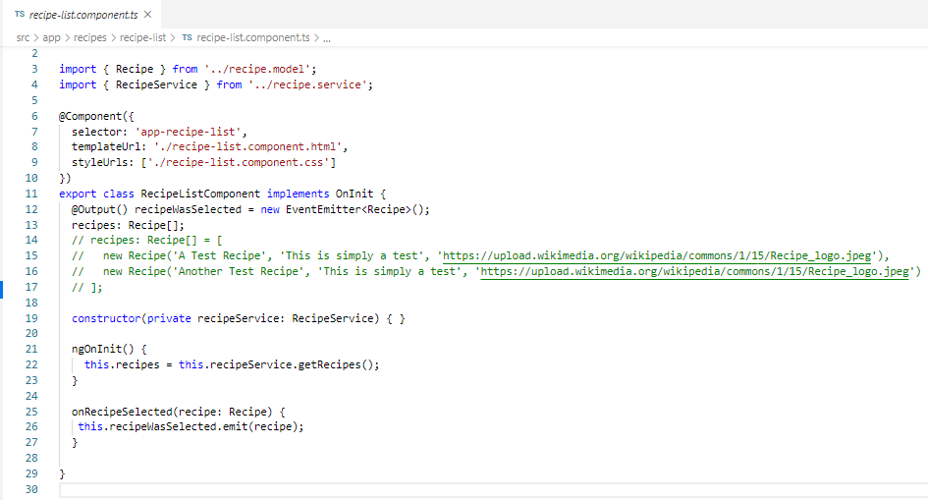
117.1 Code
https://www.udemy.com/course/the-complete-guide-to-angular-2/learn/lecture/6656236#overview
Code
In the recipe-list.component.ts, we get the data from recipe service
Recipe Component
recipes
recipes
Recipe Service
Recipe-list Component

Slide 8
117.2 Verify

Slide 9
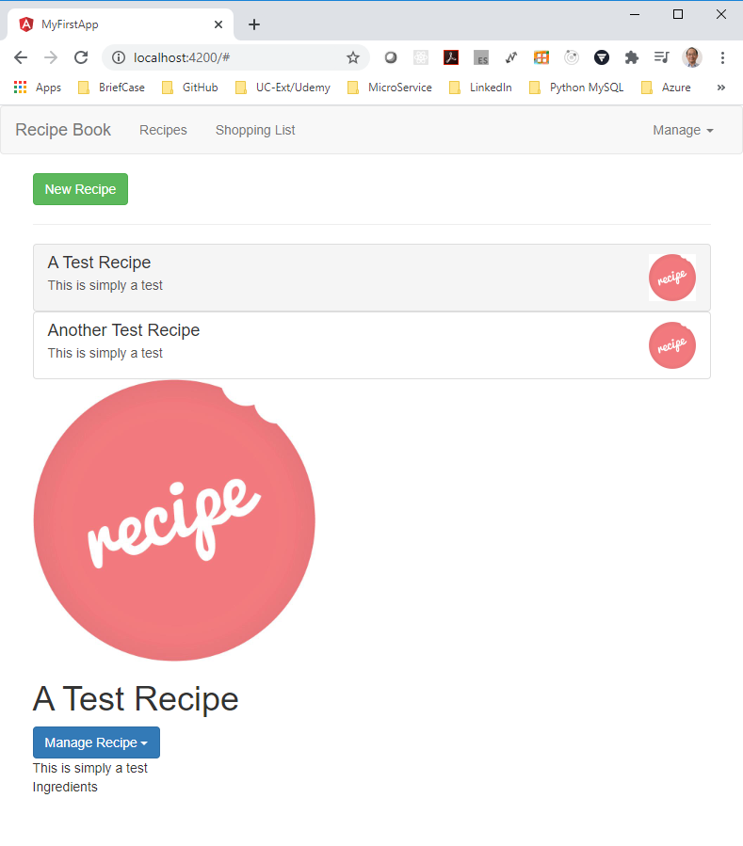
117.2 Verify
https://www.udemy.com/course/the-complete-guide-to-angular-2/learn/lecture/6656236#overview
Verify:
In the recipe component, recipes Data passed from recipe service to recipe-list component.
Result is same as before.

Slide 10
End of Chapter

