Slide 1

118 Cross Component Communication
Peter H. Chen

Slide 2
118 Cross Component Communication
https://www.udemy.com/course/the-complete-guide-to-angular-2/learn/lecture/6656238#overview
Manage Recipe Service
Root
Header
Shopping List
Recipe Book
Shopping List Service
Recipe
Service
Shopping List
Recipe List
Shopping List Item
Recipe Item
Ingredient
Recipe Details
Recipe
Model
Component
Feature

Slide 3
118.1 Code

Slide 4
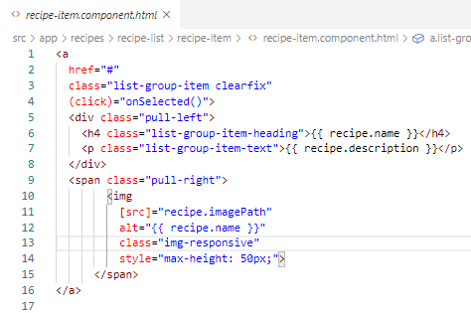
118.1 Code
https://www.udemy.com/course/the-complete-guide-to-angular-2/learn/lecture/6656238#overview
Code
In recipe-item.component.html, there is (click)=“onSelected()” and display recipe data.
Recipe Service
event
recipe-item

Slide 5
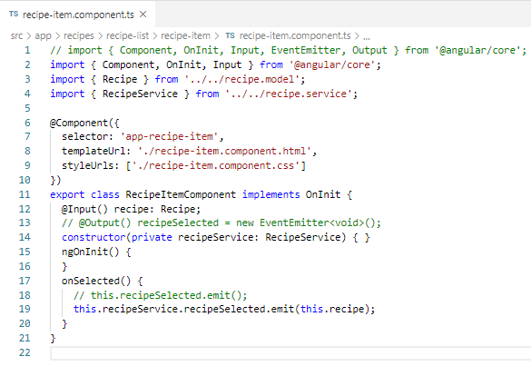
118.1 Code
https://www.udemy.com/course/the-complete-guide-to-angular-2/learn/lecture/6656238#overview
Code
In recipe-item.component.ts, we emit the selected recipe.
Recipe Service
event
recipe-item

Slide 6
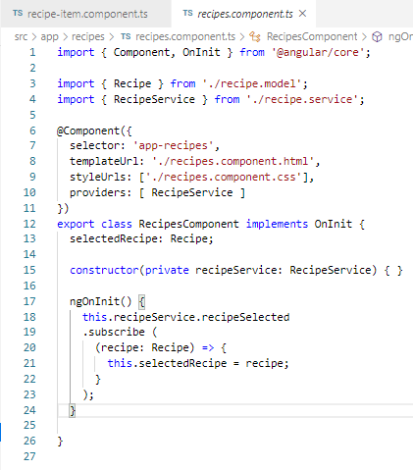
118.1 Code
https://www.udemy.com/course/the-complete-guide-to-angular-2/learn/lecture/6656238#overview
Code
In recipes.component.html, there is a recipe data communication between recipe-list component and recipe-detail component.
recipes
recipes
Recipe Service

Slide 7
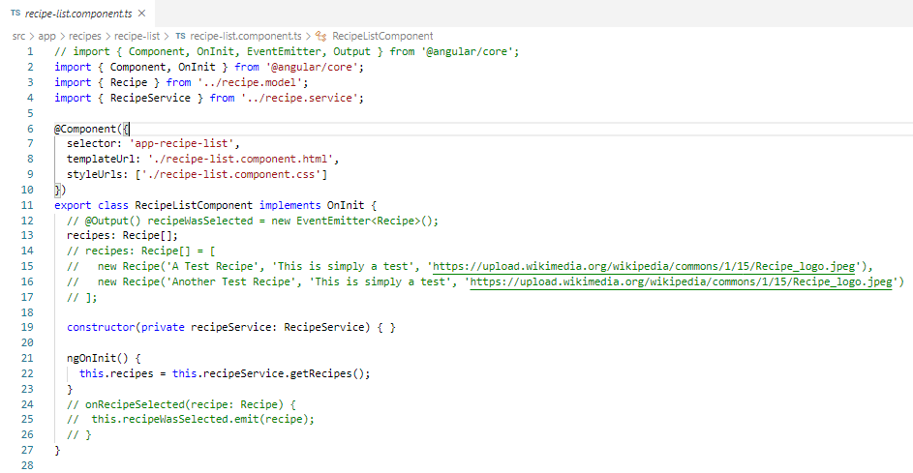
118.1 Code
https://www.udemy.com/course/the-complete-guide-to-angular-2/learn/lecture/6656238#overview
Code
In recipe-list component, we get data from recipe service component.
recipes
recipes
Recipe Service
Recipe list

Slide 8
118.2 Verify

Slide 9
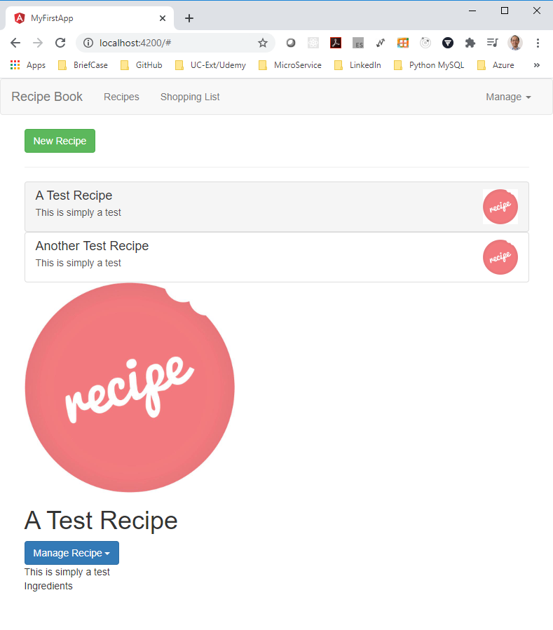
118.2 Verify
https://www.udemy.com/course/the-complete-guide-to-angular-2/learn/lecture/6656238#overview
Verify:
The data passed with subscribe().

Slide 10
End of Chapter

