Slide 1

119 Shopping List Service
Peter H. Chen

Slide 2
119 Shopping List Service
https://www.udemy.com/course/the-complete-guide-to-angular-2/learn/lecture/6656238#overview
Shopping List Service
Root
Header
Shopping List
Recipe Book
Shopping List Service
Recipe
Service
Shopping List
Recipe List
Shopping List Item
Recipe Item
Ingredient
Recipe Details
Recipe
Model
Component
Feature

Slide 3
119.1 Code

Slide 4
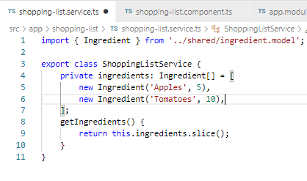
119.1 Code
https://www.udemy.com/course/the-complete-guide-to-angular-2/learn/lecture/6656238#overview
Code
In shopping-list.service.ts, add class ShoppingListService {}.

Slide 5
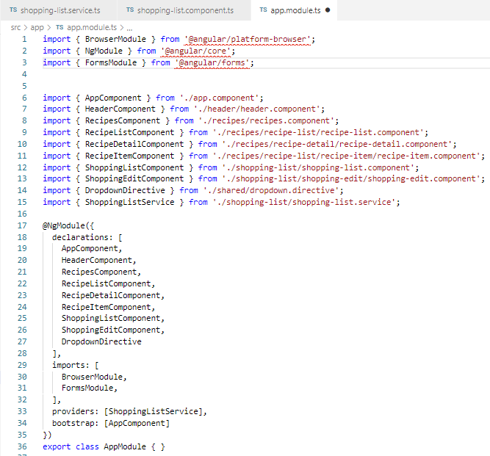
119.1 Code
https://www.udemy.com/course/the-complete-guide-to-angular-2/learn/lecture/6656238#overview
Code
In app.module.ts, add providers: [ ShoppingListService]

Slide 6
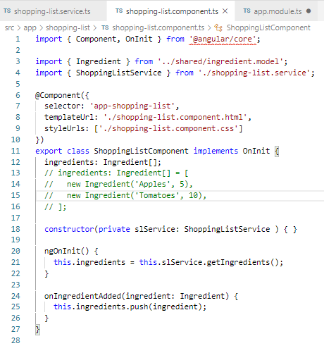
119.1 Code
https://www.udemy.com/course/the-complete-guide-to-angular-2/learn/lecture/6656238#overview
Code
In shopping-list.component.ts, add get data for ingredients.

Slide 7
119.2 Verify

Slide 8
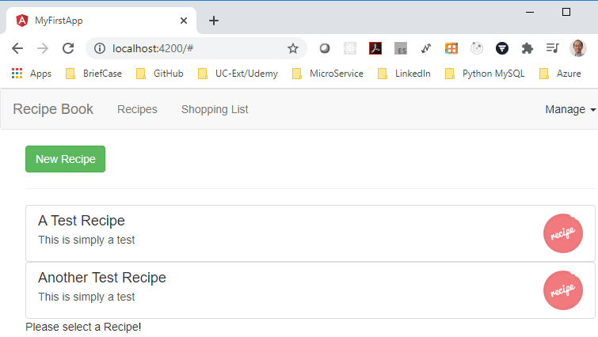
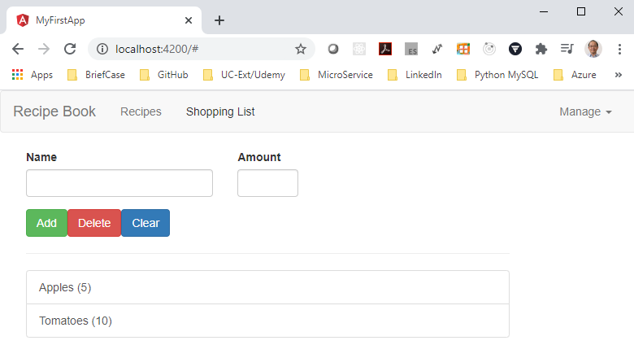
119.2 Verify
https://www.udemy.com/course/the-complete-guide-to-angular-2/learn/lecture/6656238#overview
Verify:
Click “Shopping List”

Slide 9
119.3 Code

Slide 10
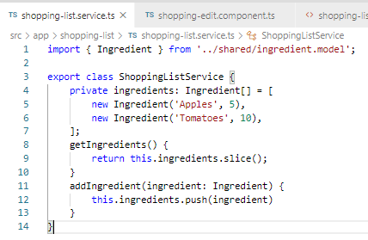
119.3 Code
https://www.udemy.com/course/the-complete-guide-to-angular-2/learn/lecture/6656238#overview
Code
In shopping-list.service.ts, add addIngredient (ingredient).

Slide 11
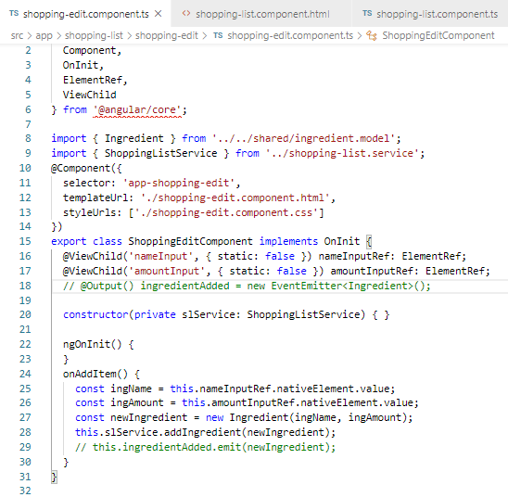
119.3 Code
https://www.udemy.com/course/the-complete-guide-to-angular-2/learn/lecture/6656238#overview
Code
In shopping-list.component.ts, add call addIngrenents().

Slide 12
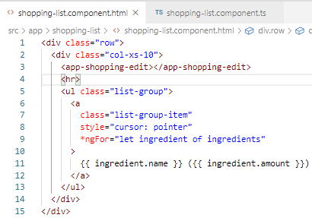
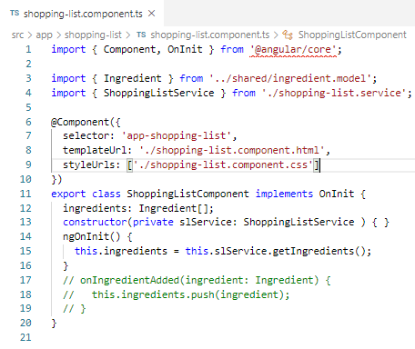
119.3 Code
https://www.udemy.com/course/the-complete-guide-to-angular-2/learn/lecture/6656238#overview
Code
In shopping-list.component, remove the onIngredentAdded call.

Slide 13
119.4 Verify

Slide 14
119.4 Verify
https://www.udemy.com/course/the-complete-guide-to-angular-2/learn/lecture/6656238#overview
Verify:

Slide 15
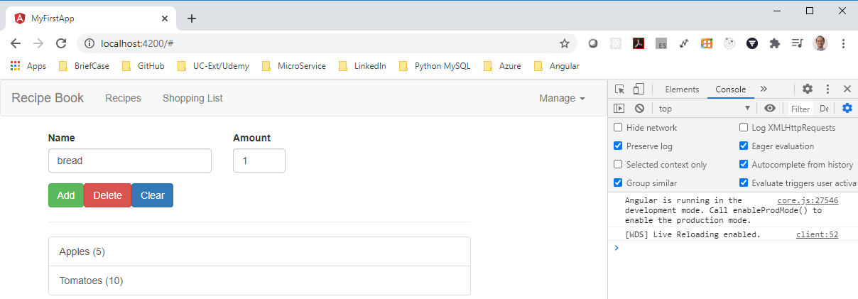
119.4 Verify
https://www.udemy.com/course/the-complete-guide-to-angular-2/learn/lecture/6656238#overview
Verify:
Add “bread” with amount 1.
There is no error and no response. Why? Will be fixed next in next discussion.

Slide 16
119.5 Summary

Slide 17
119.5 Summary
https://www.udemy.com/course/the-complete-guide-to-angular-2/learn/lecture/6656238#overview
Summary
We added Recipe under recipe component with subscribe
We added shopping-list service under app component.

Slide 18
End of Chapter

