Slide 1

120 Push Data from A to B
Peter H. Chen

Slide 2
120 Push Data from A to B
https://www.udemy.com/course/the-complete-guide-to-angular-2/learn/lecture/6656242#overview
Shopping List Service
Root
Header
Shopping List
Recipe Book
Shopping List Service
Recipe
Service
Shopping List
Recipe List
Shopping List Item
Recipe Item
Ingredient
Recipe Details
Recipe
Model
Component
Feature

Slide 3
120.1 Code

Slide 4
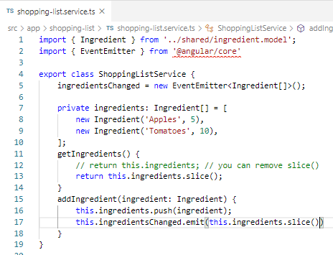
120.1 Code
https://www.udemy.com/course/the-complete-guide-to-angular-2/learn/lecture/6656242#overview
Code
The second way to fix the shallow copy.
Emit the change of shallow copy().

Slide 5
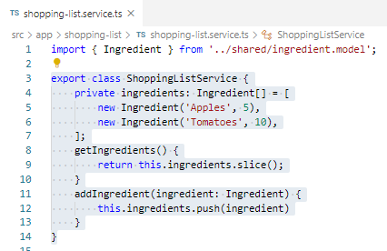
120.1 Code
https://www.udemy.com/course/the-complete-guide-to-angular-2/learn/lecture/6656242#overview
Code
In shopping-list.service.ts, the slice() make a shallow copy to the new reference address. When we push, it push the original address. The html will not update since no data changed.
How do we fix this problem?
First way, you can remove the slice(). Just return the original array.
We will fix it with second way.

Slide 6
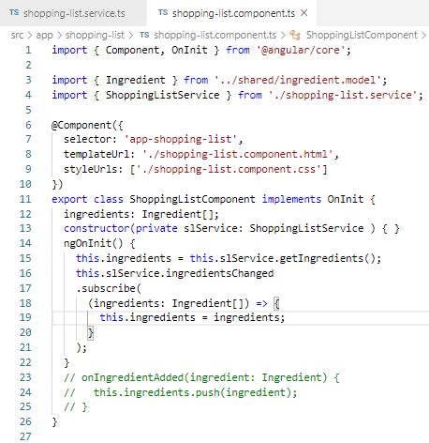
120.1 Code
https://www.udemy.com/course/the-complete-guide-to-angular-2/learn/lecture/6656242#overview
Code
In shopping-list component, we need to subscribe.

Slide 7
120.2 Verify

Slide 8
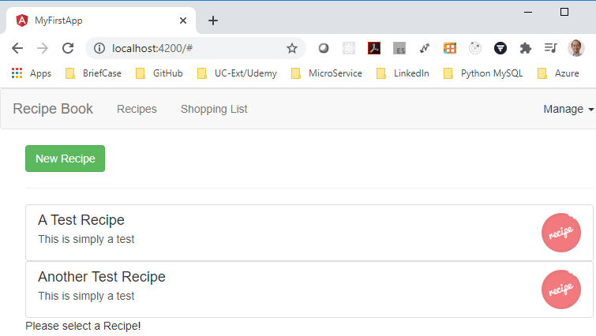
120.2 Verify
https://www.udemy.com/course/the-complete-guide-to-angular-2/learn/lecture/6656242#overview
Verify:
Click “Shopping List”

Slide 9
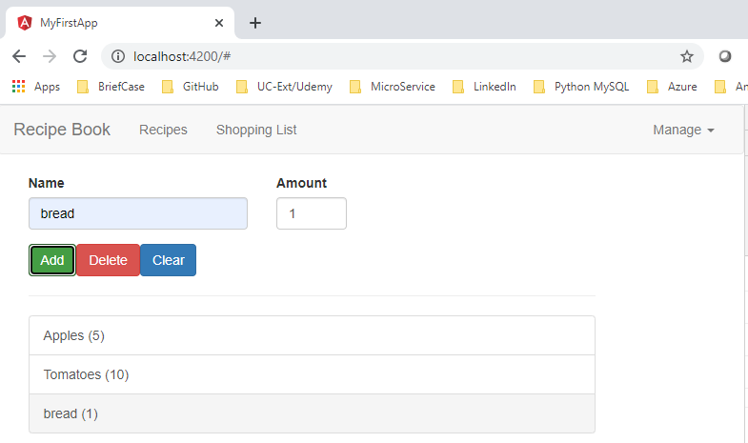
120.2 Verify
https://www.udemy.com/course/the-complete-guide-to-angular-2/learn/lecture/6656242#overview
Verify:
Add “bread” amount 1.

Slide 10
End of Chapter

