Slide 1

121 Ingredient to Recipe
Peter H. Chen

Slide 2
121 Ingredient to Recipe
https://www.udemy.com/course/the-complete-guide-to-angular-2/learn/lecture/6656244#overview
Shopping List Service
Root
Header
Shopping List
Recipe Book
Shopping List Service
Recipe
Service
Shopping List
Recipe List
Shopping List Item
Recipe Item
Ingredient
Recipe Details
Recipe
Model
Component
Feature

Slide 3
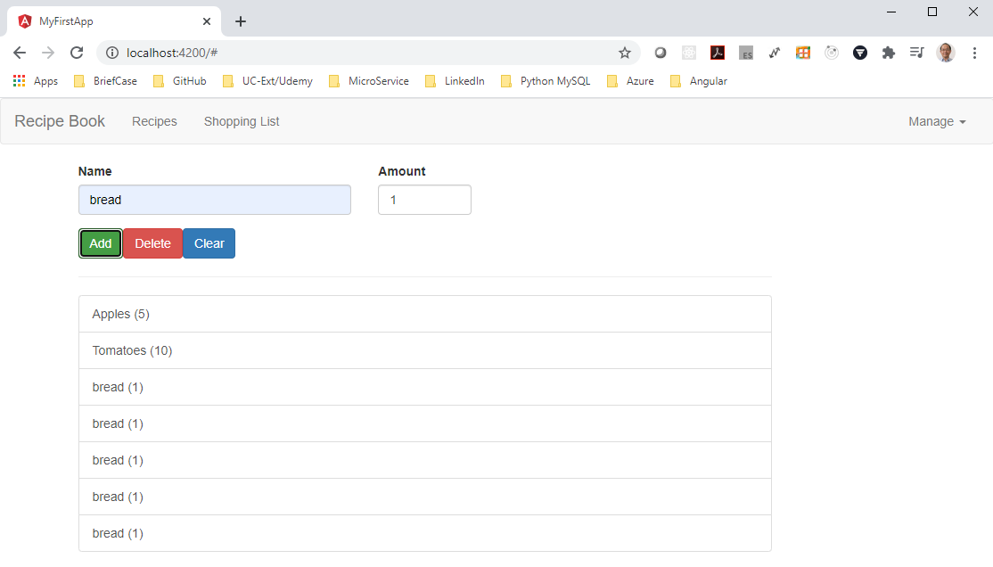
121 Ingredient to Recipe
https://www.udemy.com/course/the-complete-guide-to-angular-2/learn/lecture/6656244#overview
Ingredient to Recipe

Slide 4
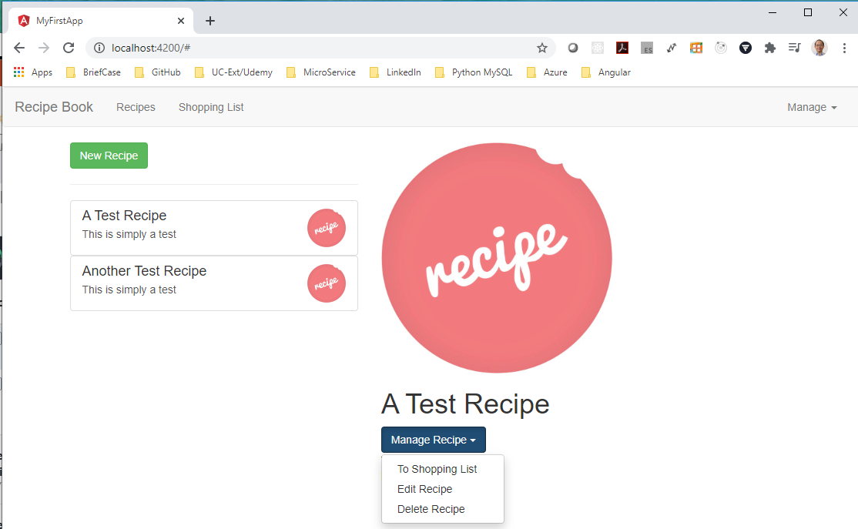
121 Ingredient to Recipe
https://www.udemy.com/course/the-complete-guide-to-angular-2/learn/lecture/6656244#overview
Ingredient to Recipe

Slide 5
121.1 Code

Slide 6
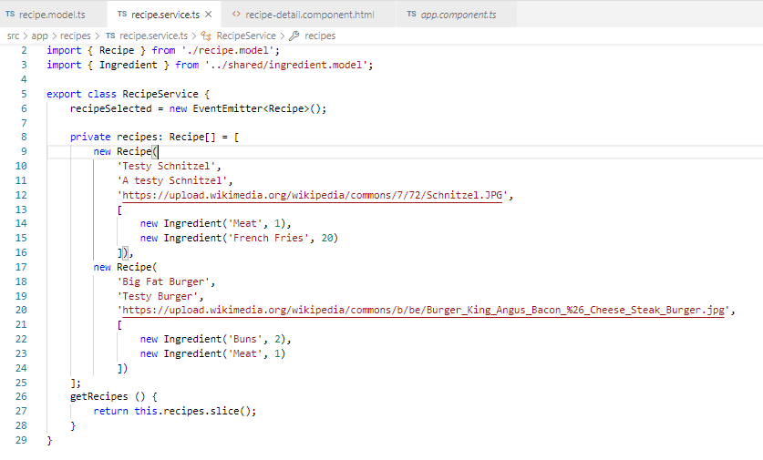
121.1 Code
https://www.udemy.com/course/the-complete-guide-to-angular-2/learn/lecture/6656244#overview
Code
Recipe.service.ts

Slide 7
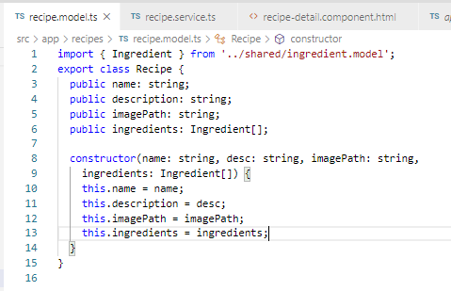
121.1 Code
https://www.udemy.com/course/the-complete-guide-to-angular-2/learn/lecture/6656244#overview
Code
Recipe.model.ts

Slide 8
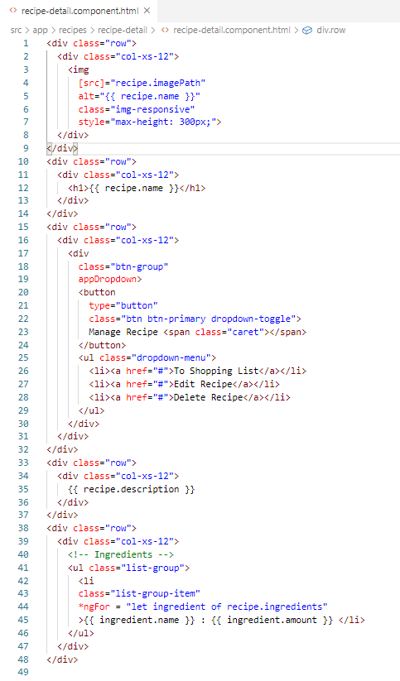
121.1 Code
https://www.udemy.com/course/the-complete-guide-to-angular-2/learn/lecture/6656244#overview
Code
Recipe-detail.component.ts

Slide 9
121.2 Verify

Slide 10
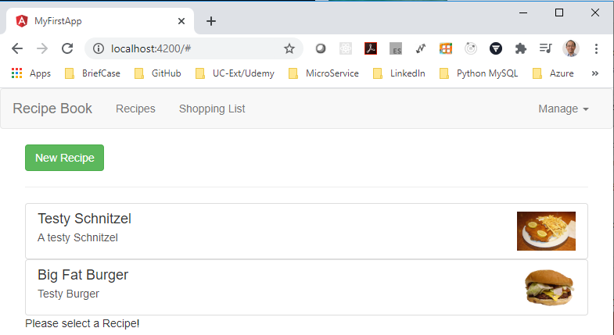
121.2 Verify
https://www.udemy.com/course/the-complete-guide-to-angular-2/learn/lecture/6656244#overview
Verify:

Slide 11
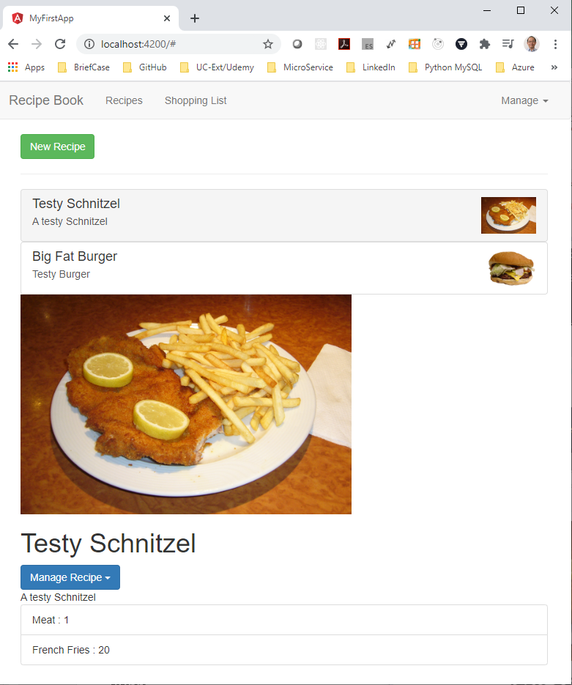
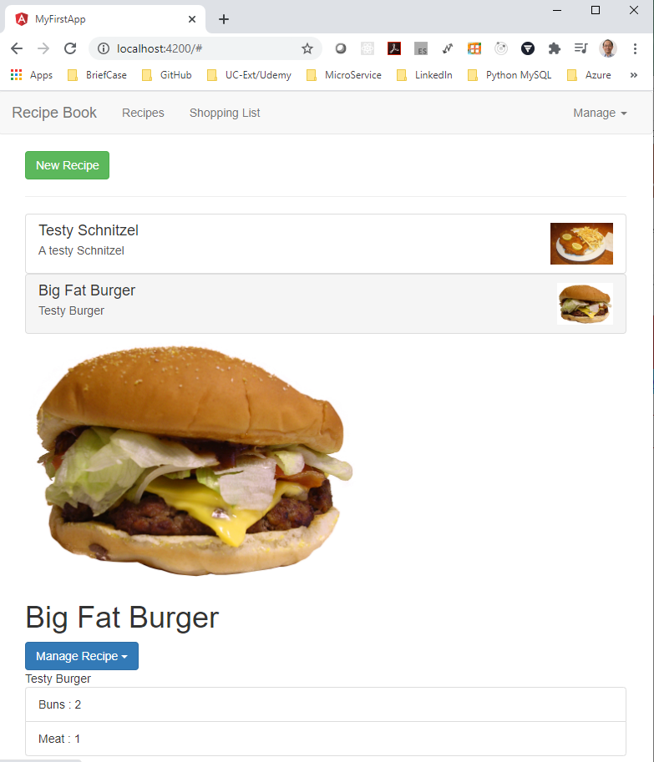
121.2 Verify
https://www.udemy.com/course/the-complete-guide-to-angular-2/learn/lecture/6656244#overview
Verify: Click Testy Schnizel and Big Fat Burger

Slide 12
End of Chapter

